Slide 1
Overcoming the Sin of…
PRIDE

Slide 2
Pride is “an over-high opinion of oneself, exaggerated self-esteem, conceit, resulting in haughty and arrogant behavior.”

Slide 3
The Bible never uses the words “pride” or “proud” in a positive sense.
Pride is the greatest challenge for the Christian because it involves mastering self.
Overcoming pride is made more difficult because of the nature of the world in which we live.

Slide 4

1. Pride Brings Destruction
“Pride goes before destruction, and a haughty spirit before a fall” (Prov. 16:18).
“He who stands on a pedestal has nowhere to step but off.” (Chinese proverb)

Slide 5
2. Pride is Deceptive
“Do you see a man wise in his own eyes? There is more hope for a fool than for him.”
Proverbs 26:12

Slide 6
2. Pride is Deceptive
Regarding Self - Rev. 3:17
Regarding Others - Phil. 2:3-4; Matt. 5:23-24; Prov. 28:25
Regarding God - Psalm 10:4-7
Regarding Right and Wrong - Prov. 14:12

Slide 7
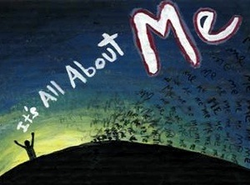
3. Pride is an Avenue of Temptation
1 John 2:15-16
Genesis 3:5-6

Slide 8
4. Pride is a Sin
“A haughty look, a proud heart, and the plowing of the wicked are sin.”
Proverbs 21:4
God’s attitude toward the pride of man:
Prov. 6:16-17, 16:5; James 4:6

Slide 9
Problems With Pride
Pride Brings Destruction
Pride is Deceptive
Pride is an Avenue of Temptation
Pride is Sin

