Slide 1
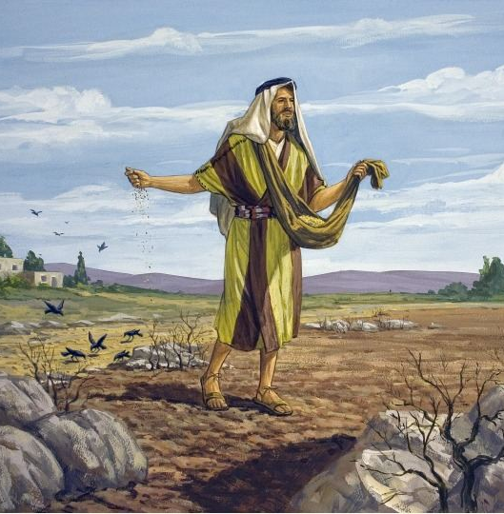
The Parable of the Soils
Matthew 13
Mark 4
Luke 8

Slide 2
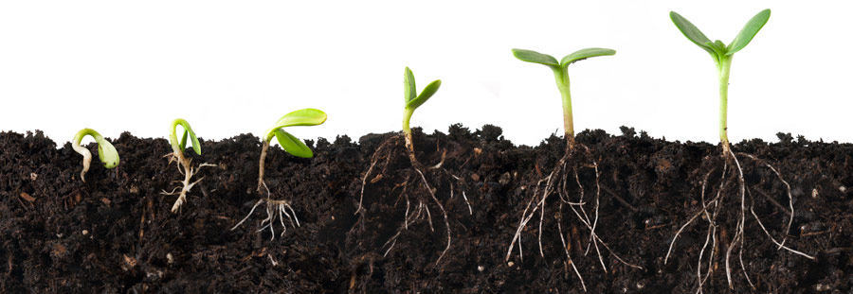
The Different Soils
Wayside Ground
Stony Ground
Thorny Ground
Good Ground

Slide 3
1. The Wayside Heart
Laziness
Arrogance
Fear
Procrastination
Callused With Sin

Slide 4
2. The Stony Heart
One who reacts to the gospel with shallow impulsiveness.
Found it easier to become a Christian than to remain a Christian.

Slide 5
3. The Thorny Heart
Cares of the World - Matt. 13:22
Riches - Matt. 13:22
Desires for Other Things - Mark 4:19
Pleasures of Life - Luke 8:14

Slide 6
4. The Good Heart
Noble and Good - Luke 8:15
Understands - Matt. 13:23
Accepts - Mark 4:20
Keeps - Luke 8:15
Patient - Luke 8:15

Slide 7
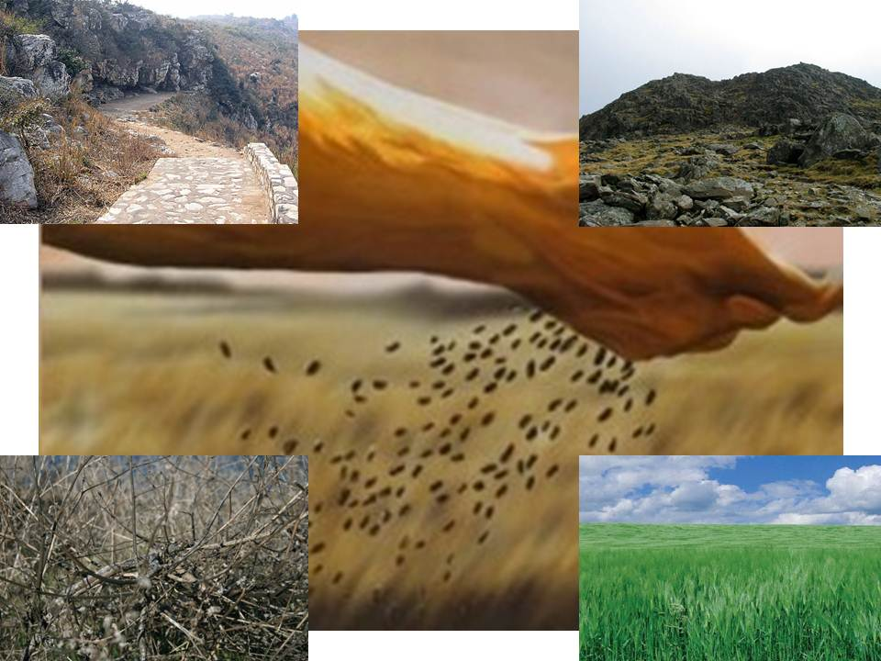
What kind of soil are you?

