Slide 1
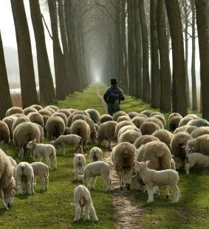
The Work of Elders
1 Peter 5:1-4

Slide 2
Scriptural Designations For Elders

Slide 3
Scriptural Designations For Elders
Elder (1 Pet. 5:1; Titus 1:5): presbuterous
Presbytery (1 Tim. 4:14, KJV, NASV) Eldership (NKJV) presbuteriou
These terms referred to one’s age, maturity, and spiritual experience.

Slide 4
Scriptural Designations For Elders
Bishop (Phil. 1:1; 1 Tim. 3:1): episkopois
Overseer (Acts 20:28): episkopous
These terms refer to a superintendent.

Slide 5
Scriptural Designations For Elders
Pastor (Eph. 4:11): poimenas
Shepherd (1 Pet. 5:2; Acts 20:28, NKJV, NASV), Feed (KJV): poimanate
Chief Shepherd (1 Pet. 5:4) archipoimenos
To tend as a shepherd.

Slide 6
Following the Wrong Model
An elder is a shepherd

Slide 7
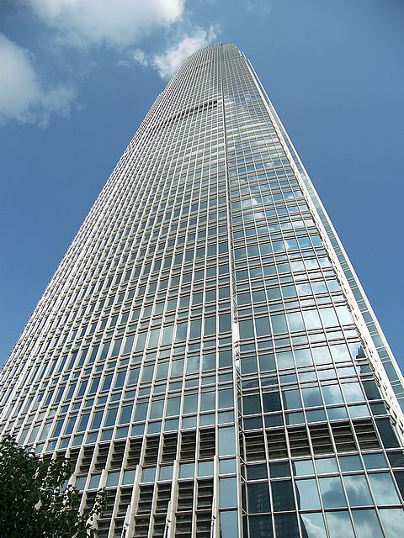
Following the Wrong Model
An administrator is a person who administers, one who has considerable executive ability.
To administer is to manage or direct, to give out or to dispense.

Slide 8
Shepherd or Feed the Flock
1 Peter 5:2, Acts 20:28
The shepherd is the scriptural model for elders to follow
A shepherd is responsible for leading the flock and providing for the safety and wellbeing of each sheep
Psalm 23 - lead (vs. 2-3), protect (v. 4), and feed (v. 5) their flock

Slide 9
Shepherd or Feed the Flock
Equip the Saints - Eph. 4:11-16
Watch - Acts 20:28-31; Heb. 13:17
Admonish, warn the unruly - 1 Thess. 5:12-14
Stop the mouths of those teaching error - Titus 1:9-11
Must be available to the members - James 5:14; Luke 2:8

Slide 10
Take the Oversight
1 Peter 5:2; Acts 20:28
To help them better fulfill their roles as spiritual leaders, they need to delegate the physical responsibilities to the deacons (Acts 6:2-4).

Slide 11
Being an Example
1 Peter 5:3
The word “example” refers to a physical impression or mark; something that can be seen
The qualifications indicate that an elder must be a man of character, thus an example to others (husband, father, worker, etc.)

Slide 12
Elders are Spiritual Leaders
Shepherding or Feeding the Flock
Taking the Oversight
Being an Example

