Slide 1
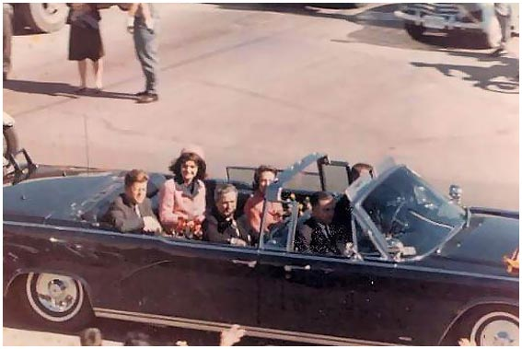
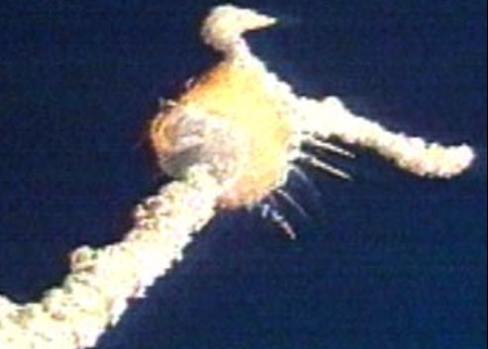
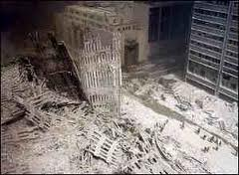
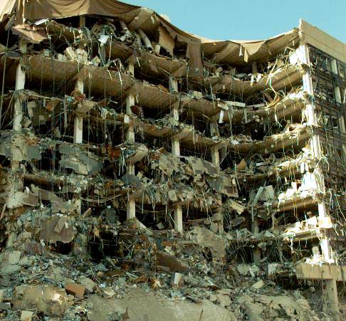

Slide 2
Jesus & Tragedy
Jesus Discusses Tragic Situations
Luke 13:1-5
John 9:1-3

Slide 3
Jesus & Tragedy
Jesus Faces the Unavoidable Question - Why?
What sin caused these tragedies?
Jesus corrected their accepted reasoning in both situations.

Slide 4
Jesus & Tragedy
Notice What Jesus Does Not Say
Jesus Calls on Us To Make the Ultimate Decision

