Slide 1
How To Overcome Obstacles in Your Life

Slide 2
Obstacles
Something that obstructs, hinders, or stand in the way or stops progress

Slide 3
How to Overcome Obstacles in Your Life
Expect Obstacles, Challenges and Temptations

Slide 4

A champion went out from the camp of the Philistines, named Goliath, from Gath, whose height was six cubits and a span. He had a bronze helmet on his head, and he was armed with a coat of mail, and the weight of the coat was five thousand shekels of bronze. And he had bronze armor on his legs and a bronze javelin between his shoulders. Now the staff of his spear was like a weaver's beam, and his iron spearhead weighed six hundred shekels; and a shield-bearer went before him. (1 Samuel 17:4-7 NKJV)

Slide 5
Goliath’s Armor
Height – Six Cubits and a span
9’ 9”
Bronze Helmet
Bronze Coat of Mail – 250 lbs.
Bronze armor on his legs
Spear – Weaver’s beam
Iron Spearhead – 25 lbs.
Shield-bearer

Slide 6
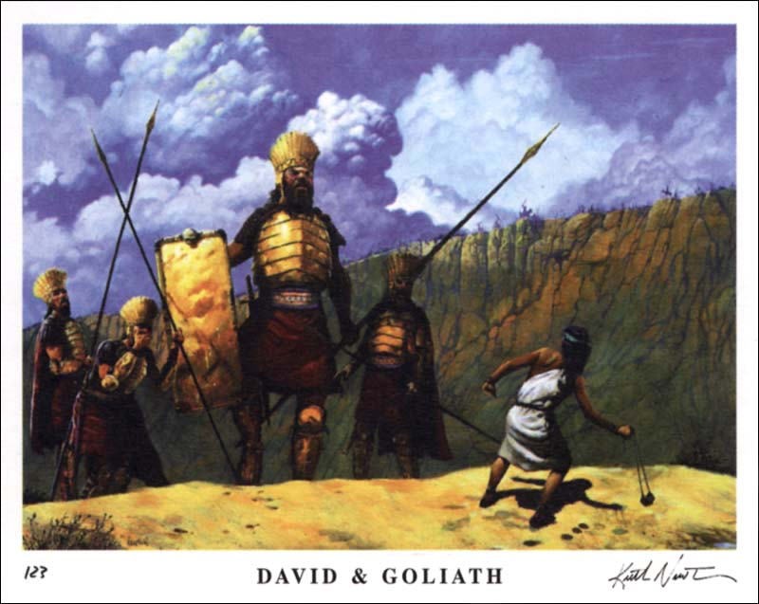

Slide 7
All the men of Israel, when they saw the man, fled from him and were dreadfully afraid. So the men of Israel said, "Have you seen this man who has come up? Surely he has come up to defy Israel; and it shall be that the man who kills him the king will enrich with great riches, will give him his daughter, and give his father's house exemption from taxes in Israel." (1 Samuel 17:24-25)

Slide 8
David spoke to the men who stood by him, saying, "What shall be done for the man who kills this Philistine and takes away the reproach from Israel? For who is this uncircumcised Philistine, that he should defy the armies of the living God?" (1 Samuel 17:26 NKJV)

Slide 9
Now Eliab his oldest brother heard when he spoke to the men; and Eliab's anger was aroused against David, and he said, "Why did you come down here? And with whom have you left those few sheep in the wilderness? I know your pride and the insolence of your heart, for you have come down to see the battle." (1 Samuel 17:28 NKJV)

Slide 10
How to Overcome Obstacles in Your Life
Expect Obstacles, Challenges and Temptations
Make an Honest Evaluation of Yourself

Slide 11
David said to Saul, "Your servant used to keep his father's sheep, and when a lion or a bear came and took a lamb out of the flock, I went out after it and struck it, and delivered the lamb from its mouth; and when it arose against me, I caught it by its beard, and struck and killed it. "Your servant has killed both lion and bear; and this uncircumcised Philistine will be like one of them, seeing he has defied the armies of the living God." (1 Samuel 17:34-36 NKJV)

Slide 12
David said, "The LORD, who delivered me from the paw of the lion and from the paw of the bear, He will deliver me from the hand of this Philistine." And Saul said to David, "Go, and the LORD be with you!" (1 Samuel 17:37 NKJV)

Slide 13
How to Overcome Obstacles in Your Life
Expect Obstacles, Challenges and Temptations
Make an Honest Evaluation of Yourself
Accept Yourself as God Made You

Slide 14
Saul clothed David with his armor, and he put a bronze helmet on his head; he also clothed him with a coat of mail. David fastened his sword to his armor and tried to walk, for he had not tested them. And David said to Saul, "I cannot walk with these, for I have not tested them." So David took them off. (1 Samuel 17:38-39 NKJV)

Slide 15
How to Overcome Obstacles in Your Life
Expect Obstacles, Challenges and Temptations
Make an Honest Evaluation of Yourself
Accept Yourself as God Made You
Remember What Your Parents Taught

Slide 16
Then he took his staff in his hand; and he chose for himself five smooth stones from the brook, and put them in a shepherd's bag, in a pouch which he had, and his sling was in his hand. And he drew near to the Philistine. (1 Samuel 17:40 NKJV)

Slide 17
My son, keep your father's command, And do not forsake the law of your mother. Bind them continually upon your heart; Tie them around your neck. When you roam, they will lead you; When you sleep, they will keep you; And when you awake, they will speak with you. For the commandment is a lamp, And the law a light; Reproofs of instruction are the way of life (Proverbs 6:20-23 NKJV)

Slide 18
How to Overcome Obstacles in Your Life
Expect Obstacles, Challenges and Temptations
Make an Honest Evaluation of Yourself
Accept Yourself as God Made You
Remember What Your Parents Taught
Never Run from a Challenge – Face IT

Slide 19
When the Philistine looked about and saw David, he disdained him; for he was only a youth, ruddy and good-looking. So the Philistine said to David, "Am I a dog, that you come to me with sticks?" And the Philistine cursed David by his gods. And the Philistine said to David, "Come to me, and I will give your flesh to the birds of the air and the beasts of the field!" (1 Samuel 17:42-44 NKJV)

Slide 20
David said to the Philistine, "You come to me with a sword, with a spear, and with a javelin. But I come to you in the name of the LORD of hosts, the God of the armies of Israel, whom you have defied. "This day the LORD will deliver you into my hand, and I will strike you and take your head from you. And this day I will give the carcasses of the camp of the Philistines to the birds of the air and the wild beasts of the earth, that all the earth may know that there is a God in Israel. (1 Samuel 17:45-46 NKJV)

Slide 21
How to Overcome Obstacles in Your Life
Expect Obstacles, Challenges and Temptations
Make an Honest Evaluation of Yourself
Accept Yourself as God Made You
Remember What Your Parents Taught
Never Run from a Challenge – Face IT
Always Trust in the Power of God

Slide 22
David said, "The LORD, who delivered me from the paw of the lion and from the paw of the bear, He will deliver me from the hand of this Philistine." (1 Samuel 17:37 NKJV)

Slide 23
"This day the LORD will deliver you into my hand, and I will strike you and take your head from you. And this day I will give the carcasses of the camp of the Philistines to the birds of the air and the wild beasts of the earth, that all the earth may know that there is a God in Israel. (1 Samuel 17:46 NKJV)

Slide 24
Those who wait on the LORD Shall renew their strength; They shall mount up with wings like eagles, They shall run and not be weary, They shall walk and not faint. (Isaiah 40:31 NKJV)

Slide 25
Now to Him who is able to do exceedingly abundantly above all that we ask or think, according to the power that works in us (Ephesians 3:20 NKJV)

Slide 26
How to Overcome Obstacles in Your Life
Expect Obstacles, Challenges and Temptations
Make an Honest Evaluation of Yourself
Accept Yourself as God Made You
Remember What Your Parents Taught
Never Run from a Challenge – Face IT
Always Trust in the Power of God
You Can Triumph Where Others Failed

Slide 27
So it was, when the Philistine arose and came and drew near to meet David, that David hastened and ran toward the army to meet the Philistine. Then David put his hand in his bag and took out a stone; and he slung it and struck the Philistine in his forehead, so that the stone sank into his forehead, and he fell on his face to the earth. So David prevailed over the Philistine with a sling and a stone, and struck the Philistine and killed him. But there was no sword in the hand of David. (1 Samuel 17:48-50 NKJV)

Slide 28
How to Overcome Obstacles in Your Life
Expect Obstacles, Challenges and Temptations
Make an Honest Evaluation of Yourself
Accept Yourself as God Made You
Remember What Your Parents Taught
Never Run from a Challenge – Face IT
Always Trust in the Power of God
You Can Triumph Where Others Failed

