Slide 1
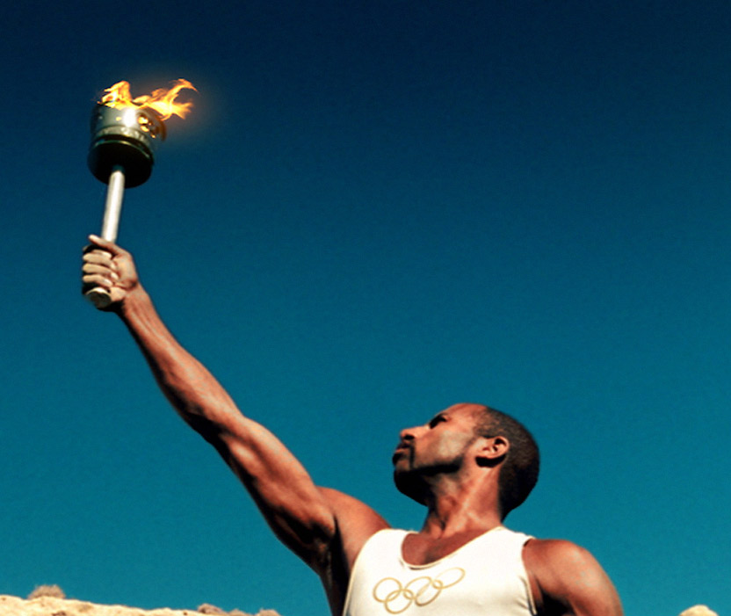
Lessons Learned From An Olympic Athlete
1 Corinthians 9:24-27

Slide 2
Athletics in First Century
The ancient Greeks were noted for their devotion to the games and gymnastic sports. They believed it was just as important to develop the body as it was to educate the mind.
As a rule, the Jews found the games to be offensive.
  The games were a form of idolatry.
  The contestants trained and competed in the nude.

Slide 3
Athletics in First Century
There were four primary games: the Isthmian, Nemean, Pythian, and the Olympian.
The Olympian games, held every four years, were the most celebrated of these events.
The Isthmian games were held every two years just outside of Corinth.

Slide 4
Athletics in First Century
The games consisted of a number of events, including different kinds of races, jumping, discus, javelin, wrestling, boxing, and even contests between heralds and trumpeters.

Slide 5
Athletics in First Century
Contestants were trained under very strict rules and supervision.
Thirty days before the events began they resided at one place where they exercised regularly, followed a strict diet, avoided luxuries and got sufficient rest.
If a contestant failed to follow these rules, he was disqualified from the games.

Slide 6
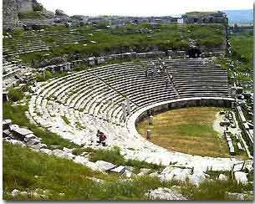
Athletics in First Century
These games were still very popular in the first century.
Stadiums had been built in various places across the Roman Empire, and large crowds of people came to watch the contests.

Slide 7
Commitment of an Athlete
Must Be Committed To Rigorous Training
  1 Corinthians 9:24-27
  temperate in all things (Gal. 5:23; 2 Pet. 1:6)
  self-mastery (Matt. 5:29-30; Gal. 2:20)
  exercise toward godliness (1 Tim. 4:7-8)
    prayer (Rom. 15:30; Col. 4:12)
    obeying the truth (Gal. 5:7)
    defending the word of God (Jude 3)
    spreading the gospel (Rom. 15:20; Phil. 4:3)

Slide 8
Commitment of an Athlete
Must Be Committed To Competing By The Rules
  Luke 14:26-27
  2 Timothy 2:5
  1 Corinthians 9:27

Slide 9
Commitment of an Athlete
Must Run To Win
  Hebrews 12:1
  Hebrews 10:36
  1 Corinthians 9:24, 26
  Colossians 3:1-2
  Philippians 3:12-14

Slide 10

The Commitment of an Athlete
We must be committed to rigorous training.
We must be committed to competing by the rules.
We must run to win.

