Slide 1
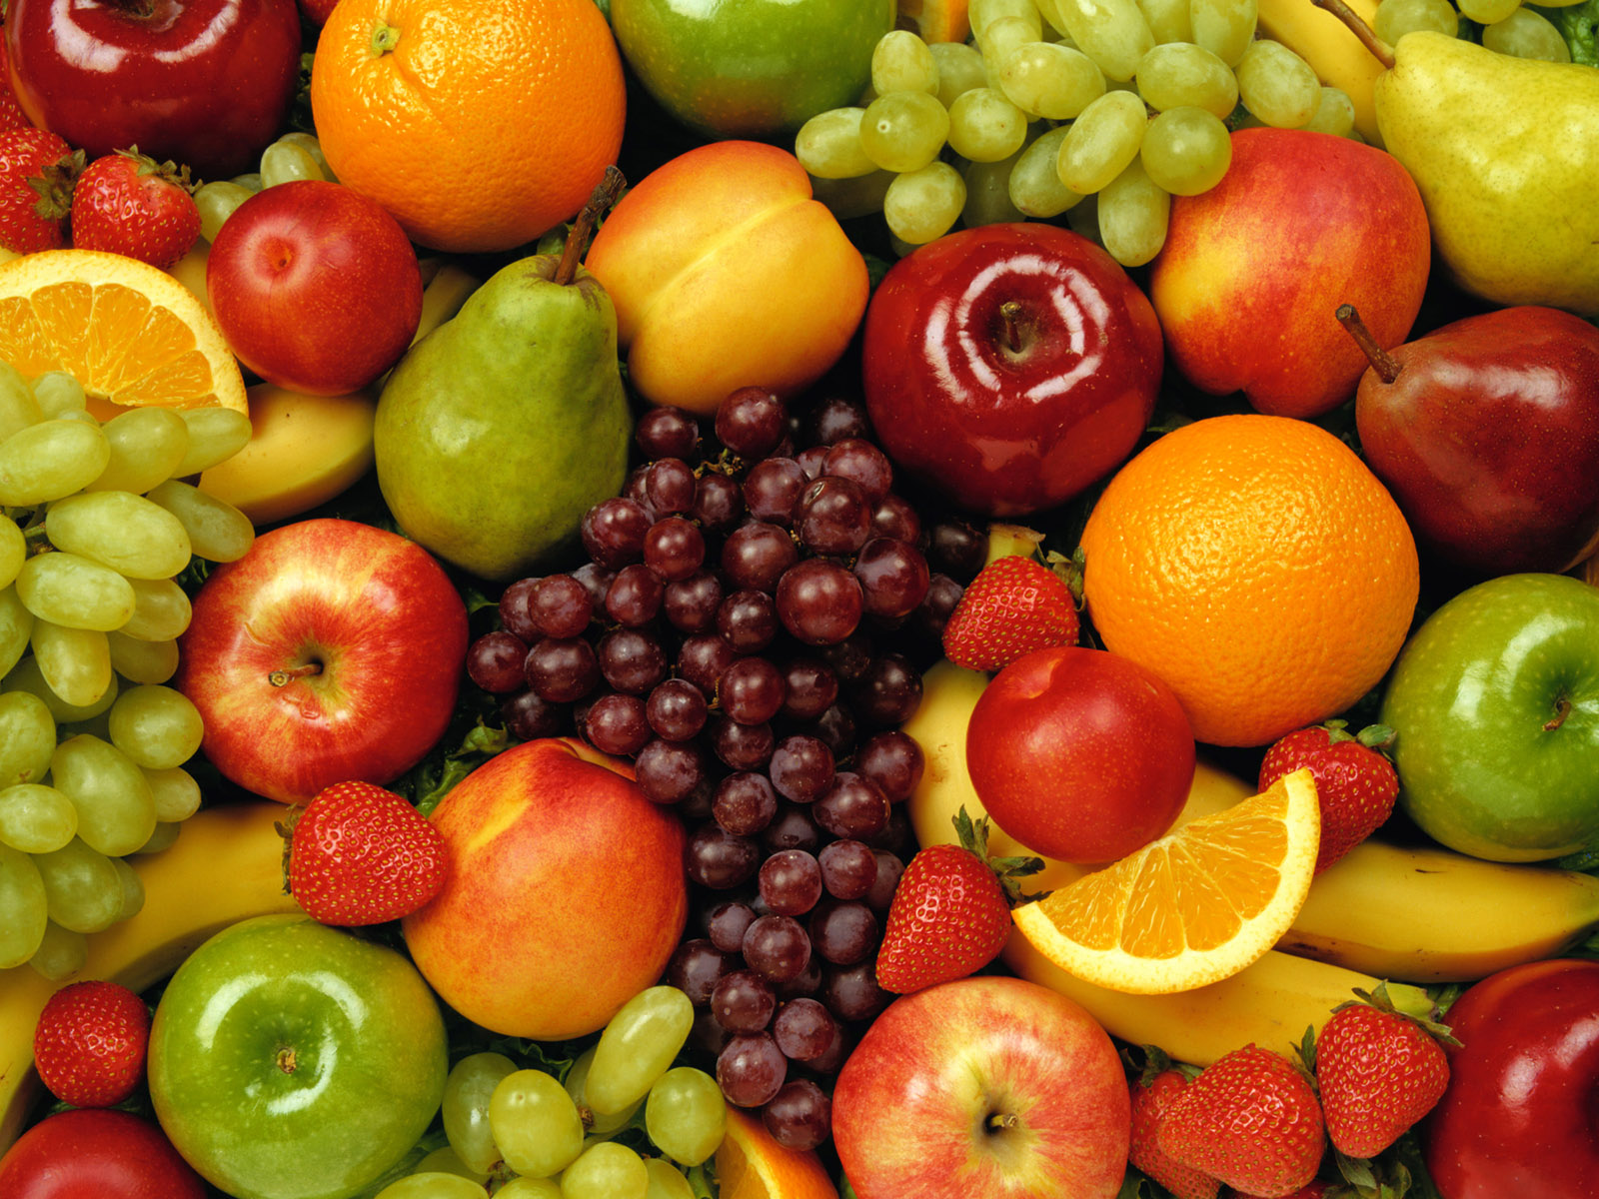
God Is Glorified In Us Bearing Fruit

Slide 2
1. Jesus’ Role In Our Fruitfulness
Jesus gives spiritual life to His disciples - vs. 4-7
  We abide in Jesus by abiding in His word - John 8:31-32
Jesus gives us the avenue of prayer by which we can ask for help - v. 7

Slide 3
2. God’s Role In Our Fruitfulness
God is the vinedresser. He is interested in helping us be more fruitful - v. 2
God will prune us to enable us to bear more fruit - v. 2

Slide 4
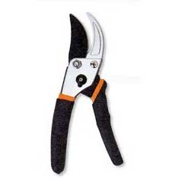
God Prunes Us By…
Cleansing us with His word - Ps. 119:9
Disciplining us through His providence - Heb. 12:9-11
Allowing us to undergo sufferings - James 1:2-4; Rom. 5:3-4

Slide 5
Progression in Quality and Quantity

Slide 6
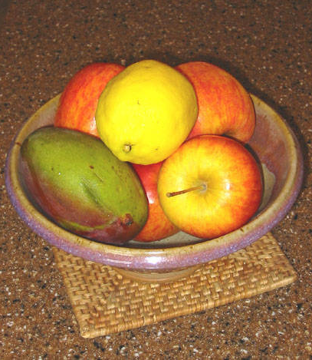
Progression in Quality and Quantity
“bear fruit”
John 15:2

Slide 7
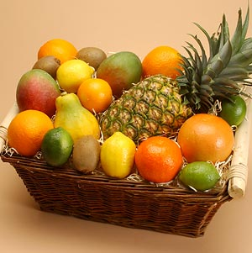
Progression in Quality and Quantity
“bear fruit”
John 15:2
“bear more fruit”
John 15:2

Slide 8
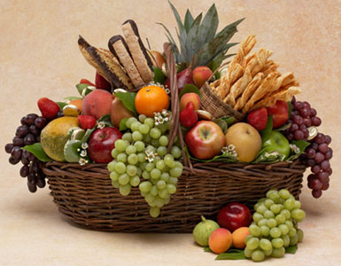
Progression in Quality and Quantity
“bear fruit”
John 15:2
“bear more fruit”
John 15:2
“bear much fruit”
John 15:8

Slide 9
3. The Fruit We Are To Bear
Our fruit must be consistent with our claim to be a Christian!
  Matthew 12:33-37
  James 3:9-12
  2 Timothy 2:19

Slide 10
3. The Fruit We Are To Bear
Spiritual Growth and Maturity - 2 Peter 1:5-8; Gal. 5:22-23
Increased Talents and Opportunities - Matt. 25:14-30
Good Deeds - Eph. 2:10; Titus 3:14
Winning Lost Souls To Christ - Rom. 1:13, Prov. 11:30

Slide 11
3. The Fruit We Are To Bear
Participation in the Spread of the Gospel - Phil. 4:15-18
Righteousness and Peace - James 3:17-18
Praise Unto God - Heb. 13:15

Slide 12
4. How Bearing Fruit Glorifies God
Shows the power of His gospel to change lives and make us fruitful - Eph. 2:1-10
Validates the effort He has put forth in our lives - John 15:2
Shows the genuineness of our faith - 1 Peter 2:11-12
Causes us to further develop the character of God in our lives - Eph. 5:1

