Slide 1
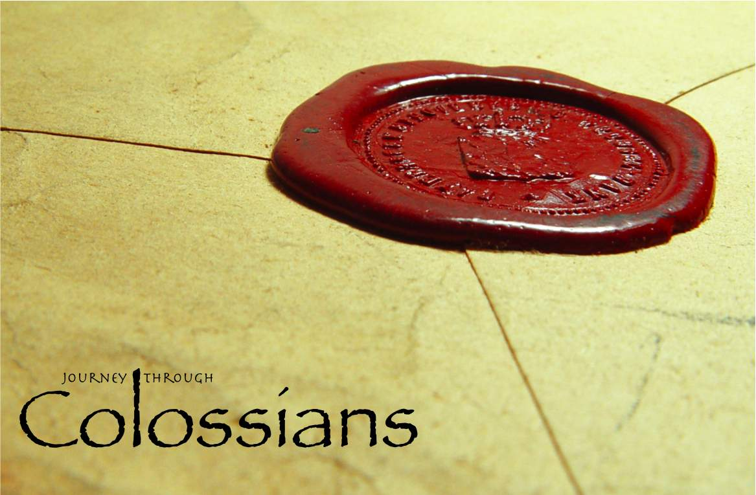

Slide 2
Reconciled in Christ
Colossians 1:19-23

Slide 3
What Is Reconciliation?
reconcile: “to make friendly again or win over to a friendly attitude” (Webster’s).
apokatallsso: “to change from one condition into another, so as to remove all enmity and leave no impediment to unity and peace” (Vine’s).

Slide 4
1. Reconciliation Is Necessary
Before reconciliation we were alienated and enemies (v. 21).
alienated: to be estranged or separated, to be shut out from one’s fellowship, to cause to be withdrawn or detached.
enemies: one who is hated, hostile, in opposition to another.
Reconciliation is necessary because without it we are doomed to suffer the eternal consequences of our sins.

Slide 5
1. Reconciliation Is Necessary
After we are reconciled we are presented to God as… (v. 22)
holy: sanctified, set apart for God’s use.
blameless: without being guilty of anything worthy of blame.
above reproach: guilty of nothing that can be called into account, unreprovable (KJV).

Slide 6
2. Reconciliation Is Possible
The death of Jesus Christ is the means by which God reconciles all things back to Himself.
v. 20 – peace is made by the blood of His cross, not by our good works or by God’s willful oversight of our transgressions.
vs. 21-22 – we are reconciled in the body of His flesh through death.

Slide 7
2. Reconciliation Is Possible
Reconciliation and salvation are found only in Jesus Christ.
v. 20 - “all things”
God has not chosen to save different people with different Saviors. All the fullness dwells in Jesus (v. 19), and it is through Jesus alone that reconciliation is offered to mankind.
Acts 4:12; John 14:6

Slide 8
3. Reconciliation Is Conditional
If we continue in the faith.
  1 Thess. 3:5; Heb. 3:12-14, 10:38; Rev. 2:10
If we are grounded and steadfast.
Col. 2:6-7; Matt. 7:24-27
If we are not moved away from the hope of the gospel which we have heard.

Slide 9
If you are not a Christian…
You are currently an enemy of God because of your sins and stand to suffer His eternal wrath.
You can be saved and brought into fellowship with God if you will respond in obedience to the gospel of Jesus Christ.
Being a Christian will require continued steadfastness and growth.

