Slide 1
Mercy
“Blessed are the merciful, for they shall obtain mercy.”
Matthew 5:7

Slide 2
What is mercy?
The basic meaning behind “mercy” is having pity on those who are afflicted, joined with a desire to help them.
Mercy is “kindness in action.”

Slide 3
What is mercy?
1. a refraining from harming or punishing offenders, enemies, persons in one’s power, etc.; kindness in excess of what may be expected or demanded by fairness; forbearance and compassion
3. a disposition to forgive, pity, or be kind
5. kind or compassionate treatment; relief of suffering
Webster’s New World Dictionary

Slide 4
2. God is Merciful
God is “the Father of mercies and the God of all comfort” (2 Cor. 1:3).
God teaches us of mercy (James 3:13-18).
God’s mercy is abundant (Ps. 86:15).
God’s mercy is faithful (Ps. 13:5).
God’s mercy endures forever (Ps. 103:17; Ps. 136 - 26 times).

Slide 5
3. God’s Mercy and Forgiveness
We appeal to God’s mercy in order to receive forgiveness for our sins.
Numbers 14:18-19
Psalm 103:8-14
Ephesians 2:4-10
“Grace” is God giving us what we don’t deserve (salvation). “Mercy” is God not giving us what we do deserve (condemnation).

Slide 6
4. Conditions of God’s Mercy
Call on the Lord - Ps. 86:5
Confess and Forsake Sin - Prov. 28:13
Have a Penitent and Contrite Heart - Luke 18:13-14
Fear the Lord and Keep His Commandments - Ps. 103:17-18; Ps. 25:10
Show Mercy to Others - Matt. 5:7

Slide 7
5. Man is Required To Be Merciful
“Therefore be merciful, just as your Father also is merciful” - Luke 6:36
The Good Samaritan was “he who showed mercy,” to which Jesus replied, “Go and do likewise” - Luke 10:37
God desires mercy and not sacrifice - Hosea 6:6; Matt. 9:13, 12:7

Slide 8
5. Man is Required To Be Merciful
“He has shown you, O man, what is good; and what does the Lord require of you but to do justly, to love mercy, and to walk humbly with your God?”
Micah 6:8

Slide 9
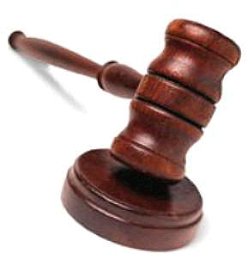
“For judgment is without mercy to the one who has shown no mercy. Mercy triumphs over judgment.”
James 2:13

