Slide 1
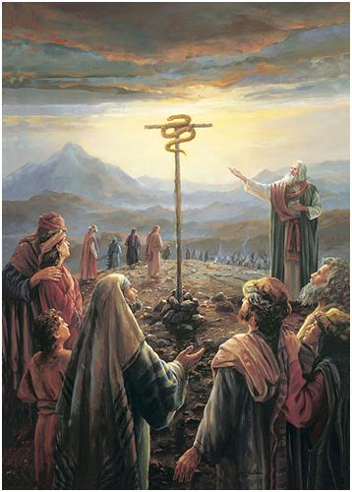
The Bronze Serpent
Numbers 21:4-9

Slide 2
Types

Slide 3
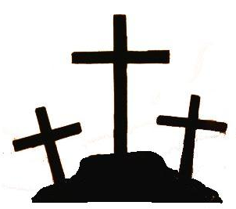
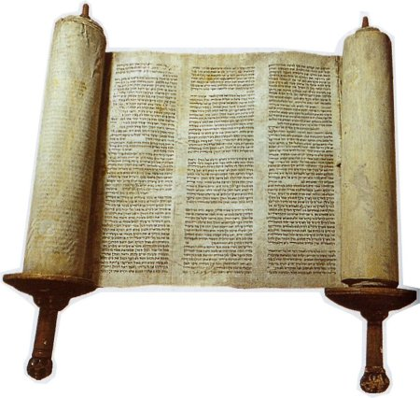
Types
“a figure, representation, or symbol of something to come, as an event in the Old Testament foreshadows another in the New Testament” (Nelson’s Illustrated Bible Dictionary).

Slide 4
Types
“And as Moses lifted up the serpent in the wilderness, even so must the Son of Man be lifted up, that whoever believes in Him should not perish but have eternal life.”
John 3:14-15

Slide 5
The Bronze Serpent
The People Complained
God Did Not Remove the Serpents, But He Provided A Remedy
The Serpent Had To Be Lifted Up
The Serpent Had To Be Looked Upon
There Was Only One Remedy
The Serpent Was Eventually Turned Into An Idol

Slide 6
The Cross of Christ
God does not promise to remove sin from our existence, but He has made a remedy.
There is only one remedy for sin.
Will you “look upon” Jesus and be saved through His gospel?

