Slide 1
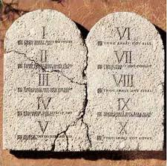
Which is the Greatest Command in the Law?
Questions asked of the Lord

Slide 2
Introduction
Many seek to simplify, prioritize God’s laws
Jesus used such attitudes to present an ultimate answer
Matthew 22:34-40
Jesus’ answer went well beyond what the lawyer probably expected
The question was a good one—and still important today—so let’s explore further

Slide 3
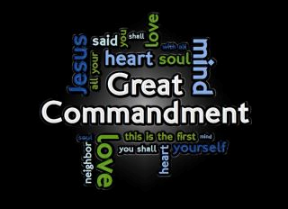
Context and timing
Asked in last week before the cross
Answer will set the stage for a question Jesus will then ask of his audience
1. Answer shows who Jesus is
2. Of 600+ laws, which most important?
3. Jesus doesn’t pick one law—but points to KEY principle behind all law—LOVE
4. What he teaches here, he was to demonstrate in less than a week

Slide 4
Jesus’ answer
Deuteronomy 6:5 “You shall love the LORD your God with all your heart, with all your soul, and with all your strength.”
Deuteronomy 10:12 “And now, Israel, what does the LORD your God require of you, but to fear the LORD your God, to walk in all His ways and to love Him, to serve the LORD your God with all your heart and with all your soul”
Deuteronomy 30:6 “And the LORD your God will circumcise your heart and the heart of your descendants, to love the LORD your God with all your heart and with all your soul, that you may live.”

Slide 5

Jesus’ answer
2nd half of answer: “You shall love your neighbor as yourself.”
From Leviticus 19:18
Two sides of same coin—1 John 4:20-21
All of God’s directives hang upon this principle—Romans 13:8-10

Slide 6

What is nature of this love?
It entails TOTAL COMMITMENT
  Emotionally
  Physically
  Intellectually
It is achieved by OBEDIENCE
  Jesus’ answer didn’t minimize any law
  Listen to what N.T. says— John 14:15; 1 John 2:5; 1 John 4:8; 1 John 4:7; 1 John 5:3

Slide 7
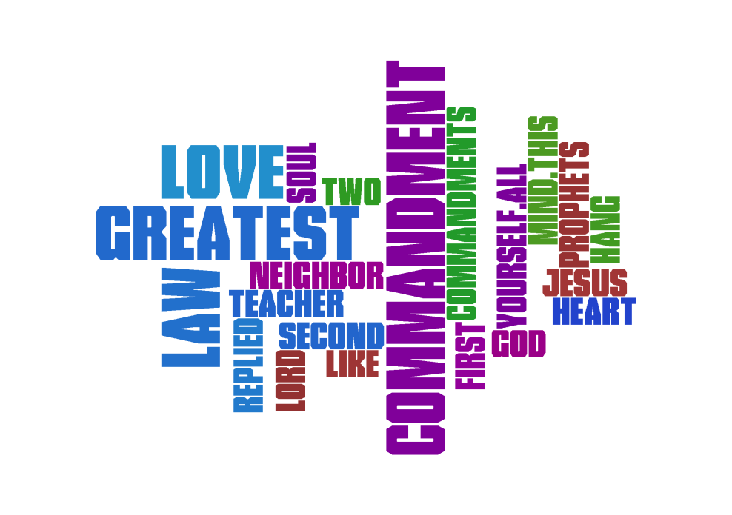
What is nature of this love?
If loving God linked to imitation of Him—then loving our fellow man naturally follows
  John 3:16 expresses God’s love for mankind
  John 13:34-35 speaks of “new” command
  John 15:12-13
  James 2:8 speaks of “royal law”

Slide 8

Priority must be to love God—totally
If we seek to be like Him—must obey!
If we become like Him—will love fellow man
Our love won’t be mushy, superficial emotion— but serious effort to be as He is
Our love for one another can’t be merely in words—but must be active good will (action)
May God bless us as we seek to love as He loves

