Slide 1

Questions Asked of the Lord

Slide 2

Gospels Make the Case for Jesus
His Miracles (John 20:30-31)
His Death, Burial, Resurrection (John 2:18-22)
The way He handled people (John 1:41, 4:29, 7:46)
The way that He died (Matt. 27:54)
His Teaching (Matt. 7:28-29)

Slide 3
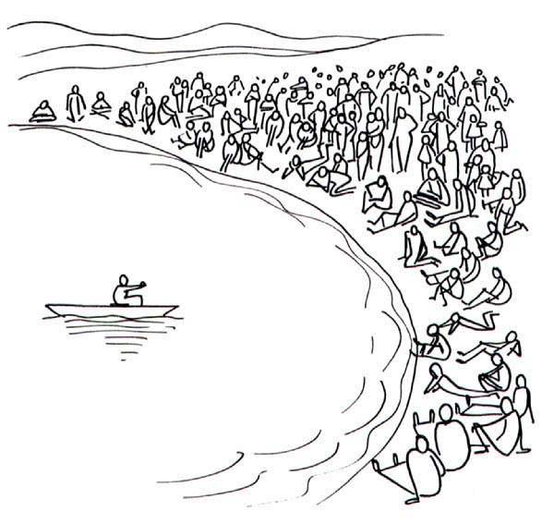
Jesus was the Master Teacher

Slide 4
Jesus was the Master Teacher
Preaching
Parables
Figures of Speech
Examples
Logical Arguments
Paradox
Questions

Slide 5

Questions
Gospels record nearly 300 questions.
A question presents a problem to the mind which must be solved, requiring the mind to work and to think.

Slide 6
Questions
To arouse curiosity or to keep their attention.
To test their present understanding.
To give them opportunity to formulate and express their own thoughts.
To cause them to think.

Slide 7
Jesus asked questions in His general teaching
Prayer (Luke 11:11-13)
Influence (Matt. 5:13)
Worry (Matt. 6:25-27)
Identity of John the Baptist (Matt. 11:7-9)
Answering the lawyer (Luke 10:26)
Men on road to Emmaus (Luke 24:17, 19, 26)

Slide 8
Jesus asked questions to expose His enemies
Mark 2:9 - “Which is easier…?’”
Matt. 12:11-12 - Doing good on the Sabbath
Matt. 15:2 - “Why do you also transgress the commandment of God because of your tradition?”
Matt. 21:25 - “The baptism of John - where was it from? From heaven or from men?”
Matt. 22:41-45 - the identity of the Christ

Slide 9
Jesus asked questions of His disciples
Storm on the Sea of Galilee (Mark 4:40)
Beware leaven of Pharisees and Sadducees (Matt. 16:8-11)
Who do men say that I am? Who do you say that I am? (Matt. 16:13, 15)
Value of the soul (Matt. 16:26)

Slide 10
Jesus asked questions of His disciples
Value of every soul (Matt. 18:12-14)
1,000 angels (Matt. 26:53)
“Do you also want to go away?” (John 6:67)
Peter’s love for Christ (John 21:15-17)

Slide 11
Questions Asked of the Lord
“Master, do you not care that we are perishing?” (Mark 4:38)
“Which is the greatest commandment in the law?” (Matt. 22:36)
“By what authority are you doing these things?” (Matt. 21:23)

Slide 12
Questions Asked of the Lord
“And who is my neighbor?” (Luke 10:29)
“Who then is greatest in the kingdom of heaven?” (Matt. 18:1)
“What shall I do to inherit eternal life?” (Luke 10:25)
“Why do You speak to them in parables?” (Matt. 13:10)

Slide 13
Other Questions Asked of the Lord
“Are You the coming one, or do we look for another?” (Matt. 11:3)
“Is it lawful for a man to divorce his wife for just any reason?” (Matt. 19:3)
“Who then can be saved?” (Matt. 19:25)

Slide 14
Other Questions Asked of the Lord
“Is it lawful to pay taxes to Caesar?” (Matt. 22:17)
“Lord, is it I?” (Matt. 26:22)
“How can a man be born when he is old? Can he enter a second time into his mother’s womb and be born?” (John 3:4)
“What is truth?” (John 18:38)

Slide 15
Questions Asked of the Lord

