Slide 1


Can We Understand the Bible Alike?

Slide 2
We Can Understand the Bible

Slide 3

We Can Understand the Bible
“Then Jesus said to those Jews who believed Him, ‘If you abide in My word, you are My disciples indeed. And you shall know the truth, and the truth shall make you free.’”
John 8:31-32

Slide 4
We Can Understand the Bible
“How that by revelation He made known to me the mystery (as I have briefly written already, by which, when you read, you may understand my knowledge in the mystery of Christ).”
Ephesians 3:3-4

Slide 5
We Can Understand the Bible
“Therefore do not be unwise, but understand what the will of the Lord is.”
Ephesians 5:17

Slide 6
We Can Understand the Bible
“For this is good and acceptable in the sight of God our Savior, who desires all men to be saved and to come to the knowledge of the truth.”
1 Timothy 2:3-4

Slide 7
God Holds Us Responsible For Understanding His Word

Slide 8
God Holds Us Responsible For Understanding His Word
“Therefore do not be unwise, but understand what the will of the Lord is.”
Ephesians 5:17

Slide 9
God Holds Us Responsible For Understanding His Word
“He who rejects Me, and does not receive My words, has that which judges him - the word that I have spoken will judge him in the last day.”
John 12:48

Slide 10
God Holds Us Responsible For Understanding His Word
“Not everyone who says to Me, ‘Lord, Lord,’ shall enter the kingdom of heaven, but he who does the will of My Father in heaven.”
Matthew 7:21

Slide 11
We Can Understand the Bible Alike

Slide 12
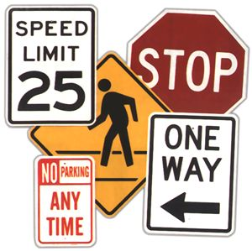
We Can Understand the Bible Alike
We understand traffic laws alike.

Slide 13

We Can Understand the Bible Alike
We understand time alike.

Slide 14
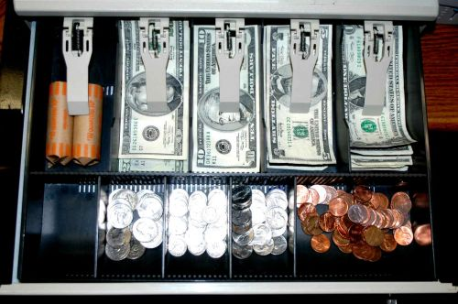
We Can Understand the Bible Alike
We understand our monetary system alike.

Slide 15
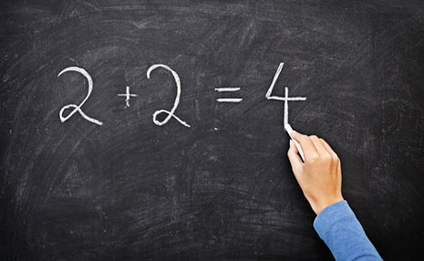
We Can Understand the Bible Alike
We understand mathematics alike.

Slide 16
We Can Understand the Bible Alike
“Jesus answered and said to them, ‘You are mistaken, not knowing the Scriptures nor the power of God.’”
Matthew 22:29

Slide 17
We Can Understand the Bible Alike
“Now I plead with you, brethren, by the name of our Lord Jesus Christ, that you all speak the same thing, and that there be no divisions among you, but that you be perfectly joined together in the same mind and in the same judgment.”
1 Corinthians 1:10

Slide 18
We Can Understand the Bible Alike
“Till we all come to the unity of the faith and of the knowledge of the Son of God, to a perfect man, to the measure of the stature of the fullness of Christ.”
Ephesians 4:14

Slide 19
We Can Understand the Bible Alike
If we understand the Bible at all, we are going to understand it alike.
If we differ on its meaning, we cannot both be right.
We might both be wrong, but we cannot both be right.

Slide 20
How We Can Understand the Bible Alike
Approach the Bible with the belief that it can be understood.
Approach the Bible with a dose of common sense.
Get rid of preconceived ideas, doctrines, and agendas, and allow the Bible to speak for itself.

Slide 21
How We Can Understand the Bible Alike
Be honest in the way that you approach the Bible. Handle it accurately (2 Tim. 2:15 NASV).
  Take everything the Bible says on a subject.
  Keep verses in their context (what is the subject of the passage, who is speaking, who is being spoken unto, etc.).
  Recognize the different types of language used in the Bible.
  Allow plain passages to explain difficult passages.

Slide 22
How We Can Understand the Bible Alike
Take time to think about what you have read.
Develop a love for the truth (2 Thess. 2:10).

Slide 23
We Can Understand the Bible Alike!

