Slide 1
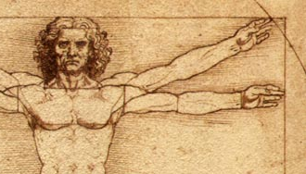
The Anatomy of a Soul Winner
Proverbs 11:30

Slide 2
The Anatomy of a Soul Winner
A Mind That Understands
  The Value of the Soul
  The Plight of the Sinner
  The Power of the Gospel
  The Responsibility of the Believer

Slide 3
The Anatomy of a Soul Winner
A Mind That Understands
Eyes That See

Slide 4
The Anatomy of a Soul Winner
A Mind That Understands
Eyes That See
Ears That Hear

Slide 5
The Anatomy of a Soul Winner
A Mind That Understands
Eyes That See
Ears That Hear
Feet That Go

Slide 6
The Anatomy of a Soul Winner
A Mind That Understands
Eyes That See
Ears That Hear
Feet That Go
A Heart That Cares

