Slide 1
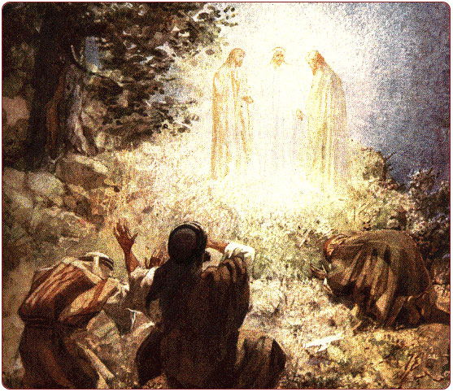
Peter, James and John

Slide 2
Occasions When These Three Are Singled Out
Raising of Jairus’ Daughter
  Mark 5:21-43, Luke 8:40-56
Transfiguration
  Mark 9:2-10, Matt. 17:1-9, Luke 9:27-36
Prayer in Gethsemane
  Mark 14:32-42, Matt. 26:36-46

Slide 3
Possible Explanations
They were the Lord’s closest friends.
Each occasion needed only a limited number of witnesses.
They had advanced beyond the other disciples.
These experiences equipped them for their future roles and responsibilities.

Slide 4
Conclusion:
We don’t know for sure why these three men were singled out on these occasions.
The Scriptures never give a clear answer.

Slide 5
Conclusion:
Jesus had power over death, He was deity, and He did suffer in the body upon the cross.
God will bless us in proportion to our willingness and effort to grow and learn.
We need to appreciate these three apostles for the role that each played in the establishment of the church and the deliverance of the gospel.

