Slide 1

Dangers Facing the Church Today

Slide 2

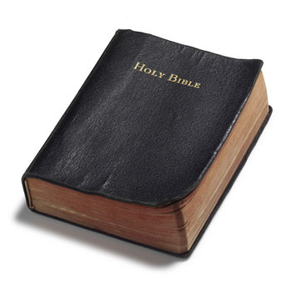



The Social Gospel

Slide 3


The social gospel is a concept that emphasizes the “whole man” and caters to his “social needs.”
  Secular Education
  Medical Care
  Care for Orphans and Aged
  Recreation
  Finances
  Relationships

Slide 4
The Social Gospel is unscriptural because…
Is Not Authorized
Degrades the Church of the Lord
Cheapens the Cross
Fails To Provide True Edification

Slide 5
Evidence of the Social Gospel Appeal Being Used By Our Brethren

Slide 6

1. Implementation of Denominational Church-Growth Plans
Mega-Church handbook.
Numerical growth is the bottom line.
Recommended to me by two different “conservative” gospel preachers.

Slide 7
2. Announcements and Fliers For Teen Events

Slide 8
12th Street church of Christ
Bowling Green, KY
A Teen Retreat for Grades 5 through 12
June 2nd and 3rd, 2000

Slide 9
12th Street church of Christ
Bowling Green, KY
Friday Evening - 12th Street Church of Christ
7:00 p.m. - Introduction
7:15 p.m. - Singing
7:45 p.m. - Peter
8:45 p.m. - Pizza and Registration at Bowling Green Junior High (across from the Twelfth Street Building)
Note: Expenses for pizza and Saturday's activities are being covered by private donations.

Slide 10
12th Street church of Christ
Bowling Green, KY
Saturday - Alford's Farm
9:00 a.m. - Welcome
9:15 a.m. - Singing
9:50 a.m. - Nehemiah
11:30 a.m. - Lunch
12:30 p.m. - Singing
12:45 p.m. - Acquila and Priscilla
2:30 - 7:00 p.m. - Outdoor Activities

Slide 11
12th Street church of Christ
Bowling Green, KY
Outdoor Activities will include (among other things) Volleyball, Hiking, Tug-of-War, Hay Rides, so you will need to bring clothes for "Roughing It"
Meals provided are Friday Night Pizza, Saturday Lunch, and Saturday Dinner
Because of the physical activities involved, you will need to provide a medical release.

Slide 12
12th Street church of Christ
Bowling Green, KY
The elders of the 12th Street Church of Christ deeply regret the message conveyed by our brochures and web page regarding the Young Peoples' Weekend on June 2 and 3, 2000.
We want to state clearly that it is our desire to serve the Lord and to do His work in accordance with His word.

Slide 13
12th Street church of Christ
Bowling Green, KY
We believe the Scriptures authorize local churches to do the work of preaching the word, edifying themselves, and caring for needy saints (1 Thess.1:8: Eph. 4:11-16, Acts 11:27-30).
Social and recreational activities are not part of that work.

Slide 14
12th Street church of Christ
Bowling Green, KY
We want to clarify the false ideas implied in our brochure and on our web page.
We erred in our misleading ads for this young peoples' meeting, and extend our apologies for doing so.

Slide 15
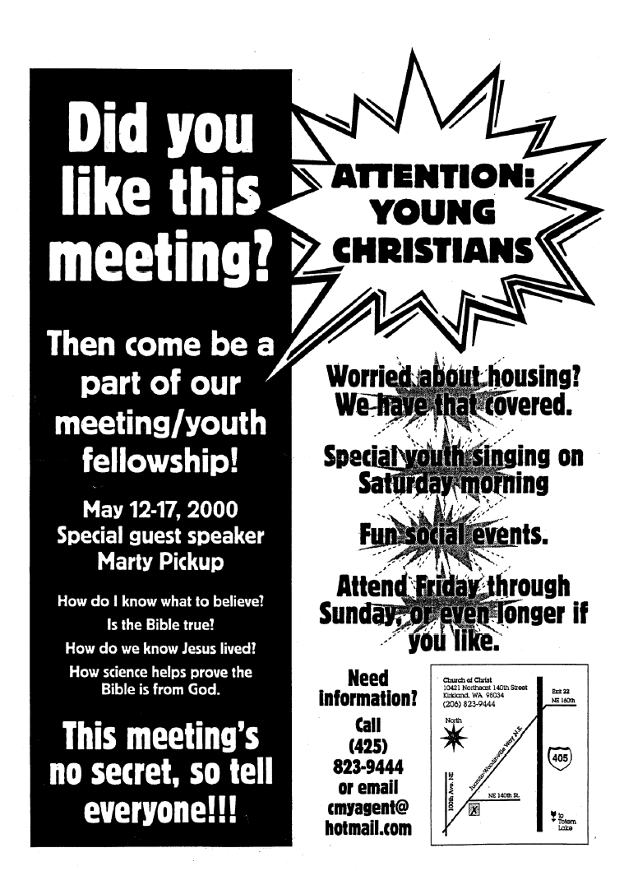

Slide 16
“Fun social events.”

Slide 17
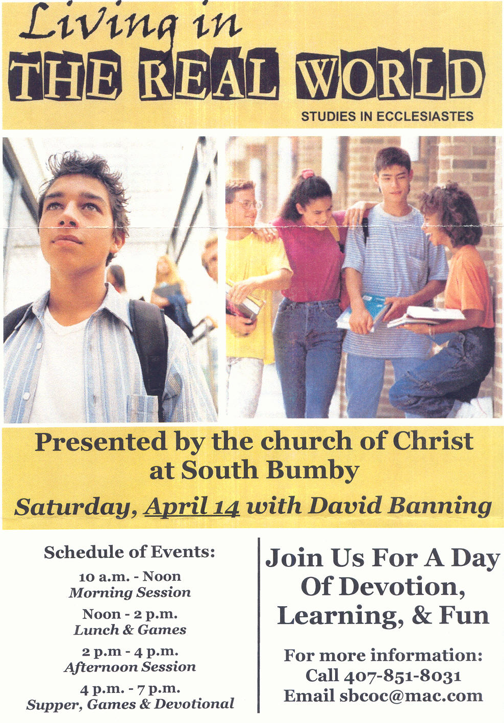

Slide 18
“Join Us For A Day Of Devotion, Learning, & Fun”
“Lunch & Games”
“Supper, Games & Devotional”

Slide 19
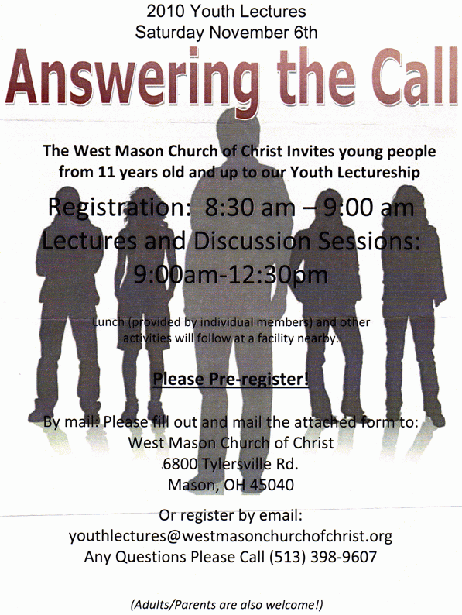

Slide 20
“Lunch (provided by individual members) and other activities will follow at a facility nearby.”

Slide 21
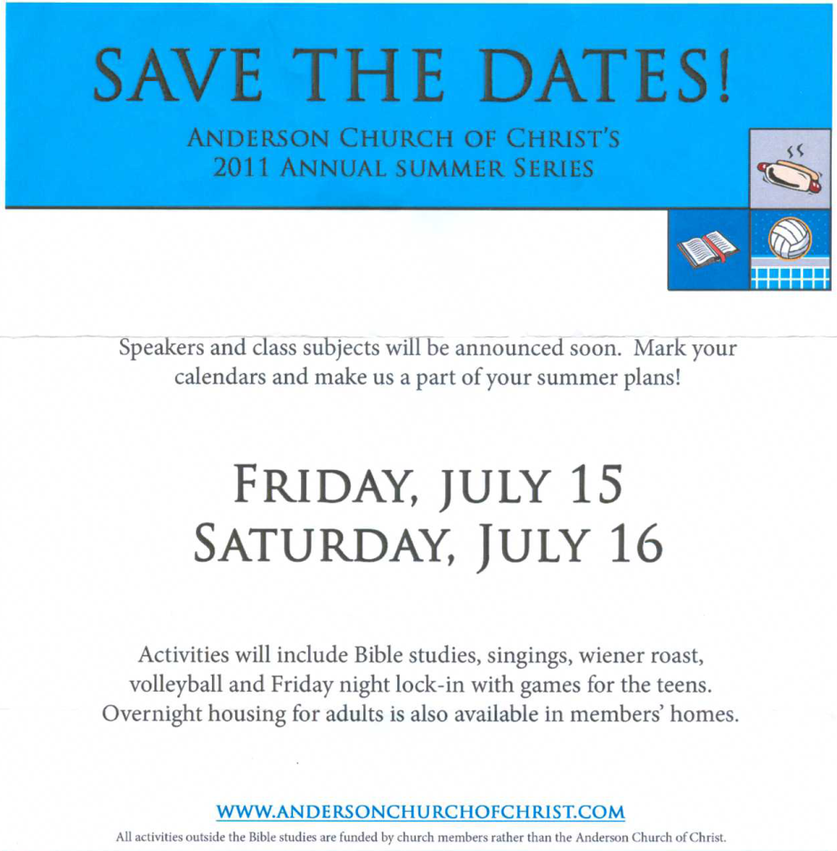

Slide 23
“Activities include Bible studies, singings, wiener roast, volleyball and Friday night lock-in with games for teens.”

Slide 24
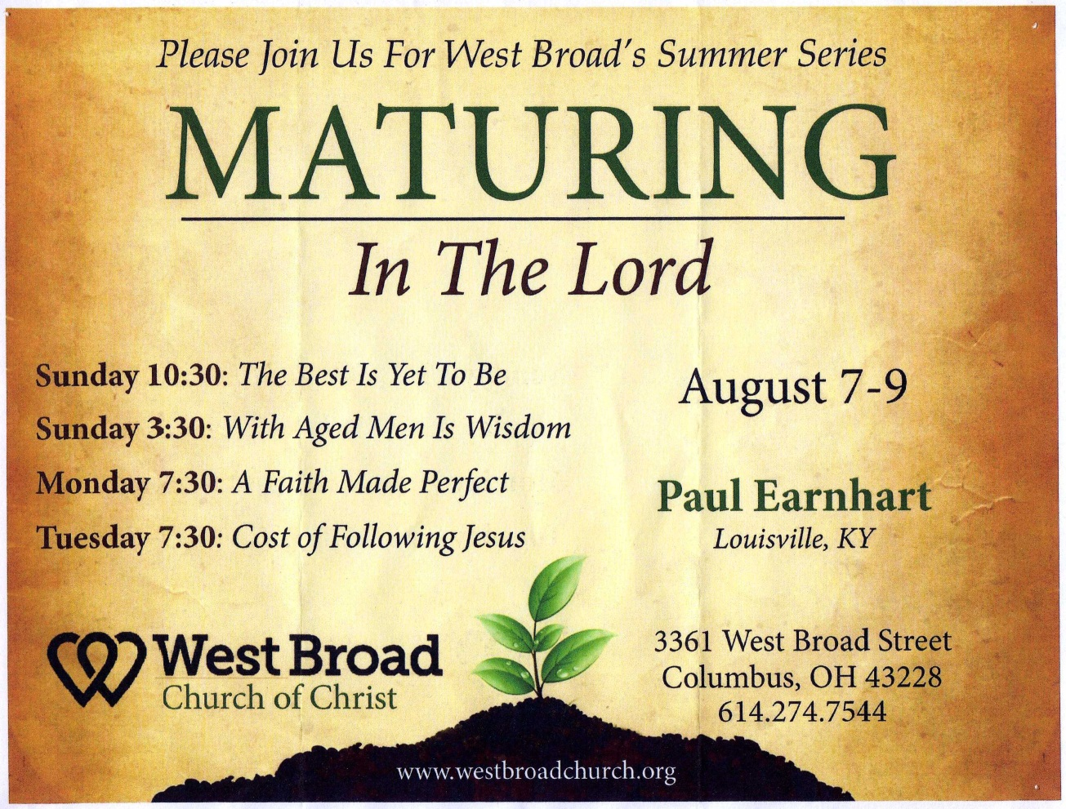

Slide 25
Where are the…
Fun social events, pizza parties, wiener roasts, and lock-ins?
Why don’t we try to “entice” our “mature” brethren like we do our teens?

Slide 26

Such catering to our young people:
Is an insult to their spirituality.
Is developing a segment within the brotherhood that is ripe for apostasy and rebellion against the old paths.

Slide 27
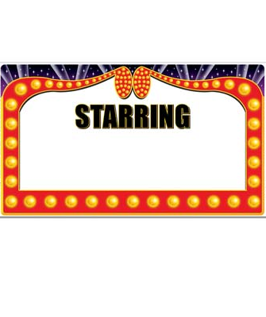
3. Credentials For Preachers
Gospel Meeting
Big Name Preacher

Slide 28
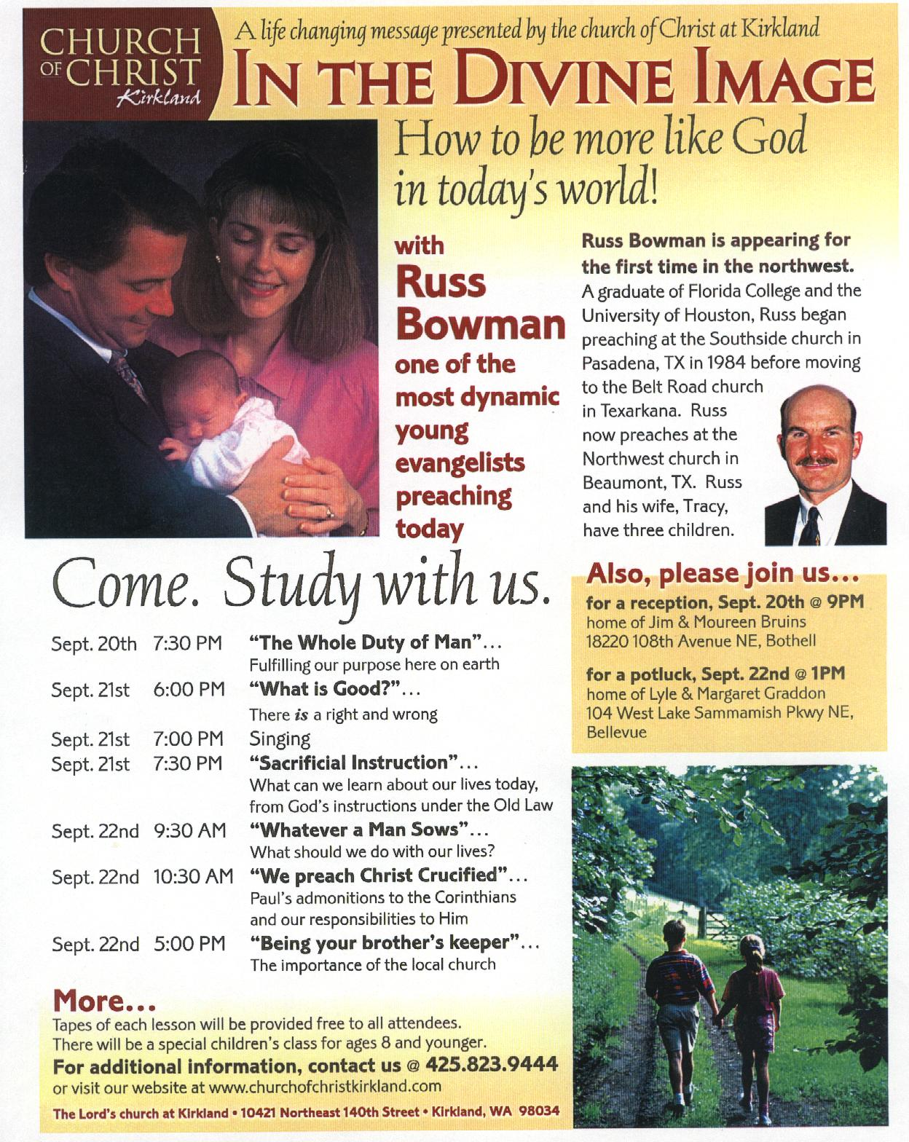

Slide 29
“one of the most dynamic young evangelists preaching today”

Slide 30
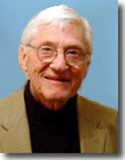
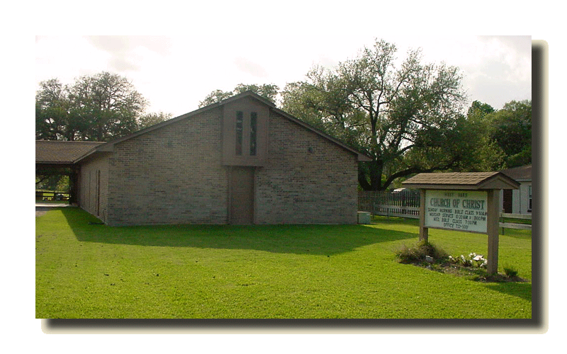
West Oaks church of Christ
Columbus, Texas
David Edwin Harrell, Jr
August 16-20, 2006

Slide 31
Brother Harrell’s Credentials
College degrees and universities attended
Books he has authored
Won a number of professional honors and awards

Slide 32
Brother Harrell’s Credentials
“Recognized as an authority on religion and politics in America, Professor Harrell has appeared on network television news programs such as Good Morning America, Nightline, CBS News, NBC News, and CNN News, and has been quoted in Time, Newsweek, U.S. News & World Report, The Economist, and The Nation.”

Slide 33
Paul’s Opinion of Credentials
Our faith should be in the power of God, not in the wisdom of men - 1 Cor. 2:1-5
Men who “plant” and “water” are “nothing.” It is God who gives the increase - 1 Cor. 3:5-7
Those attracted by worldly credentials are not “called” by the gospel - 1 Cor. 1:26

Slide 34
“For I am not ashamed of the gospel of Christ, for it is the power of God to salvation for everyone who believes, for the Jew first and also for the Greek.”
Romans 1:16

Slide 35
“For I am not ashamed of the gospel of Christ, for it is the power of God to salvation for everyone who believes, for the Jew first and also for the Greek.”
Romans 1:16
Let us trust in the power of the Gospel to save souls and be content to do the Lord’s work the Lord’s way!

