Slide 1

Dangers Facing the Church Today

Slide 2
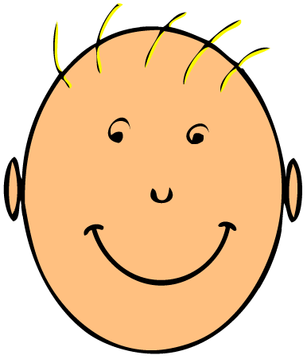
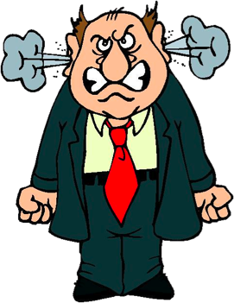
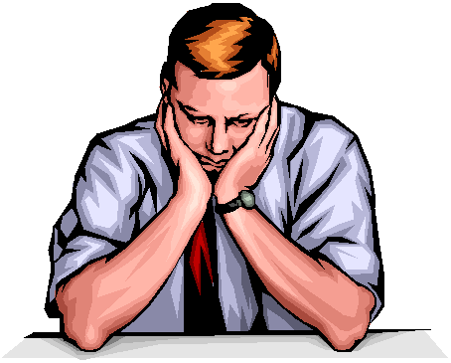

Emotionalism

Slide 3
emotion
“the power of feeling.”
“any of various complex reactions with both mental and physical manifestations, as love, hate, fear, anger, etc.”

Slide 4
emotionalism
“the disposition or tendency to see and judge all things from an emotional point of view”
“the act or habit of appealing to the emotions”

Slide 5
Our Assemblies
Some guard against any display of emotion.
Others decry what they perceive as cold formalism.
We must maintain a proper balance between the two extremes.

Slide 6
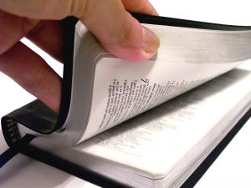
Reason Before Emotion
Isaiah 1:18
Acts 2:37
Acts 24:25
Romans 10:1-3

Slide 7
There is a place for emotion.
Love - 1 Pet. 4:8
Hope - Rom. 12:12
Joy - Phil. 4:4
Sorrow - 2 Cor. 7:10
Hatred - Prov. 8:13
Fear - Matt. 10:28

Slide 8
But emotion comes from knowledge.
God’s love motivates us to love (1 John 4:9-11).
God’s promises - hope (1 Pet. 1:3-4, 13).
Reconciliation - joy (Rom. 5:10-11).
Our sin - sorrow (2 Cor. 7:8).
God’s character - hate sin (Prov. 8:13).
Judgment - fear (Acts 24:25).

Slide 9
Emotion must produce fruit.
Love - obedience (John 14:15).
Hope - patience (Rom. 8:24-25).
Joy - sacrifice (2 Cor. 8:2-5).
Sorrow - repentance (2 Cor. 7:9-10).
Hatred of sin - an acceptance of God’s truth (Psalm 119:127-128).
Fear of judgment - godly living (Acts 16:30-31).

Slide 10
Emotionalism
Characteristic of paganism, not New Testament Christianity
1 Kings 18:26-28
Acts 19:34

Slide 11
Proper Worship
God is a God of order.
Worship is to be decent and in order
  1 Cor. 14:40
Emotions can be controlled
  Col. 3:8, 12-14

Slide 12

Proper Worship
Some brethren are beginning to appeal to emotionalism in worship.
Advocating raising hands, handclapping, singing solos, etc.
Authority???

Slide 13
When Emotion Becomes Emotionalism
When emotion becomes an end to itself.
When emotion is not based upon God’s word.
When emotion is the basis for our faith.

Slide 14
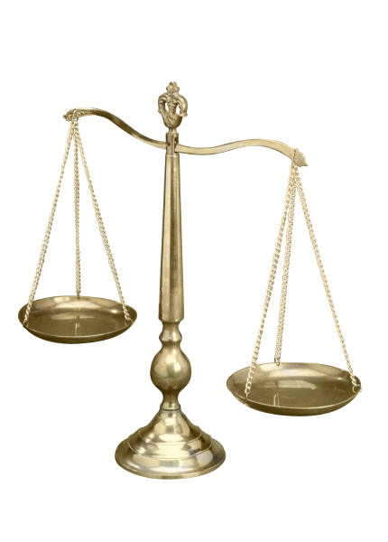
Maintaining Balance
Our service must be heartfelt and sincere.
But our emotions must be based upon knowledge, and controlled, and produce the proper fruit.

