Slide 2

Dangers Facing the Church Today

Slide 3
Acts 20:29-30
29 For I know this, that after my departure savage wolves will come in among you, not sparing the flock.
30 Also from among yourselves men will rise up, speaking perverse things, to draw away the disciples after themselves.
31 Therefore watch…

Slide 4
Dangers Indicated in New Testament
Departures from the faith - 1 Tim. 4:1, 2 Tim. 4:2-3
Judaizing Teachers - Acts, 2 Cor., Gal.
Gnosticism - Col., 1 John
Five of seven churches of Asia told to repent Rev. 2-3

Slide 5
Today’s Dangers
Today’s battles are not the same as yesterday’s battles.
Dangers are on the horizon, at the door, and already in the pulpit and pew!
“Therefore Watch!”

Slide 6
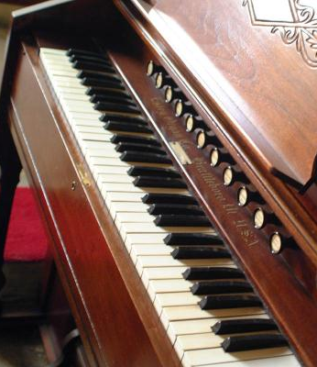
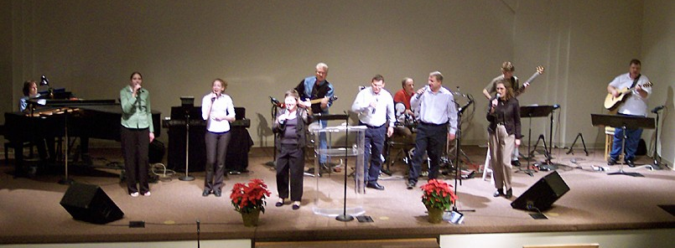
Instrumental Music
In Worship

Slide 7
Churches Introducing Instruments
Max Lucado, Oak Hills church in San Antonio, TX, starting using instrumental music during their Sunday evening services in 2004.
Richland Hills church of Christ in Ft. Worth, TX, started using the instrument, as well as offering communion, during Saturday evening services in 2006.
Quail Springs church of Christ, Oklahoma City, OK, started in 2008.

Slide 8

1. We Are Told To Sing
Matthew 26:30
Acts 16:25
Romans 15:9
1 Corinthians 14:15
Ephesians 5:19
Colossians 3:16
Hebrews 2:12, 13:15
James 5:13

Slide 9
2. Instruments Are Not Authorized

Slide 10
2. Instruments Are Not Authorized
“Show me where the Bible says, ‘Thou shalt not use instruments?’”

Slide 11
2. Instruments Are Not Authorized
“Show me where the Bible says, ‘Thou shalt not use instruments?’”
“Where does the Bible say that we can use musical instruments?”

Slide 12
2. Instruments Are Not Authorized
Hebrews 7:12-14 - silence of Scripture is prohibitive, not permissive.
Genesis 6:14-16 - gopher wood automatically excluded all other types of wood.
Numbers 19:2 - animal specified by God automatically excluded all other animals.
“Singing” automatically excludes all other types of music.

Slide 13
3. Answering Arguments In Favor of the Instrument
“I like the use of musical instruments.”
Worship is not about what we like, but about what God wants from us (John 4:23-24).

Slide 14
3. Answering Arguments In Favor of the Instrument
“Instruments Help Improve Our Singing.”
No, instruments drown out the singing, and completely change the kind of music that we are offering to God.
We are to make melody in our “heart” (Eph. 5:19), not on a “harp.”
Some who use the instrument are often complimentary of the singing ability of those in the Lord’s church.

Slide 15
3. Answering Arguments In Favor of the Instrument
“Used Instruments in the Old Testament.”
Such was commanded (2 Chron. 29:25-28).
Law of Moses was fulfilled and taken out of the way when Jesus died (Col. 2:14).
If we go back and keep one part of the Law of Moses, we are obligated to keep all (Gal. 5:3).

Slide 16
3. Answering Arguments In Favor of the Instrument
“Aren’t There Harps In Heaven?”
Revelation 5:8, 14:2, 15:2
Revelation is a book of signs and symbols.
Will there really be harps in heaven?
To follow this passage, every person would have to play a harp.

Slide 17
3. Answering Arguments In Favor of the Instrument
“Doesn’t the Possession of Talents Infer the Use of Those Talents?”
“If one is a good piano player, shouldn’t he play the piano in church to the glory of God?”
What if a woman were a good public speaker? 1 Cor. 14:34-35, 1 Tim. 2:11-12

Slide 18
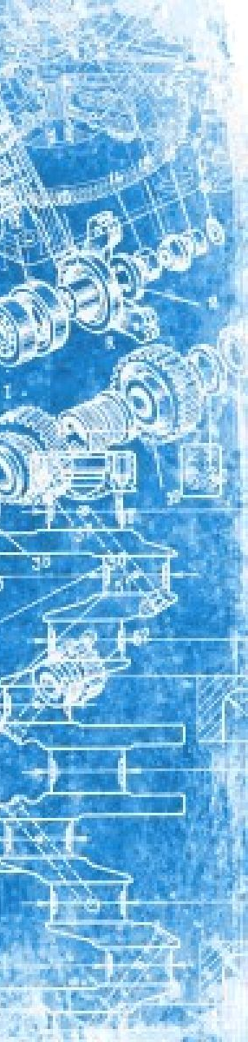
The Quail Springs Church of Christ
A Blueprint For Apostasy

Slide 19
1. False Beliefs Regarding the Use of the Instrument

Slide 20
1. False Beliefs Regarding the Use of the Instrument
“…for some time it’s an area where we believed we had freedom, but we wouldn’t practice that freedom primarily because of our tradition…”
“We’re raising generations that leave us because they just don’t buy this anymore, so maybe we ought to practice the freedom we believe we have.”

Slide 21
2. Get Members Used To It

Slide 22
2. Get Members Used To It
“…already had kind of a band. And we have a worship style here, even in our a cappella service, we’ve tended toward more contemporary Christian worship music. So in some ways, we weren’t really re-inventing the wheel; we were just further developing what we have done before.”

Slide 23
3. Be Willing To Suffer Casualties

Slide 24
3. Be Willing To Suffer Casualties
“The day that one of the elders announced that they arrived at this conclusion, that we were going forward, that this would be a part of our future, a certain percentage of the congregation broke out in applause and a number of people got up and left in tears…”
“When we started this process, our average attendance was in the 900-950 range and by the time we finished, we were in the 600-650 range.”

Slide 25

Lack of teaching leads to ignorance.
Exposure to a false practice leads to tolerance and then demand.
Those demanding the innovations will eventually have their way.

