Slide 1
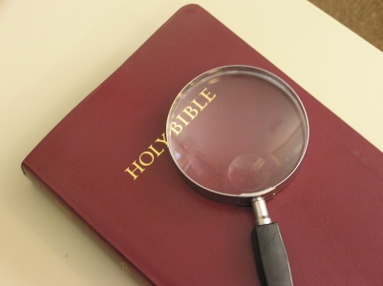
Identifying the Church That Jesus Built
Matthew 16:15-19

Slide 2
The Church Is Important
It is the body of Christ - Eph. 1:22-23
It is part of God’s eternal plan, manifesting His divine wisdom - Eph. 3:9-11
Jesus died for the church - Eph. 5:23-25
Purchased it with His blood - Acts 20:28

Slide 3
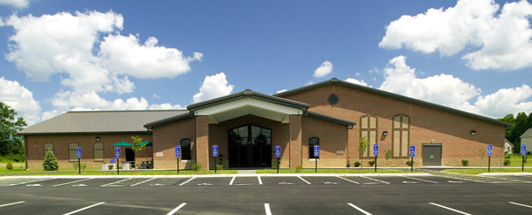
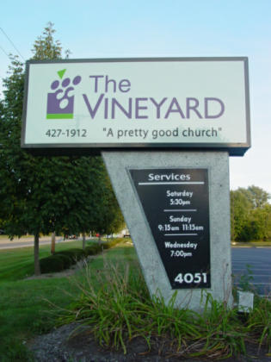
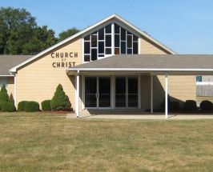
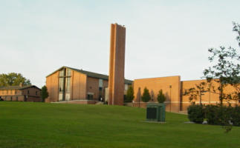
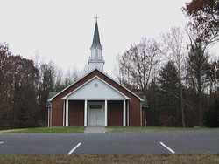
“One church is as good as another!”
“Join the church of your choice!”

Slide 4
Where is the one church that Jesus built?
Where is the one church that Jesus built?

Slide 5
Where is the one church that Jesus built?
Where is the one church that Jesus built?
There is a pattern.
Hebrews 8:5

Slide 6
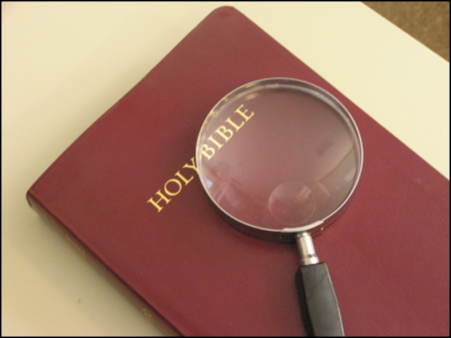
The Organization of the Church
Jesus is the Head - Col. 1:18
Headquarters is in Heaven - 1 Peter 3:22
Local Church - Phil. 1:1
  saints
  bishops (elders)
  deacons

Slide 7
The Worship of the Church
First day of the week - Acts 20:7
Lord’s Supper - 1 Cor. 11:23-26
Giving - 1 Cor. 16:1-2
Praying - 1 Cor. 14:15
Singing - 1 Cor. 14:15
Preaching - Acts 20:7

Slide 8
The Work of the Church
Evangelism - 1 Tim. 3:14-15
Edification - Eph. 4:11-12
Limited Benevolence - Rom. 15:25-26

Slide 9
The Name of the Church

Slide 10
The Name of the Church
Catholic Church
Assembly of God
Pentecostal Church
Church of the Nazarene
Baptist Church
Christian Church
Lutheran Church
Methodist Church
Bible Church
Presbyterian Church
Episcopal Church
Unitarian Church
Salvation Army
Community Church
Seventh-Day Adventist
Jehovah’s Witness
Church of Jesus Christ of Latter-Day Saints

Slide 11
The Name of the Church
Agape Assembly of God Deaf Church
Church of the Carpenter
Hillside Chapel of the Christian and Missionary Alliance
The Way of the Cross Gospel Ministries
Community Glory of Christ Gospel Church
Metropolitan Community Church of Eternal Joy
Maranatha Christian Fellowship Church
House of God Church Keith Dominion

Slide 12
The Name of the Church
church of God - 1 Cor. 1:2
church of Christ - Rom. 16:16
church of the firstborn - Heb. 12:33
church of the living God - 1 Tim. 3:15
church of God in Christ Jesus - 1 Thess. 2:14

Slide 13
Identifying the Church That Jesus Built
The Bible contains the pattern for the church that Jesus built.
  Organization
  Worship
  Work
  Name

