Slide 1




Sins of the Tongue

Slide 2
Lying

Slide 3
What is a lie?
To lie is “to make a statement that one knows is false, especially with intent to deceive” (Webster’s).
“In Scripture the word is used to designate all the ways in which men deny or alter the truth in word or deed…” (The New Unger's Bible Dictionary).

Slide 4
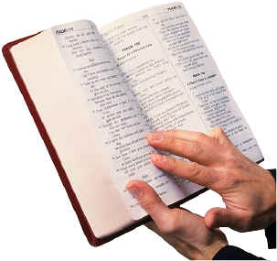
All lying is wrong and sinful.
“You shall not bear false witness against your neighbor” - Ex. 20:16
“Therefore, putting away lying, ‘Let each one of you speak truth with his neighbor,’ for we are members of one another” Eph. 4:25
“Do not lie to one another…” Col. 3:9

Slide 5

Is it ever right to tell a lie?

Slide 6
Is it ever right to tell a lie?
If one uses a subjective standard, such as stressing the benefits or consequences of telling a lie, then the answer will be “yes.”

Slide 7
Is it ever right to tell a lie?
If one uses a subjective standard, such as stressing the benefits or consequences of telling a lie, then the answer will be “yes.”
If one uses an objective standard (God’s Word) then the answer will be “no.”

Slide 8

Is it ever right to tell a lie?
The Bible teaches that all lying is wrong and sinful, and gives no exception to this rule.

Slide 9
Biblical Examples of Good People Telling Lies
Abraham - Gen. 12:11-19, 20:2
Sarah - Gen. 18:15
Isaac - Gen. 26:7-9
Jacob - Gen. 27:19-20, 24
Rahab - Joshua 2:4-6
David - 1 Sam. 21:2
Peter - Matt. 26:69-75

Slide 10
Biblical Examples of Good People Telling Lies
The fact that goon men and women in the Bible sometimes told lies does not mean that lying is a good thing, or that God allows or endorses the practice of lying.
Instead it should serve as a sober warning of the fact that good men and women can easily be overtaken in this sin.

Slide 11
Why Lying Is Wrong
Lies Originate With Satan
  John 8:44, Rev. 12:9
Lies Destroy Mankind
  Gen. 3:1-5, 2 Tim. 2:24-26, Ps. 52:2-4
Lies Destroy the Quality of Man’s Life
  1 Peter 3:10

Slide 12
Why Lying Is Wrong
Lies Oppose the Identity and Work of Christ
  John 14:6, 18:37, 8:32
Lies Are Contrary To Sound Doctrine
  1 Tim. 1:9-10
God Hates Lying
  Prov. 6:16-19, Heb. 6:18, Prov. 19:5, Rev. 21:8

Slide 13
“Therefore, putting away lying, ‘Let each one of you speak truth with his neighbor,’ for we are members of one another” (Eph. 4:25)
“A righteous man hates lying” (Prov. 13:5)

