Slide 1
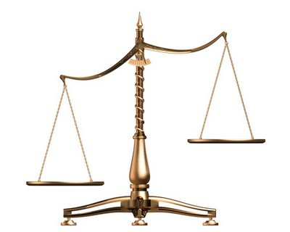
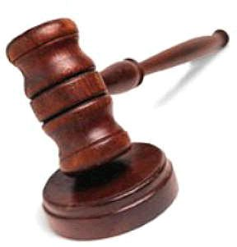

Making the Case For Jesus
Is Jesus Really the Son of God?

Slide 2

“What then shall I do with Jesus who is called Christ?”
Matthew 27:22

Slide 3
13 When Jesus came into the region of Caesarea Philippi, He asked His disciples, saying, “Who do men say that I, the Son of Man, am?”
14 So they said, “Some say John the Baptist, some Elijah, and others Jeremiah or one of the prophets.”
15 He said to them, “But who do you say that I am?”
Matthew 16:13-15

Slide 4
1. The Way He Spoke
“No man ever spoke like this Man” (John 7:46).
“And so it was, when Jesus had ended these sayings, that the people were astonished at His teaching, for He taught them as one having authority, and not as the scribes” (Matt. 7:28-29).

Slide 5
2. His Claims
He was the Messiah - John 4:25-26
He was equal with God - John 5:17-18
He was the Son of God - John 10:30-36
He had the power to forgive sins - Mark 2:5

Slide 6
3. Miracles That Backed Up His Claims
Mark 2:5-12
Acts 2:22
John 3:2
His enemies could not deny His miracles - John 11:47

Slide 7
4. What Others Said About Him
His mother - John 2:3-5
Peter - Matthew 16:16
John - 1 John 1:1-4
Thomas - John 20:24-29
Paul - Galatians 1:23
Centurion - Matthew 27:54

Slide 8
5. Fulfilled Prophecy
Jesus made detailed predictions…
His death and resurrection - Matthew 20:17-19
Peter’s Denial - Mark 14:30
Destruction of Jerusalem - Matthew 24

Slide 9
5. Fulfilled Prophecy
Jesus was the subject of 332 prophecies recorded in the Old Testament
The probability of only eight of these prophecies being fulfilled in the life of one man is 1 in 10¹⁷

Slide 10
6. Does He Fit the Profile?

Slide 11
6. Does He Fit the Profile?
Omniscient - John 16:30
Omnipotent - Matthew 28:18
Omnipresent - Matthew 28:20
Holy - 1 Peter 2:22
Sovereign - Colossians 1:15
Eternal - John 1:1
Immutable - Hebrews 13:8
Forgiving - Mark 2:5-12

Slide 12
6. Does He Fit the Profile?
“For in Him dwells all the fullness of the Godhead bodily.”
Colossians 2:9

Slide 13
Is Jesus Really the Son of God?
The Way He Spoke
His Claims
Miracles That Backed Up His Claims
What Others Said About Him
Fulfilled Prophecy
Does He Fit the Profile?

Slide 14
Is Jesus Really the Son of God?
The Way He Spoke
His Claims
Miracles That Backed Up His Claims
What Others Said About Him
Fulfilled Prophecy
Does He Fit the Profile?
“But who do you say that I am?” (Matt. 16:15)

