Slide 2
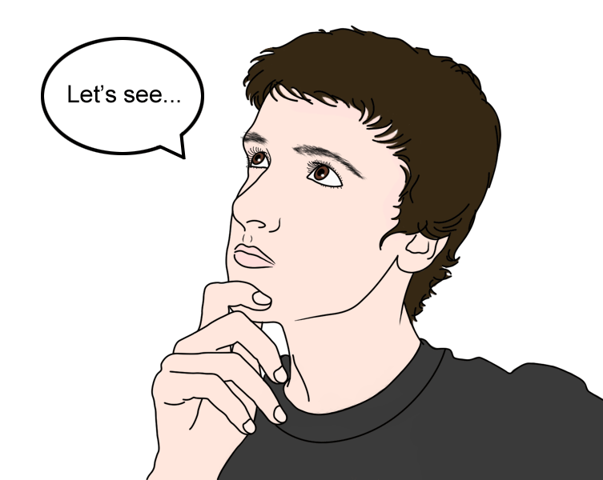
Do We Really Have A Choice?

Slide 3
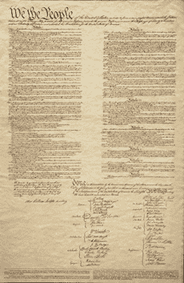
Our Constitution
Mt. 6:24.
Prov. 14:12.
Jn. 12:48.
Isa. 55:8-9.
Gal. 1:8-9.

Slide 4

God Reveals His Choice
2 Jn. 9.
Rev. 22:18-19.
Eph. 4:4-6.
How Many Is One?
Do We Have A Right To Choose between ONE?

Slide 5
God Reveals His Choice
“There is One Lord” – Is One Lord as good as another? DO we have a choice of Lords? (Saviors?) Ac. 4:12.
“There is One Spirit” – Do we have a right to follow the spirit of our choice? Is one spirit as good as another spirit?

Slide 6
God Reveals His Choice
“There is One Hope” – Is One Hope as good as another? Is the Jewish hope of heaven as good as the Christian’s hope?
“There is One Body” – Body is the church (Eph. 1:22-23). Is one church as good as another? Do we have a choice of churches?

Slide 7
God Reveals His Choice
“There is One Faith” – Do we really have a choice of faiths? Is one faith as good as another? (Jn. 8:24; 2 Thess. 2:10-12).

Slide 8
God Reveals His Choice
“There is One Baptism” – God said there is ONE baptism. Is one baptism as good as another? Do we really have a choice of baptisms? Is sprinkling and pouring as good as Bible Baptism, which is a burial (Rom. 6:3-5; Col. 2:12; 1 Pet. 3:21; Ac. 2:38).

Slide 9
God Reveals His Choice
“There is One GOD”
Is one GOD as good as another god?
Do we have a choice of gods?

Slide 10
You Can’t Choose Your Own Way
John 14:6.
Psa. 119:89.
Mt. 15:9, 13.

Slide 11
The Church Of God’s Choice
Mt. 16:18; Ac. 2; Psa. 127:1.
Heb. 8:5; Col. 3:17.
Mt. 28:18; Col. 1:18; Eph. 5:23.
Ac. 20:7; 1 Cor. 16:1-2; Eph. 5:19; Col. 3:16; Ac. 2:42; 2 Tim. 4:2.

Slide 12
Lessons
Your eternal destiny will be determined by the choices you make on earth.
Obey God’s choice to be saved: Believe – Mk. 16:16. Repent – Ac. 17:30. Confess – 1 Jn. 4:15. Be Baptized – Ac. 2:38.
You cannot attend the church of your choice and go to heaven. You MUST attend the church of God’s choice that follows what God prescribed for men to obey and be saved!

Slide 13
Lessons
If you will believe in the one God and the One Lord, listen to the voice of the one Spirit as he speaks from the pages of the Bible, believe and obey the one faith revealed therein, submit to the one baptism, God will add you to the one body (Ac. 2:47), and you will have the one hope of heaven!
We must accept God’s Choice to be saved!

