Slide 2
Richard Dawkins on Creationists…
“It is absolutely safe to say that if you meet somebody who claims not to believe in evolution, that person is ignorant, stupid, or insane (or wicked, but I’d rather not consider that.”)

Slide 3
Can reasonable people believe the things that are crucial to the Christian faith?
John 20:24-29

Slide 4
“Faith is the assurance of things hoped for, the conviction of things not seen”
Hebrews 11:1

Slide 5

God has left “fingerprints” all over this world
    Romans 1:18-22
    Acts 14:15-17

Slide 6


Slide 7
The universe we inhabit either:
Popped into existence from nothing
Was called into existence by some Eternal Force that pre-existed it
    “For every house is built by someone, but the builder of all things is God”
    Hebrews 3:4

Slide 8
Where did it all come from?
Two possibilities:
Mind or Matter

Slide 9
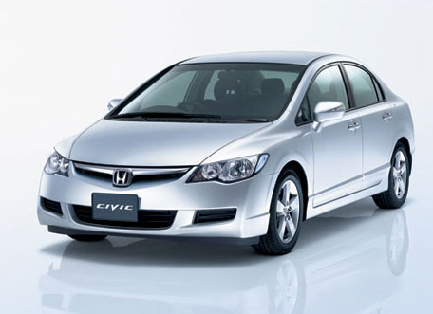

Slide 10
“The heavens declare the glory of God; and the sky above proclaims his handiwork.”
Psalm 19:1

Slide 11
“For you formed my inward parts; you knitted me together in my mother’s womb. I praise you, for I am fearfully and wonderfully made.”
Psalm 139:13-14

Slide 12
“All things were made through Him, and without Him was not any thing made that was made.”
John 1:3

Slide 13
“But these are written that you may believe that Jesus is the Christ, the Son of God, and that believing you may have life in His name.”
John 20:31

Slide 14
“Blessed are those who have not seen and yet have believed”
Will You Believe This Evening?

