Slide 1

How Do I Know What My Priorities Are?
Notes:
Title Slide: How Do I Set My Priorities? (article by Gary Henry & help from Don McClain charts.)

Slide 2

Matthew 6:19-21
“Do not lay up for yourselves treasures on earth, where moth and rust destroy and where thieves break in and steal; but lay up for yourselves treasures in heaven, where neither moth nor rust destroys and where thieves do not break in and steal. For where your treasure is, there your heart will be also.”
Notes:
Text of Matthew 6:19-21—Jesus’ Sermon on the Mount. Jesus was speaking about the character and heart of those who would be part of the new spiritual kingdom. They must have the proper focus.

Slide 3
Matthew 6:31-32
“Therefore do not worry, saying, 'What shall we eat?' or 'What shall we drink?' or 'What shall we wear?‘ For after all these things the Gentiles seek. For your heavenly Father knows that you need all these things.
Notes:
Text of Matthew 6:31-32—Jesus’ Sermon on the Mount. Jesus was speaking about the character and heart of those who would be part of the new spiritual kingdom. They must have the proper focus.

Slide 4
Matthew 6:33-34
“But seek first the kingdom of God and His righteousness, and all these things shall be added to you. Therefore do not worry about tomorrow, for tomorrow will worry about its own things. Sufficient for the day is its own trouble.
Notes:
Text of Matthew 6:33-34—Jesus’ Sermon on the Mount. Jesus was speaking about the character and heart of those who would be part of the new spiritual kingdom. They must have the proper focus.

Slide 5

How Do I Know What My Priorities Are?
Work
Family
Friends
Church
Leisure
GOD
Notes:
The Chart…Explain—Decisions and choices we all must make. Where does God fit into those choices? Understand this—every person determines how to divide the time in his life!

Slide 6
Matthew 19:16-17
“Now behold, one came and said to Him, ‘Good Teacher, what good thing shall I do that I may have eternal life?’ So He said to him, ‘Why do you call Me good? No one is good but One, that is, God. But if you want to enter into life, keep the commandments.’"
Notes:
Text of Matthew 19:16-22—the story of the Rich Young Ruler. Notice (vs.16,17); he asked a good question and came to the best person to get the correct answer. The conclusion of the Lord’s answer—“keep the commandments.”

Slide 7
Matthew 19:18,19
“He said to Him, ‘Which ones?’ Jesus said, 'You shall not murder, You shall not commit adultery, You shall not steal, You shall not bear false witness,
Honor your father and your mother, and, You shall love your neighbor as yourself.’”
Notes:
Text of Matthew 19:16-22—the story of the Rich Young Ruler. Notice (vs.18,19) the ruler asked for clarification—so Jesus quoted some of the commands from the Law of Moses.

Slide 8
Matthew 19:20-21
“The young man said to Him, ‘All these things I have kept from my youth. What do I still lack?’ Jesus said to him, ‘If you want to be perfect, go, sell what you have and give to the poor, and you will have treasure in heaven; and come, follow Me.’"
Notes:
Text of Matthew 19:16-22—the story of the Rich Young Ruler. Notice (vs.20,21) the ruler told the Lord he had kept the commandments since his youth. But, he KNEW that something was still lacking! Jesus knew the answer for He could see into the ruler’s heart (1 Sam.16:7); He told him the ONE thing that was holding him back. What did he do with the Lord’s answer?

Slide 9
Matthew 19:20-22
“But when the young man heard that saying, he went away sorrowful, for he had great possessions."
Notes:
Text of Matthew 19:16-22—the story of the Rich Young Ruler. Notice (vs.22) the ruler rejected the Lord’s answer. He had given the answer for which the young man was searching, but he was not willing to pay! The cost was too high—his priorities were different from the Lord’s!

Slide 10
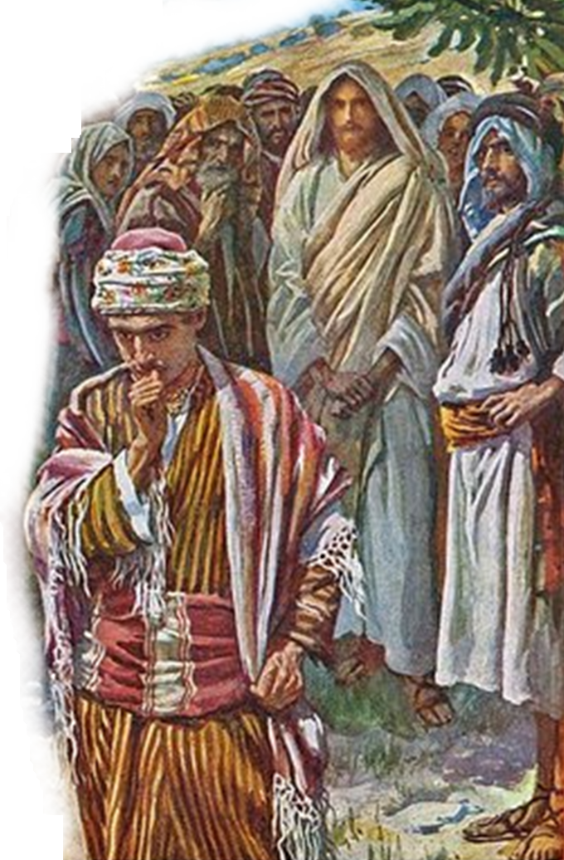
What he said about his values indicated one thing; but his actions indicated another.
Notes:
We see a contradiction here between what the young man’s values seem to be and what they actually are. His conduct shows that his values were much different from what the question led others to believe!

Slide 11
How Do I Know What My Priorities Are?
Can easily get out of order.
When asked, we probably answer correctly.
Are knowledge and good intentions enough?
Where do your priorities really lie?
Notes:
If we are not constantly careful, our list of priorities can get out of order. At such times, it may not be easy to be honest enough to face the truth about the situation. When someone asks what is most important to us, we are tempted to answer in terms of what we know should be most important. Because we think we are, more or less, moving in a direction where we put first things first ("I plan to pray and study my Bible more just as soon as I get my schedule under control, etc."), we may think that gives us the right to say the spiritual concerns are our top priority right now. But the Lord does not judge what our priorities are by listening to what we say. He looks at what we do. And if we do not somehow gather our courage and look, as He does, at what actually means the most to us -- and repent accordingly -- eternity holds no hope for us. Before it's too late to make changes, we need to be asking ourselves some blunt questions about what our priorities really are.
o

Slide 12

What Do I Think About?
Our minds should be set on spiritual things.
  “But his delight is in the law of the LORD, And in His law he meditates day and night.” {Psalm 1:2}
Notes:
Our true priorities are the things our minds are drawn to when they are "in neutral."
When activities and obligations do not require us to be thinking about anything in particular, our thoughts are attracted, like things to a magnet, to our real enthusiasms.
The person who finds that he meditates on God only when he forces himself to do so is lying if he says his spiritual life is his overriding concern.

Slide 13
What Do I Think About?
Our minds should be set on spiritual things.
  “If then you were raised with Christ, seek those things which are above, where Christ is, sitting at the right hand of God. Set your mind on things above, not on things on the earth.” {Colossians 3:1,2}
Notes:
Our true priorities are the things our minds are drawn to when they are "in neutral."
When activities and obligations do not require us to be thinking about anything in particular, our thoughts are attracted, like things to a magnet, to our real enthusiasms.
The person who finds that he meditates on God only when he forces himself to do so is lying if he says his spiritual life is his overriding concern.

Slide 14
What Do I Think About?
“Finally, brethren, whatever things are true, whatever things are noble, whatever things are just, whatever things are pure, whatever things are lovely, whatever things are of good report, if there is any virtue and if there is anything praiseworthy--meditate on these things.”
{Philippians 4:8}
“For those who live according to the flesh set their minds on the things of the flesh, but those who live according to the Spirit, the things of the Spirit. For to be carnally minded is death, but to be spiritually minded is life and peace. Because the carnal mind is enmity against God; for it is not subject to the law of God, nor indeed can be. So then, those who are in the flesh cannot please God.” {Romans 8:5-9}
Notes:
Our true priorities are the things our minds are drawn to when they are "in neutral."
When activities and obligations do not require us to be thinking about anything in particular, our thoughts are attracted, like things to a magnet, to our real enthusiasms.
The person who finds that he meditates on God only when he forces himself to do so is lying if he says his spiritual life is his overriding concern.

Slide 15
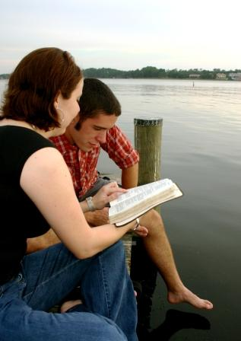
What Do We Talk
About Most?
Our conversations arise quite naturally out of things that are on our minds.
  “But those things which proceed out of the mouth come from the heart, and they defile a man.” {Matthew 15:18}
Notes:
What Do We Talk About Most? --
Is it God? Our conversations arise quite naturally out of the things that are on our minds.
If we have to admit that we rarely talk about the Lord, except in connection with the church services, that ought to tell us something.
And even if we do sometimes talk about spiritual matters, if our acquaintances would have to say that our conversation gravitates more naturally and enthusiastically toward other things, then there is serious doubt whether our ultimate priorities are really spiritual.

Slide 16
What Do We Talk
About Most?
Our conversations arise quite naturally out of things that are on our minds.
  “For by your words you will be justified, and by your words you will be condemned.”
  {Matthew 12:37}
Notes:
What Do We Talk About Most? --
Is it God? Our conversations arise quite naturally out of the things that are on our minds.
If we have to admit that we rarely talk about the Lord, except in connection with the church services, that ought to tell us something.
And even if we do sometimes talk about spiritual matters, if our acquaintances would have to say that our conversation gravitates more naturally and enthusiastically toward other things, then there is serious doubt whether our ultimate priorities are really spiritual. Also see Acts 4:20—spoke what they seen and heard. (apostles) Acts 17:21—spent time to hear or tell some new thing!

Slide 17
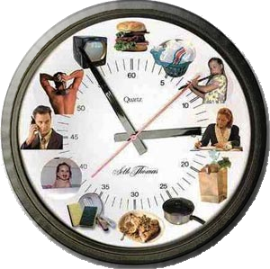
How Do We Spend
Our Time?
How does the spiritually minded person spend most of his time?
  “Oh, how I love Your law! It is my meditation all the day.” {Psalm 119:97}
Notes:
How Do We Spend Our Time? --
Hardly anybody has as much "spare" time as he would like. But all of us have some, and the way we spend it displays our priorities.
For example, I have known families who "vacationed" by traveling to gospel meetings or Bible lectureships at congregations in distant states.
Judging from their use of time that was theirs to do with as they pleased, one would tend to believe such folks if they said they loved the Lord more than anything else.
On the other hand, I have known folks who all their working lives complained that they didn't have as much time as they wanted to do the Lord's work -- and then spent virtually all of their retirement years in personal leisure, with perhaps less time devoted to the Lord than before!
The fact is, the way we spend our time speaks loudly regarding our values.

Slide 18
How Do We Spend
Our Time?
How does the spiritually minded person spend most of his time?
  “These were more fair-minded than those in Thessalonica, in that they received the word with all readiness, and searched the Scriptures daily to find out whether these things were so.” {Acts 17:11}
Notes:
How Do We Spend Our Time? --
Hardly anybody has as much "spare" time as he would like. But all of us have some, and the way we spend it displays our priorities. Also see Acts 5:42; 1 Thess.5:17.
For example, I have known families who "vacationed" by traveling to gospel meetings or Bible lectureships at congregations in distant states.
Judging from their use of time that was theirs to do with as they pleased, one would tend to believe such folks if they said they loved the Lord more than anything else.
On the other hand, I have known folks who all their working lives complained that they didn't have as much time as they wanted to do the Lord's work -- and then spent virtually all of their retirement years in personal leisure, with perhaps less time devoted to the Lord than before!
The fact is, the way we spend our time speaks loudly regarding our values. Also see Acts 5:42; 1 Thess.5:17

Slide 19

How Do We Spend
Our Money?
Do we give to the Lord’s work first, and satisfy our wants with what we have left?
  “And not only as we had hoped, but they first gave themselves to the Lord, and then to us by the will of God.”
  {2 Corinthians 8:5}
Notes:
How Do We Spend Our Money? --
Money is tight these days – thus, more than ever, we need to prioritize the way we spend it.
Do we give to the Lord’s work FIRST and satisfy our wants with what we have left? – (Mal. 1:6-8; 3:8-10; 1 Cor. 16:1,2; 2 Cor. 8:1-5)
Suppose a Bible class teacher recommended a $50 reference book that would help us in our study of the Scriptures, but we said we couldn't afford it. Suppose a preacher recommended a $30-a-year periodical that would help us grow spiritually, but we said it cost too much.
If it was known that we sometimes spent that much on sporting events and recreational activities, that it wasn't unusual for us to spend that much in a single evening at a restaurant, that we couldn't object to spending that much on decorative home furnishings, etc., could anyone take seriously our claim that the Lord is our uppermost concern?

Slide 20
How Do We Spend
Our Money?
Do we give to the Lord’s work first, and satisfy our wants with what we have left?
  “On the first day of the week let each one of you lay something aside, storing up as he may prosper, that there be no collections when I come.”
  {1 Corinthians 16:2}
Notes:
How Do We Spend Our Money? --
Money is tight these days – thus, more than ever, we need to prioritize the way we spend it.
Do we give to the Lord’s work FIRST and satisfy our wants with what we have left? – (Mal. 1:6-8; 3:8-10; 1 Cor. 16:1,2; 2 Cor. 8:1-5)
Suppose a Bible class teacher recommended a $50 reference book that would help us in our study of the Scriptures, but we said we couldn't afford it. Suppose a preacher recommended a $30-a-year periodical that would help us grow spiritually, but we said it cost too much.
If it was known that we sometimes spent that much on sporting events and recreational activities, that it wasn't unusual for us to spend that much in a single evening at a restaurant, that we couldn't object to spending that much on decorative home furnishings, etc., could anyone take seriously our claim that the Lord is our uppermost concern?

Slide 21
What “Gives” When We Face Conflicting Priorities?
Scheduling Conflicts.
  Attendance
  Bible Study
  Prayer
When social activities conflict with spiritual activities.
  Ballgames, band
  Gospel Meetings
Indeed, it's when priorities collide that we learn the most about ourselves, our values, and whether or not the Lord reigns within us.
Notes:
What "Gives" When We Face Conflicting Priorities? --
Of the many conflicts involving priorities, perhaps none are more annoying than "scheduling" conflicts. We’re unable to be two places at the same time; very often, we have to sacrifice one activity for another. Heb.10:24,25; 2 Tim.2:15.
When that happens, if we subordinate the Lord’s things to worldly activities, we lie about our professed priorities.
In the matter of sports, to take a familiar example, if we can manage it so that our softball league and the church services hardly ever conflict, that is all well and good, but it says relatively little about our priorities.
When the occasional conflict does arise, that is when we make a statement about our priorities.
The same is true of work. If, while on business trips, we've been willing to violate our commitment to assemble with brethren at our travel destination, we may try to make it look as if we chose between one thing that was "optional" and another that was not.

Slide 22

What Would Others Say Our Priorities Are?
You do not live in a vacuum.
  “You are the salt of the earth; but if the salt loses its flavor, how shall it be seasoned? It is then good for nothing but to be thrown out and trampled underfoot by men. You are the light of the world. A city that is set on a hill cannot be hidden.”
  {Matthew 5:13,14}
Notes:
Others may not know us as well as we know ourselves, but they are often more objective about what they do know.
The neighbor who lives next door could probably sum up in a word of two what we are really about.
Perhaps more than anybody, our children are able to cut through our preachments and tell what actually matters most to us in the rough and tumble of daily living.

Slide 23
What Would Others Say Our Priorities Are?
You do not live in a vacuum.
  “Nor do they light a lamp and put it under a basket, but on a lampstand, and it gives light to all who are in the house. Let your light so shine before men, that they may see your good works and glorify your Father in heaven.”
  {Matthew 5:15,16}
Notes:
Others may not know us as well as we know ourselves, but they are often more objective about what they do know.
The neighbor who lives next door could probably sum up in a word of two what we are really about.
Perhaps more than anybody, our children are able to cut through our preachments and tell what actually matters most to us in the rough and tumble of daily living.

Slide 24
What Would Others Say Our Priorities Are?
Others may not know us as well as we know ourselves, but they are often more objective about what they do know.
  Neighbors,
  Friends
  Co-workers, etc.
Notes:
Others may not know us as well as we know ourselves, but they are often more objective about what they do know.
The neighbor who lives next door could probably sum up in a word of two what we are really about.
Perhaps more than anybody, our children are able to cut through our preachments and tell what actually matters most to us in the rough and tumble of daily living. Also see Phil.2:15,16.

Slide 25
How Then Do I Know—In All Honesty—What My Priorities Are?
What Do We Think About?
What Do We Talk About Most?
How Do We Spend Our Time?
How Do We Spend Our Money?
What "Gives" When We Face a Conflict in Priorities?
What Would Others Say Our Priorities Are?
Notes:
How then do I know -- in all honesty -- what my priorities are?
What Do We Think About?
What Do We Talk About Most?
How Do We Spend Our Time?
How Do We Spend Our Money?
What "Gives" When We Face A Conflict Of Priorities?
What Would Others Say Our Priorities Are?
By looking at what I am, in fact, doing with my life.
Paul wrote: "To whom you present yourselves slaves to obey, you are that one's slaves whom you obey, whether of sin to death, or of obedience to righteousness" (Rom. 6:16).
At least one thing would seem to be clear: I can't pour the first and the best of what I am into pursuing what has euphemistically been called the American Dream and still turn around and say I love the Lord with all my heart.
I can't go "all out" for one thing and then truthfully claim that something else is more important. Jesus said: "No one can serve two masters...You cannot serve God and mammon" (Matt. 6:24).
Where my priorities are, there my energy and enthusiasm will also be! ----

Slide 26
How Then Do I Know—In All Honesty—What My Priorities Are?
What I am, in fact, doing with my life - (Romans 6:16,17)
I can't go "all out" for one thing and then truthfully claim that something else is more important –
(Matthew 6:24).
Where my priorities are, there my energy and enthusiasm will also be!
Do What I Can Do!
Notes:
Paul wrote: "To whom you present yourselves slaves to obey, you are that one's slaves whom you obey, whether of sin to death, or of obedience to righteousness" (Rom. 6:16).
At least one thing would seem to be clear: I can't pour the first and the best of what I am into pursuing what has euphemistically been called the American Dream and still turn around and say I love the Lord with all my heart.
I can't go "all out" for one thing and then truthfully claim that something else is more important. Jesus said: "No one can serve two masters...You cannot serve God and mammon" (Matt. 6:24).
Where my priorities are, there my energy and enthusiasm will also be! ----

