Slide 1
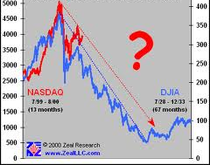
Why Do We Lose Zeal?

Slide 2
1. The “new” wears off Acts 17:21
- Solution: 2 Pet. 1:1-13

Slide 3
2. We stop intensely studying Heb. 5:12
- Solution: Eccl. 12:13; Heb. 5:13-14

Slide 4
3. We forget the labor & yoke of sin Mt. 11:28-30
- Solution: 1 Tim. 1:12-14; Acts 17:16 (1 Jn. 4:13)

Slide 5
4. We return to sin Ps. 51:12-15
- Solution: Rev. 2:3-5; Acts 8:22-23 (1 Jn. 1:9)

Slide 6
5. We become discouraged when others reject truth Jer. 20:7-9a
- Solution: Is. 55:8-9, 11; Rom. 10:1; 11:14; Jer. 20:9b

Slide 7
Why Do We Lose Zeal?

Slide 8
“What Must I Do To Be Saved?”
Hear The Gospel (Rom. 10:17)
Believe In Christ (Jn. 8:24)
Repent Of Sins (Acts 2:38)
Confess Christ (Rom. 10:10)
Be Baptized (I Pet. 3:21)
For The Erring Child:
Repent (Acts 8:22), Confess (I Jn. 1:9),
Pray (Acts 8:22)

