Slide 1

In the Valley of Temptation
“For God knows that in the day you eat of it your eyes will be opened, and you will be like God, knowing good and evil.” {Genesis 3:5}
Notes:
Title Slide: In the Valley of Temptation…Gen.3:5…

Slide 2
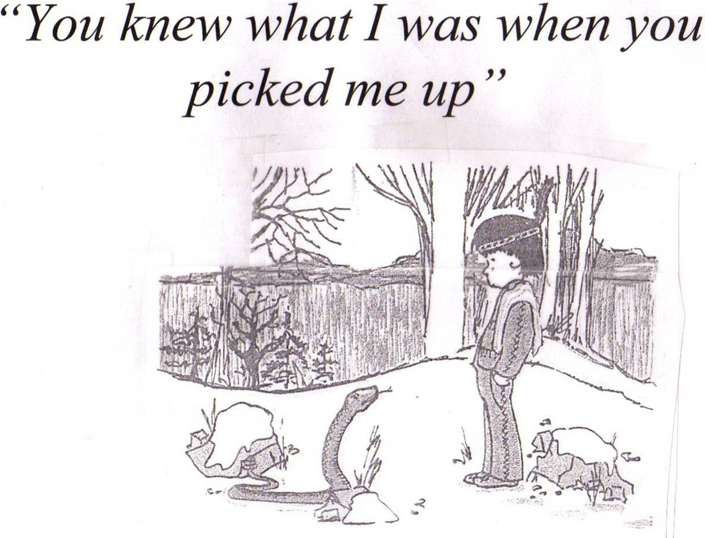
Notes:
“You knew what I was when you picked me up.” Generally speaking, it’s not ignorance that causes one to yield to temptation—it’s his own weakness in differing areas of life. Weaknesses—we all have them, and the devil knows what they are!!

Slide 3
The Danger of Temptation
Where does temptation come from?
Does everyone have the same temptation?
  “Let no one say when he is tempted, "I am tempted by God"; for God cannot be tempted by evil, nor does He Himself tempt anyone. But each one is tempted when he is drawn away by his own desires and enticed. Then, when desire has conceived, it gives birth to sin; and sin, when it is full-grown, brings forth death.” {James 1:13-15}
Notes:
Danger of Temptation.
Where does temptation come from?
Does everyone have the same temptations? Discuss Jam. 1:13-15…

Slide 4
Avenues of Temptation
All temptation travels on one of three paths.
Every sin fits into one of these groups.
  “Do not love the world or the things in the world. If anyone loves the world, the love of the Father is not in him. For all that is in the world--the lust of the flesh, the lust of the eyes, and the pride of life--is not of the Father but is of the world.” {1 John 2:15,16}
Notes:
Avenues of Temptation.
All temptation travels on one of three paths…
Every sin fits into one of these groups… Discuss 1 Jno.2:15,16…

Slide 5
God Tempts No Man
Adam and Eve had a choice.
God did not tempt them—Satan lied!
  “But of the fruit of the tree which is in the midst of the garden, God has said, 'You shall not eat it, nor shall you touch it, lest you die.’ Then the serpent said to the woman, ‘You will not surely die.’” {Genesis 3:3,4}
Notes:
God Tempts No Man!.
Adam and Eve had a choice…
God did not tempt them—Satan lied to them! He told them a half-truth. Discuss Genesis 3:3,4…

Slide 6
Eve Took the Bait!
“So when the woman saw that the tree was good for food, that it was pleasant to the eyes, and a tree desirable to make one wise, she took of its fruit and ate. She also gave to her husband with her, and he ate.” {Genesis 3:6}
Notes:
Eve Took the Bait!! Gen.3:6…she yielded—she gave the fruit to Adam—he yielded!

Slide 7

The Devil’s Schemes
Discourage You
Distract You
Deceive You
Destroy You!
Notes:
The Devil’s Schemes …
Discourage You
Distract You
Deceive You
Destroy You!!!!!!!!!
Discuss…

Slide 8
“Lest You Fall Into Temptation”
Did you pray?
  “And do not lead us into temptation, but deliver us from the evil one. For Yours is the kingdom and the power and the glory forever.” {Matthew 6:13}
Did you focus on God’s word?
  “I thought about my ways, and turned my feet to Your testimonies. I made haste, and did not delay to keep Your commandments.” {Psalm 119:59,60}
Notes:
“Lest You Fall Into Temptation.”
Did you pray?...Matt.6:13
Did you focus on God’s word? Psa.119:59,60…

Slide 9
“Lest You Fall Into Temptation”
Are you busy in your Father’s business?
  “But seek first the kingdom of God and His righteousness, and all these things shall be added to you.” {Matthew 6:33}
What is your main goal?
  “Finally, there is laid up for me the crown of righteousness, which the Lord, the righteous Judge, will give to me on that Day, and not to me only but also to all who have loved His appearing.” {2 Timothy 4:8}
Notes:
“Lest You Fall Into Temptation.”
(3) Are you busy in your Father’s business?...Matt.6:33
(4) What is your main goal? 2 Tim.4:8…

Slide 10
God’s Promise
God’s desire is for all to be saved.
  “Who desires all men to be saved and to come to the knowledge of the truth.” {1 Timothy 2:4}
He has made a way for that to become a reality.
  “No temptation has overtaken you except such as is common to man; but God is faithful, who will not allow you to be tempted beyond what you are able, but with the temptation will also make the way of escape, that you may be able to bear it.” {1 Corinthians 10:13}
Notes:
God’s Promise…
God’s desire is for all to be saved...1 Tim.2:4
He has made a way for that to become a reality—even when we are tempted! 1 Cor.10:13… Discuss…

Slide 11
Jesus’ Test
What was Jesus’ goal when He was tempted?
  “…It is written, 'Man shall not live by bread alone, but by every word that proceeds from the mouth of God.” {Matthew 4:4}
  “…It is written again, 'You shall not tempt the LORD your God.” {Matthew 4:7}
  “…Away with you, Satan! For it is written, 'You shall worship the LORD your God, and Him only you shall serve.” {Matthew 4:10}
Notes:
Jesus Passed His Test—show us the way!
(1) What was Jesus’ goal when Satan tempted Him in the wilderness? Matthew 4:1-11…Rejected and did not yield—how? “IT IS WRITTEN…”

Slide 12

Concluding Thoughts
What will be your GOAL when temptation comes knocking at your door?
Notes:
Summary—Invitation

