Slide 1
In the Valley of Death
“Yea, though I walk through the valley of the shadow of death, I will fear no evil; for You are with me; Your rod and Your staff, they comfort me.” {Psalm 23:4}
Notes:
Title Slide: In The Valley of Death (Psa.23:4)

Slide 2
The Need to Know About Death
“LORD, make me to know my end, and what is the measure of my days, that I may know how frail I am.” {Psalm 39:4}
Notes:
The Need to Know About Death. (Psa.39:4) We need to understand that death is part of life.

Slide 3
The Need to Know About Death
“So teach us to number our days, that we may gain a heart of wisdom.” {Psalm 90:12}
Notes:
The Need to Know About Death. (Psa.90:12) We need to understand that death is part of life.

Slide 4
“And He Died…”
“So all the days that Adam lived were nine hundred and thirty years; and he died.” {Genesis 5:5}
“So all the days of Seth were nine hundred and twelve years; and he died.” {Genesis 5:8}
“So all the days of Enosh were nine hundred and five years; and he died.” {Genesis 5:11}
Notes:
“And he Died.”. (Genesis 5:,5,6,11) Read the entire genealogy of Adam in Genesis 5. All end with the same three words—”AND HE DIED.” No matter how long a person lives, his life ends at some point.

Slide 5
Death Is Inevitable
“And as it is appointed for men to die once, but after this the judgment.” {Hebrews 9:27}
“Whereas you do not know what will happen tomorrow. For what is your life? It is even a vapor that appears for a little time and then vanishes away.” {James 4:14}
Notes:
Death Is Inevitable. (Heb.9:27; Jam.4:14) Nothing that men learn about science, medicine, or the human body is going to result in their living forever. This tent of flesh, blood, and clay will one day return to the ground from which it came (Gen.3:19). Every person should live with an understanding of the certainty that his life will end someday! What does this mean to us? Be prepared!

Slide 6
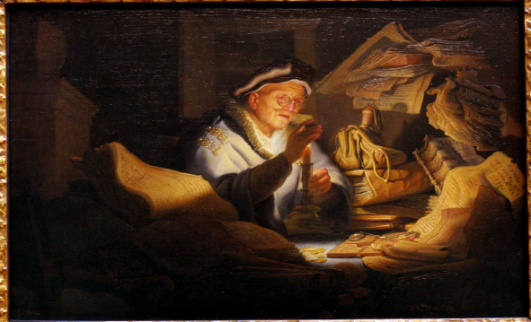
Preparation Is Essential
“And I will say to my soul, ‘Soul, you have many goods laid up for many years; take your ease; eat, drink, and be merry.’ But God said to him, 'Fool! This night your soul will be required of you; then whose will those things be which you have provided?’”
{Luke 12:19,20}
Notes:
Preparation Is Essential. (Luke 12:15-20) The Parable of the Rich Young Fool…Discuss

Slide 7
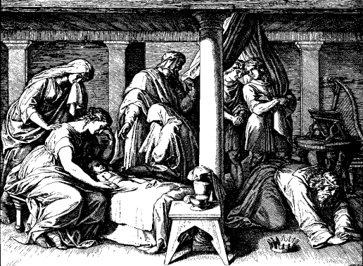
Preparation Is Essential
“And he said, While the child was alive, I fasted and wept; for I said, Who can tell whether the LORD will be gracious to me, that the child may live? But now he is dead; why should I fast? Can I bring him back again? I shall go to him, but he shall not return to me.”
{2 Samuel 12:22,23}
Notes:
Preparation Is Essential. (2 Samuel 12:22,23) Account of David and Bathsheba’s child’s death and David accepting God’s answer to his petitions…Discuss

Slide 8
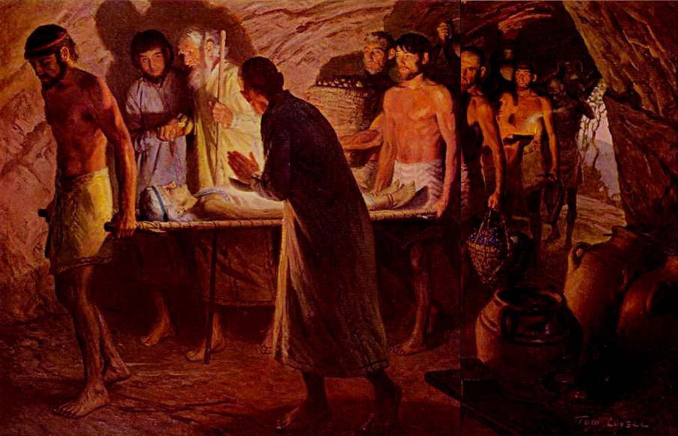
Death Is Untimely
“Sarah lived one hundred and twenty-seven years; these were the years of the life of Sarah. So Sarah died in Kirjath Arba (that is, Hebron) in the land of Canaan, and Abraham came to mourn for Sarah and to weep for her.“ {Genesis 23:1,2}
Notes:
Death is Untimely. (Genesis 23:1,2) Account of death of Sarah—Abraham’s wife. Buying the cave and burying her in the cave.

Slide 9
Death Is Untimely
“And the king was exceedingly sorry; yet, because of the oaths and because of those who sat with him, he did not want to refuse her. Immediately the king sent an executioner and commanded his head to be brought. And he went and beheaded him in prison, brought his head on a platter, and gave it to the girl; and the girl gave it to her mother.“ {Mark 6:26-28}
Notes:
Death Is Untimely. (Mark 6:26-28) Account of death of John the Baptist. Beheaded by Herod because of oath made during a moment of lust!

Slide 10
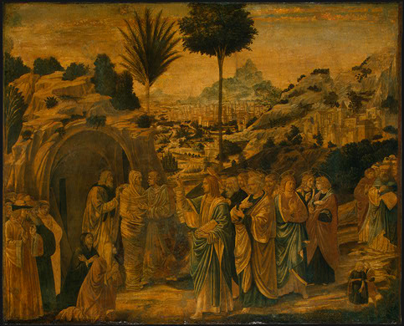
Death Is Untimely
“Therefore, when Jesus saw her weeping, and the Jews who came with her weeping, He groaned in the spirit and was troubled. And He said, ‘Where have you laid him?’ They said to Him, ‘Lord, come and see.’ Jesus wept.“ {John 11:33-35}
Notes:
Death Is Untimely. (John 11:33-35) Account of death of Lazarus. Jesus raised him from the dead—four days after his death!

Slide 11
Concluding Thoughts
Seeing the truth of these facts—what have you done to prepare?
Understanding the certainty of death can teach us some powerful lessons!
  “Better to go to the house of mourning than to go to the house of feasting, for that is the end of all men; and the living will take it to heart.” {Ecclesiastes 7:2}
Notes:
Concluding Thoughts... (Eccl.7:2) Summary—Invitation…

