Slide 1

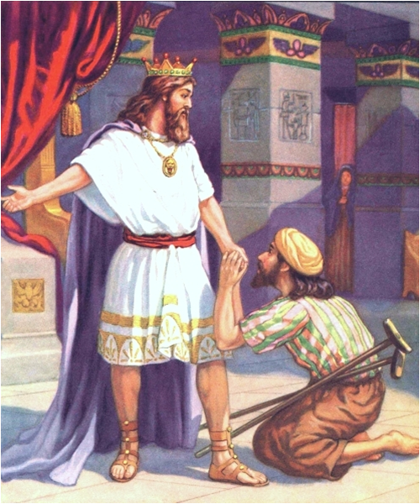
David
“served the purpose of God”
(Acts 13:36, NAS)

Slide 2
David Served the Purpose of God
David’s Job:
  Lead God’s People in Way of Righteousness
Our Job:
  Save Ourselves
  Lead Others to God
    2 Timothy 2:2
    “Christ has no hands but our hands”

Slide 3
David: a Man after God’s Own Heart
Man after God’s Heart – Acts 13:22
King Saul rejected – 1 Samuel 13:13-14
Attitude
  David wanted to please God
  Psalm 122:1
David was not perfect
  He repented of his sins
  King Saul - excuses, David - corrections

Slide 4
David Started Early in Life
Anointed by Samuel (1 Samuel 16:1-13)
God looks at the heart (v. 7)
Spirit of the Lord came upon him (v.13)
Prudent in speech (v. 18)

Slide 5
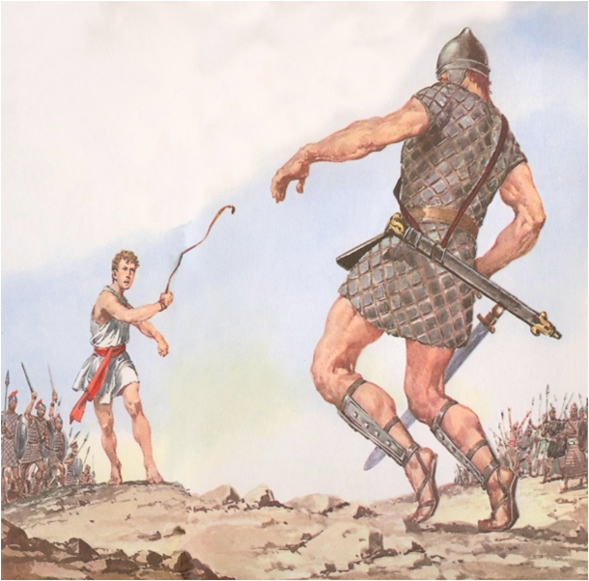
David and Goliath
1 Samuel 17
Goliath challenged Israel (v.8-10)
All were terrified (v. 11)
David was not afraid (v. 32)
David trusted in God (v. 45-47)
David was victorious because he trusted in God (v. 49-51)

Slide 6
David Behaved Wisely
David accepted by the people (1 Sam. 18:5)
Military Success (v. 6)
  Made King Saul angry (v. 8)
David behaved wisely (v. 14, 30)
David loved his people (1 Sam. 23)
David respected the Lord’s Anointed
  Wilderness of En Gedi (1 Sam. 24)
  Wilderness of Ziph (1 Sam. 26)

Slide 7
David Sinned
Adultery with Bathsheba (2 Sam. 11)
Murdered Uriah (v. 5)
Nathan confronted him (2 Sam. 12)
David repented (v. 13)
  2 Corinthians 7:10
  Psalm 51
  1 Corinthians 10:12
No sin is too terrible

Slide 8
David Led the People
Defeated their enemies
Kept out idolatry
Restored worship
Wrote many Psalms
Other kings were compared to him

Slide 9

Are You Serving
The Purpose of God

