Slide 1
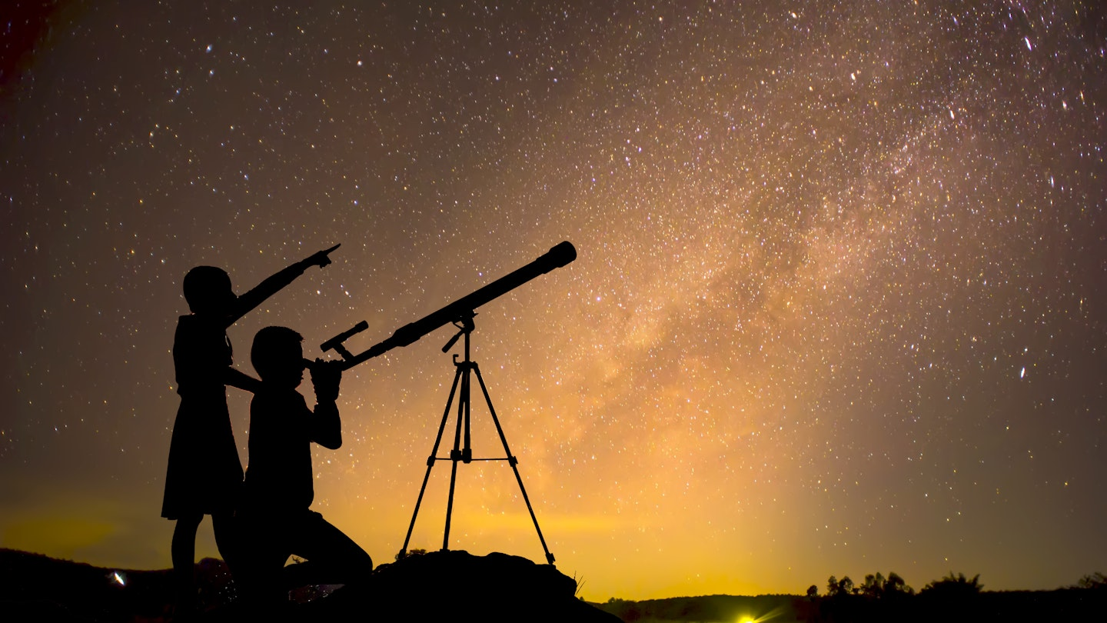
How God Reveals Himself to Us

Slide 2
1. Through Physical Creation
Because what may be known of God is manifest in them, for God has shown it to them.
For since the creation of the world His invisible attributes are clearly seen, being understood by the things that are made, even His eternal power and Godhead, so that they are without excuse.
Romans 1:19-20

Slide 3
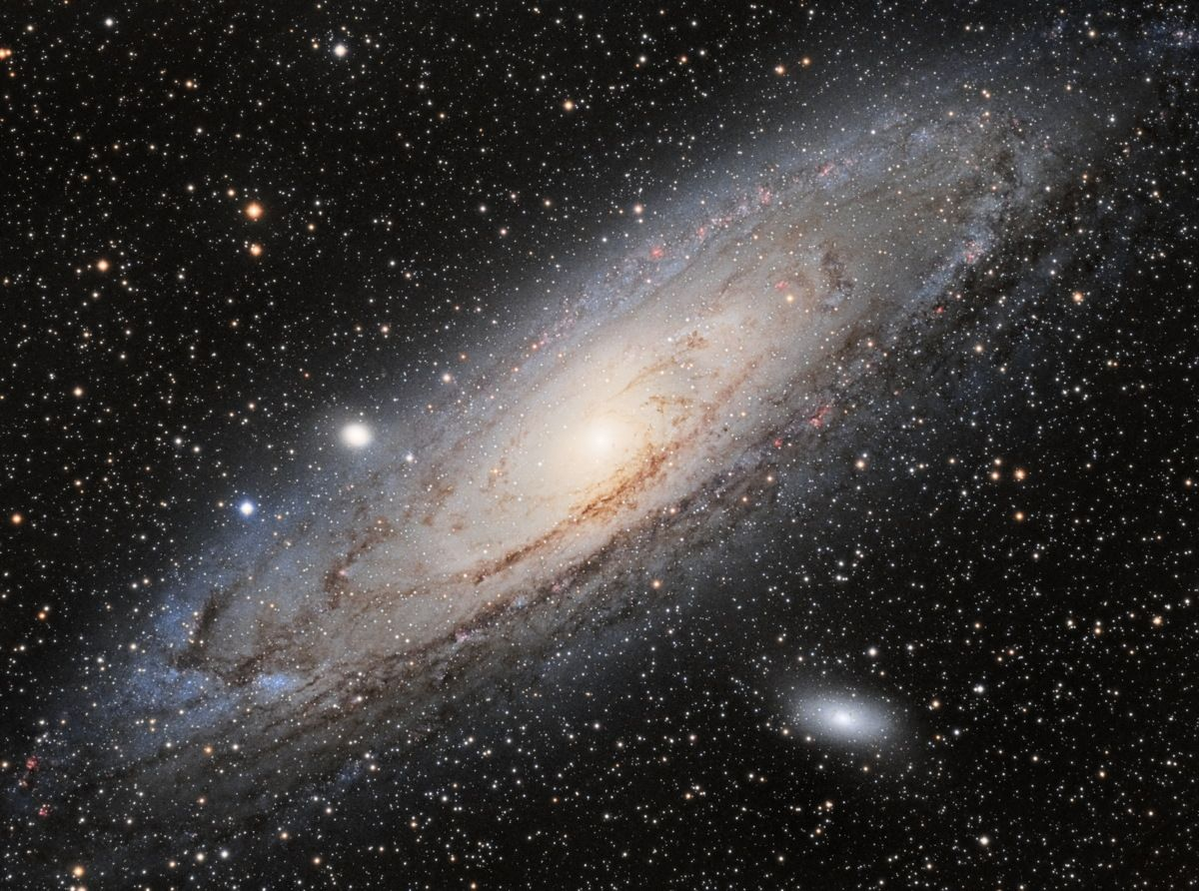

Slide 4
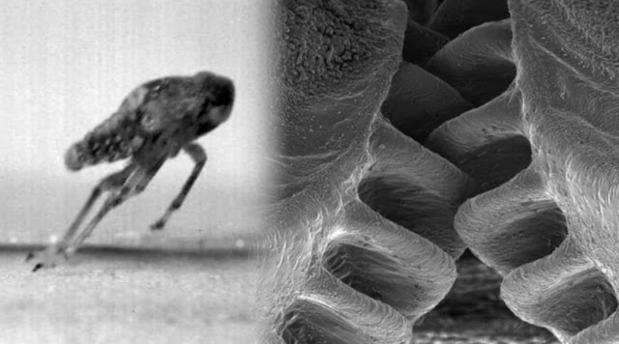
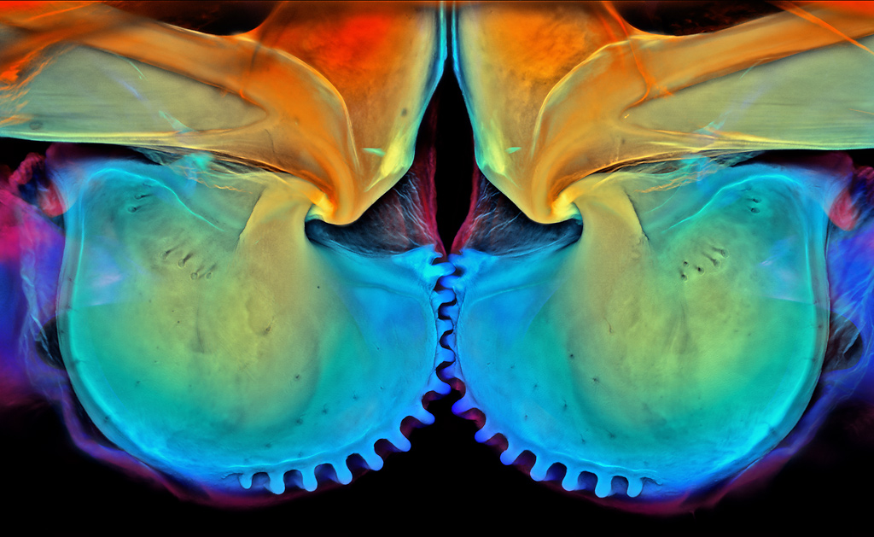
Gears of Juvenile Planthopper

Slide 5
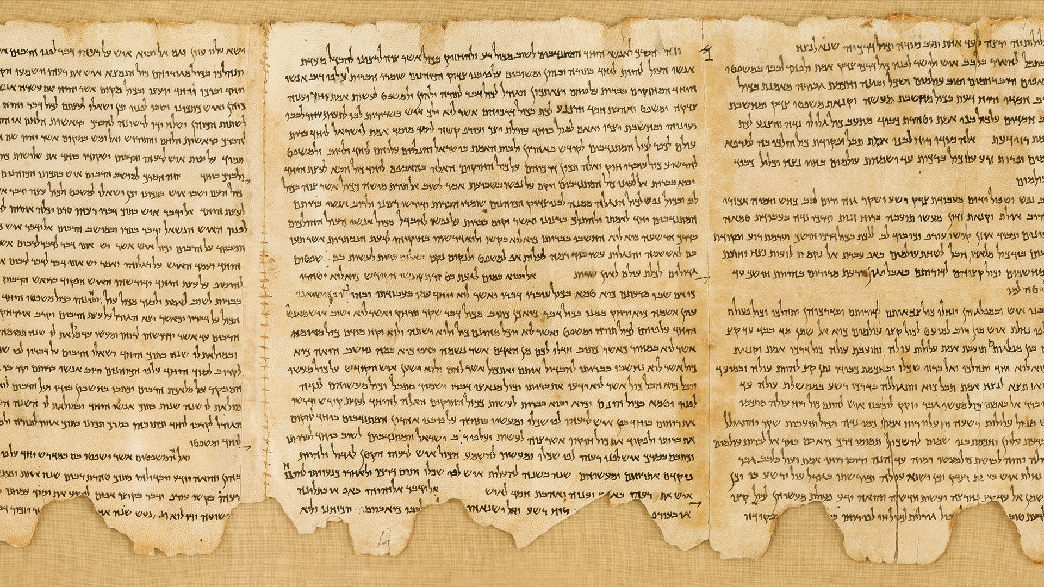
2. Through His Word

Slide 6
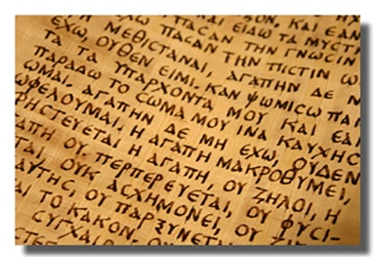
2. Through His Word
1 Corinthians 2:9-13
Genesis 2:16-17
Genesis 3:15
Hebrews 4:12
Psalm 119:162

Slide 7
3. Through His Son
Philip said to Him, “Lord, show us the Father, and it is sufficient for us.”
Jesus said to him, “Have I been with you so long, and yet you have not known Me, Philip? He who has seen Me has seen the Father; so how can you say, ‘Show us the Father?’”
John 14:8-9

Slide 8
3. Through His Son
In the beginning was the Word, and the Word was with God, and the Word was God...
And the Word became flesh and dwelt among us, and we beheld His glory, the glory as of the only begotten of the Father, full of grace and truth.
John 1:1, 14

Slide 9
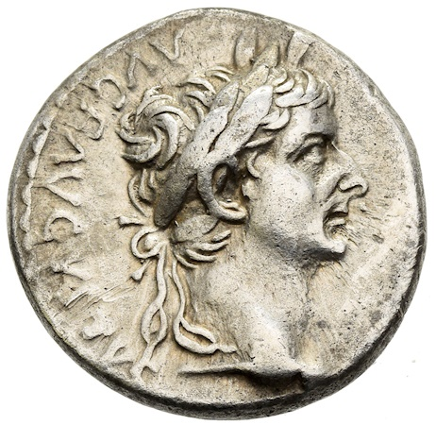
3. Through His Son
He is the image of the invisible God, the firstborn over all creation.
Colossians 1:15
And He said to them, “Whose image and inscription is this?”
Matthew 22:20

Slide 10
God Reveals Himself to Us
Through His Creation
Through His Word
Through His Son

