Slide 2
Here I am LORD, Send ME!
The Attitude:
Isaiah 6:8
8 Also I heard the voice of the Lord, saying:
“Whom shall I send,
And who will go for Us?”
Then I said, “Here am I! Send me.”

Slide 3
The Attitude:
Mark 10:15: Assuredly, I say to you, whoever does not receive the kingdom of God as a little child will by no means enter it.” 16And He took them up in His arms, laid His hands on them, and blessed them.

Slide 4
The Attitude:
John 9:4, John 17:4, 1 Cor 15:58,
2 Cor 9:8, Gal 6:4, Eph 4:12,
Col 1:10, 2 Thes 3:10,
James 1:25 25 But he who looks into the perfect law of liberty and continues in it, and is not a forgetful hearer but a doer of the work, this one will be blessed in what he does.

Slide 5
The Work:
John 4:34-38 Jesus said to them, “My food is to do the will of Him who sent Me, and to finish His work. 35Do you not say, ‘There are still four months and then comes the harvest’? Behold, I say to you, lift up your eyes and look at the fields, for they are already white for harvest! 36And he who reaps receives wages, and gathers fruit for eternal life, that both he who sows and he who reaps may rejoice together. 37For in this the saying is true: ‘One sows and another reaps.’ 38I sent you to reap that for which you have not labored; others have labored, and you have entered into their labors.
We have the responsibility to take the Gospel to others

Slide 6
Who Is To Teach?
The passages we sited before about working, 1 Cor 15:58, 2 Cor 9:8, Gal 6:4, Eph 4:12, Col 1:10 and Rev 22:12 very clearly put the responsibility upon each and everyone of us to be about this work of spreading the Gospel.
The fields white for harvest represents the people in the world who need to be brought to the Father by the Gospel.
“Here I am Lord, send me”.

Slide 7
The example:
Acts 8:4. Scattered abroad by persecution, the disciples " went everywhere preaching the word."
I Thes 1:1:
Paul is praising them here. And here’s why,
For our gospel did not come to you in word only, but also in power, and in the Holy Spirit and in much assurance, as you know what kind of men we were among you for your sake.
6And you became followers of us and of the Lord, having received the word in much affliction, with joy of the Holy Spirit,

Slide 8
The example:
1 Thes 1:7 so that you became examples to all in Macedonia and Achaia who believe.
8 For from you the word of the Lord has sounded forth, not only in Macedonia and Achaia, but also in every place. Your faith toward God has gone out, so that we do not
1 Thes 2:13 For this reason we also thank God without ceasing, because when you received the word of God which you heard from us, you welcomed it not as the word of men, but as it is in truth, the word of God, which also effectively works in you who believe.

Slide 9
Heaven’s Invitation:
Hear the Gospel Romans 10:17
Believe Jesus is the Christ Acts 16:31
Repent of Your Sins Luke 13:3
Confess Jesus as Lord Matt. 10:32
Be Baptized Mark 16:16, Acts 2:38,
1Peter 3:21
Faithfully Serve Jesus Revelation 2:10

Slide 11
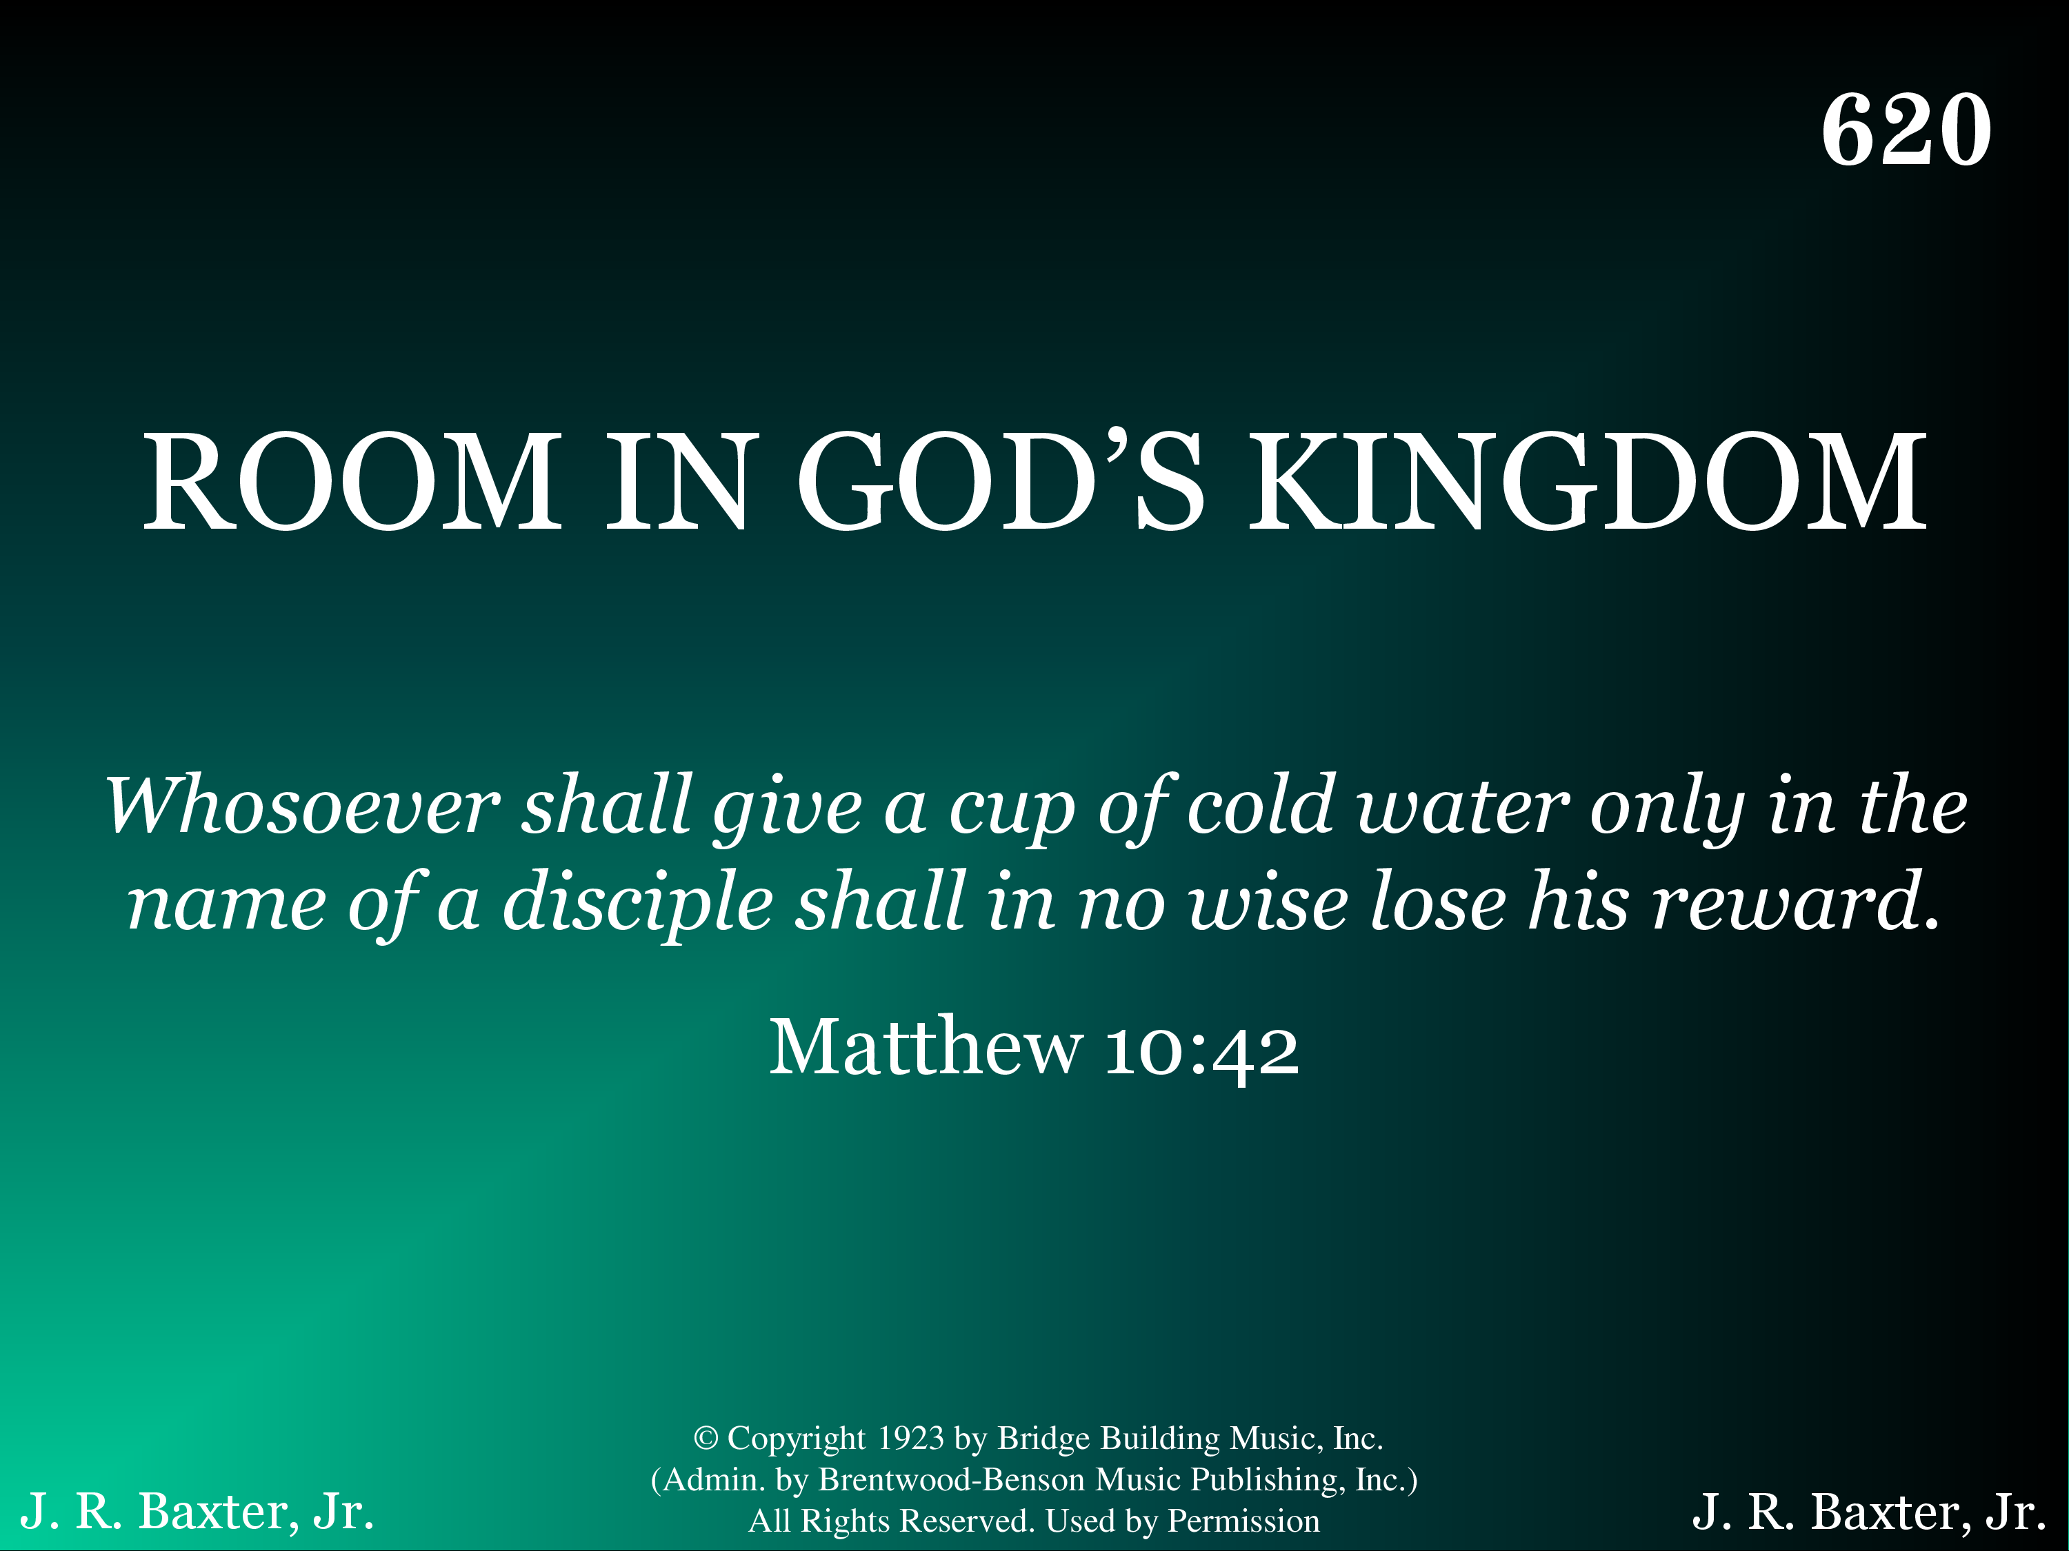
620 - Room In God's Kingdom - Title

Slide 12
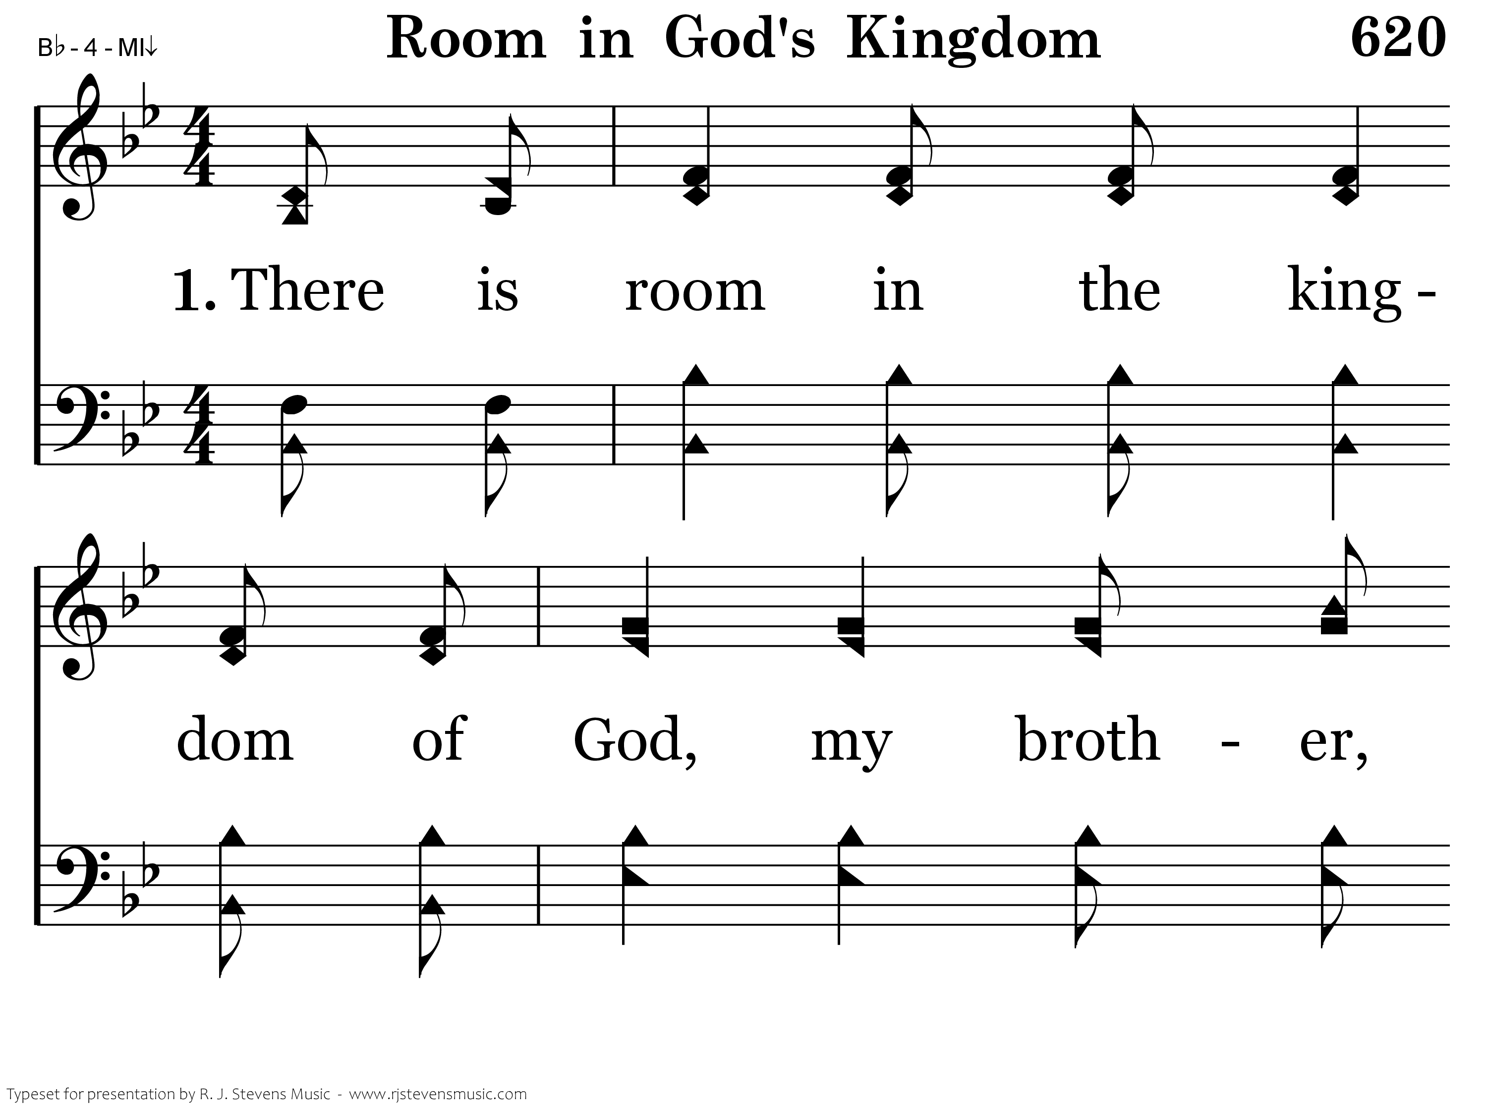
620 - Room In God's Kingdom - 1.1

Slide 13
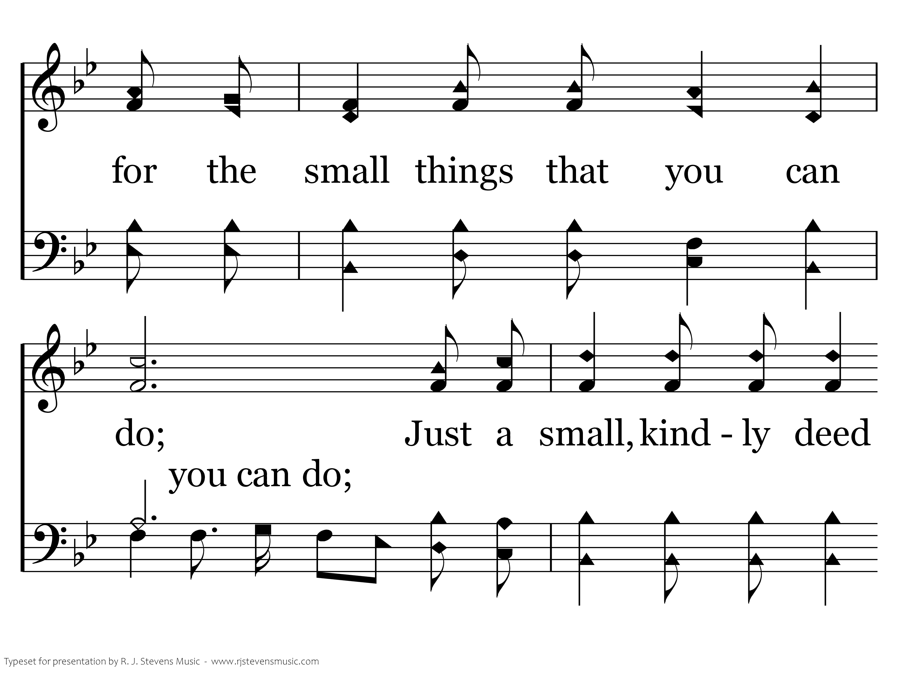
620 - Room In God's Kingdom - 1.2

Slide 14
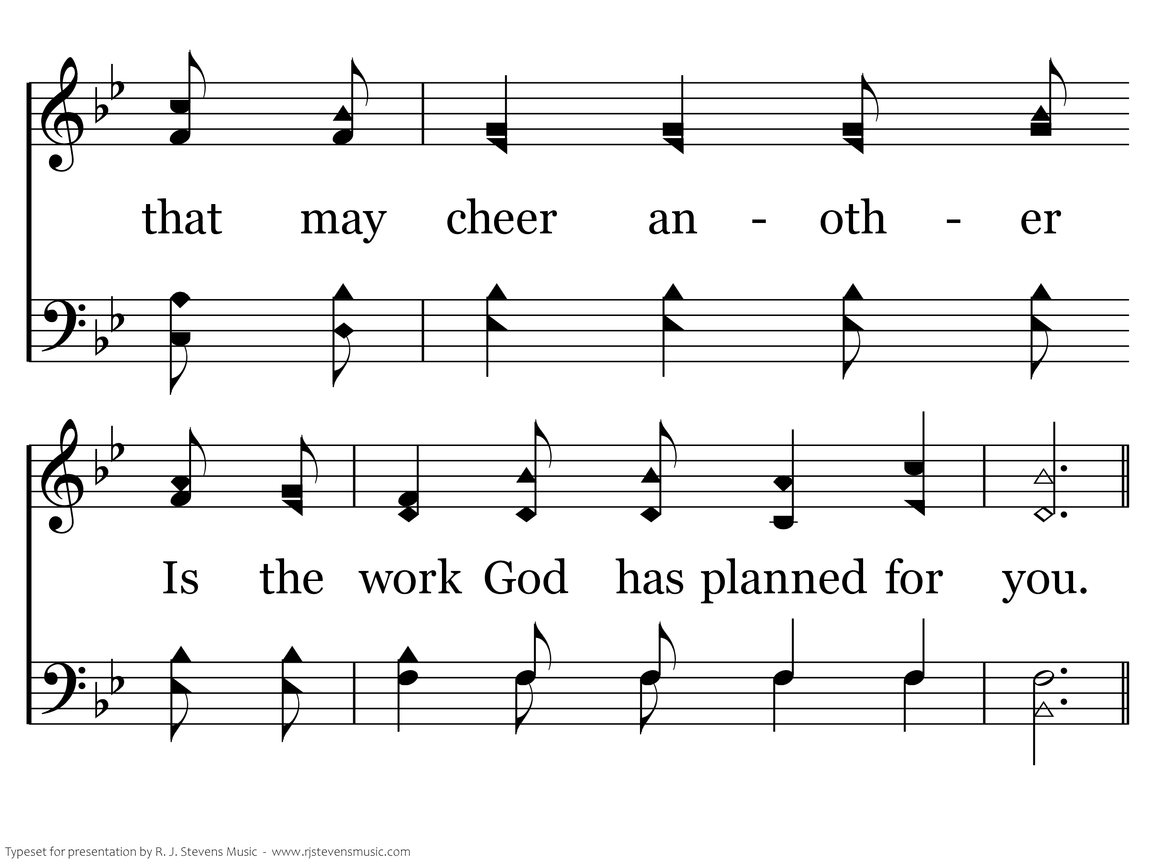
620 - Room In God's Kingdom - 1.3

Slide 15
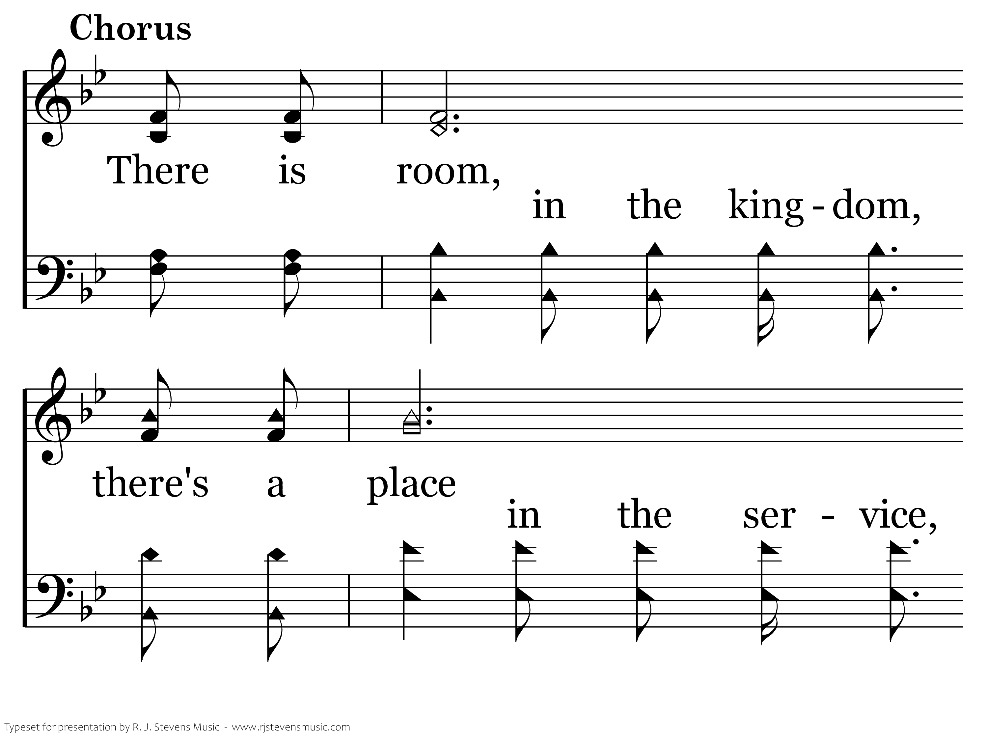
620 - Room In God's Kingdom - C.1

Slide 16
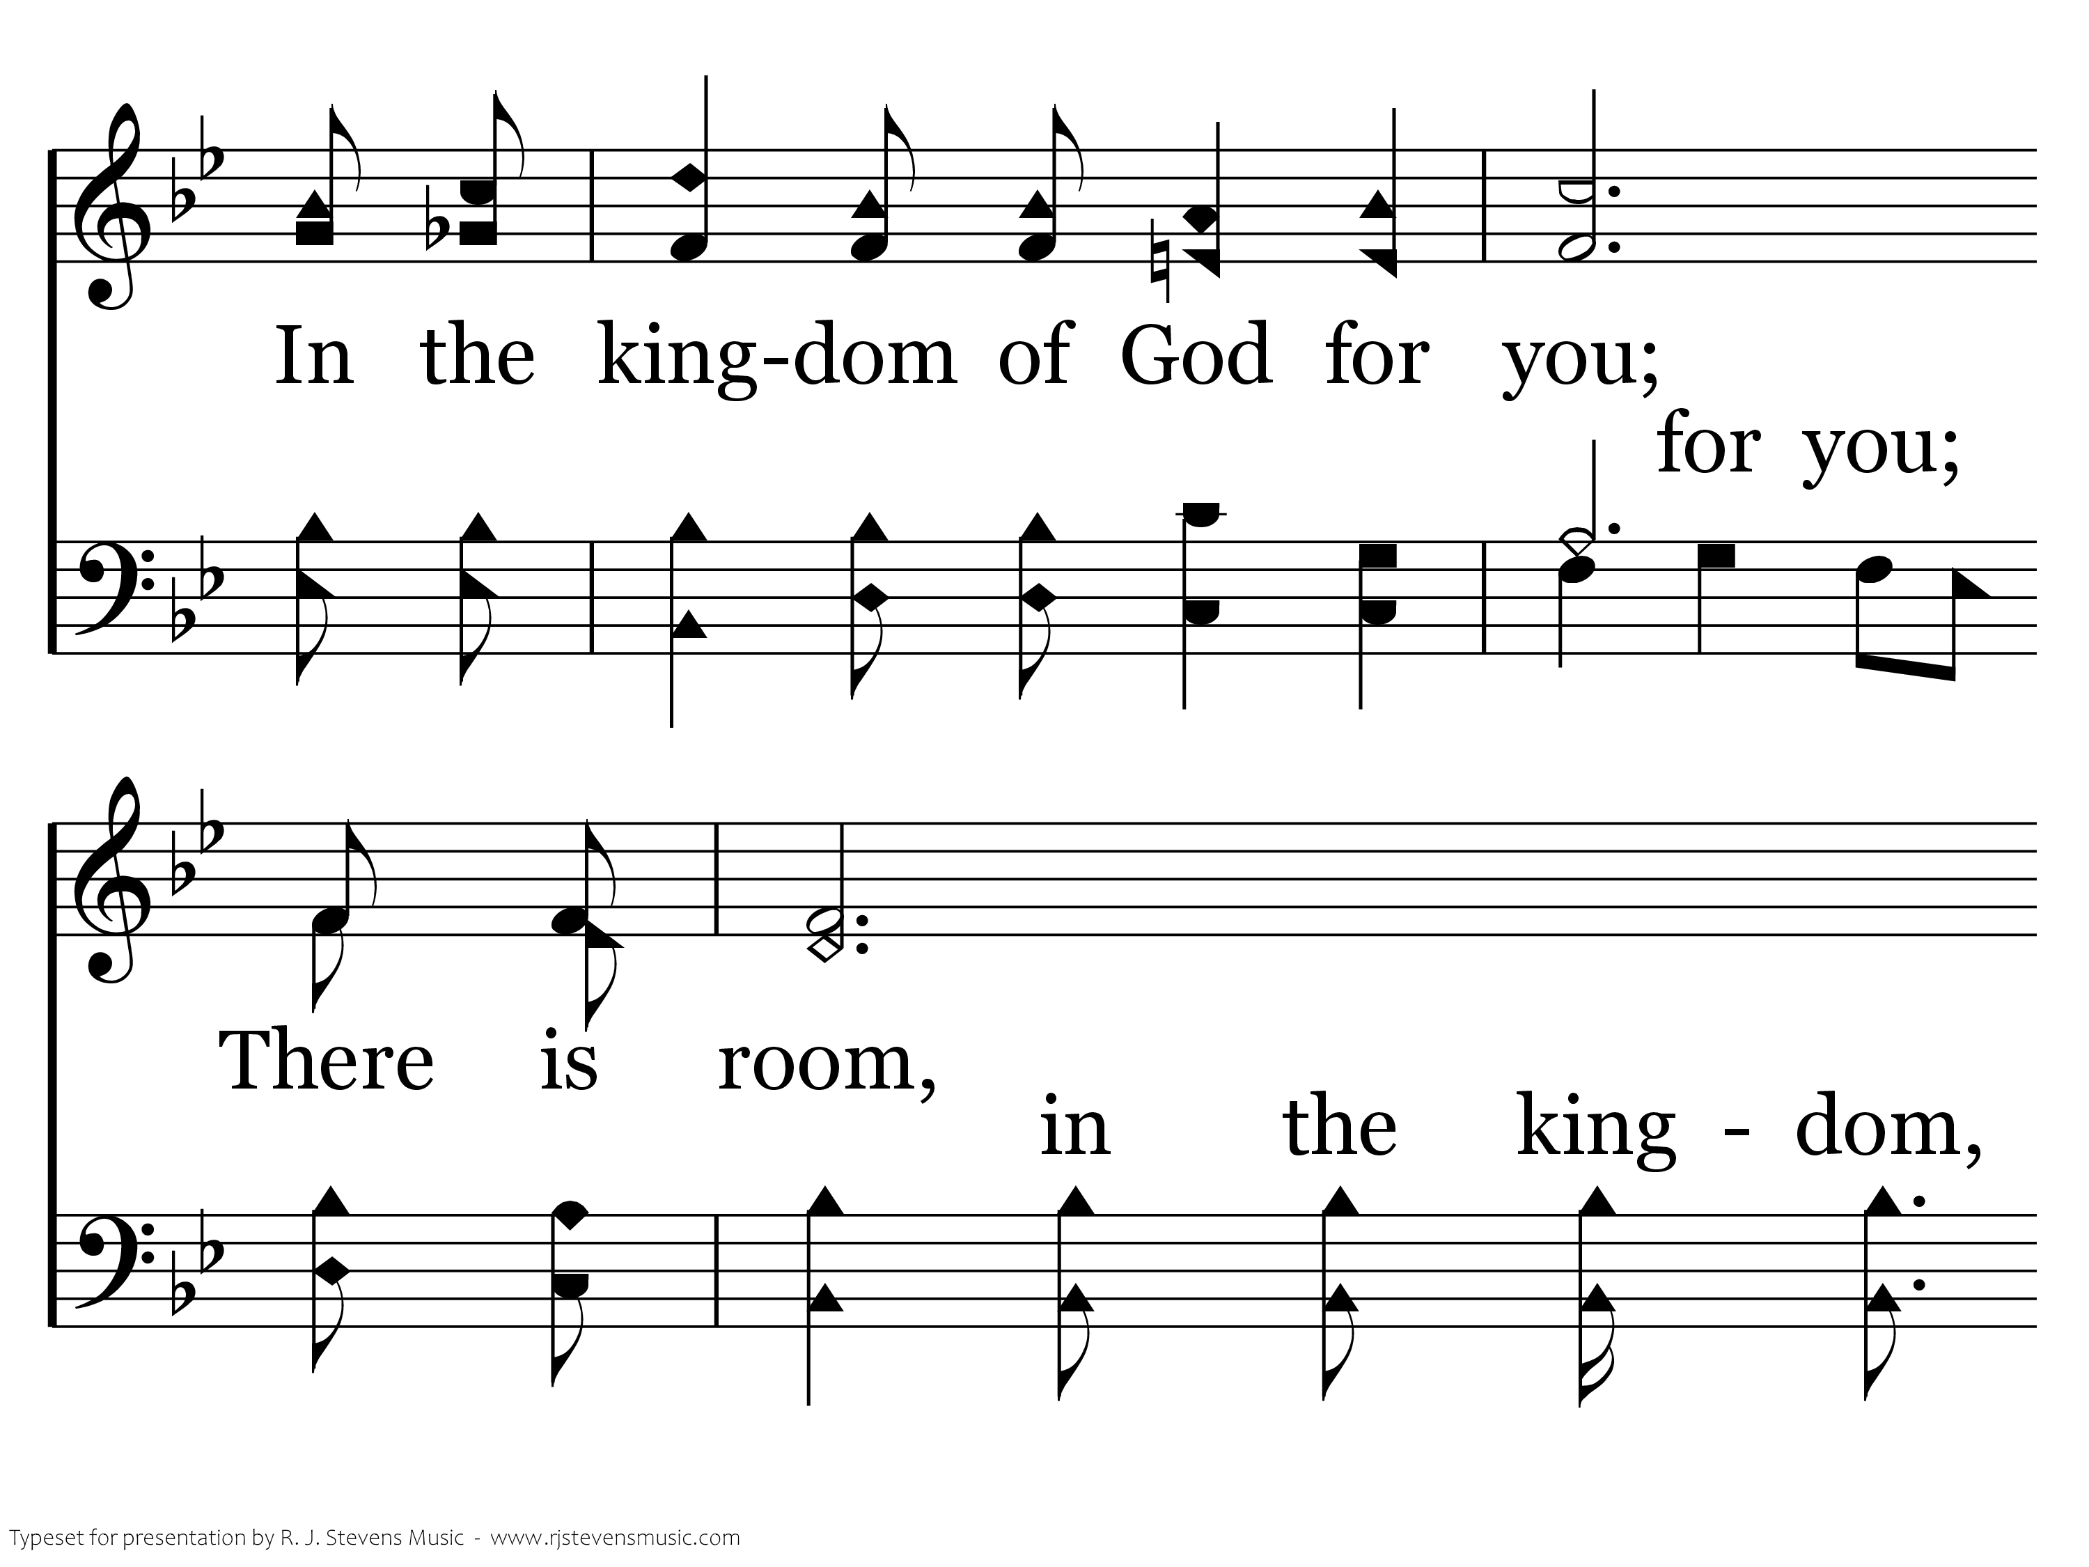
620 - Room In God's Kingdom - C.2

Slide 17
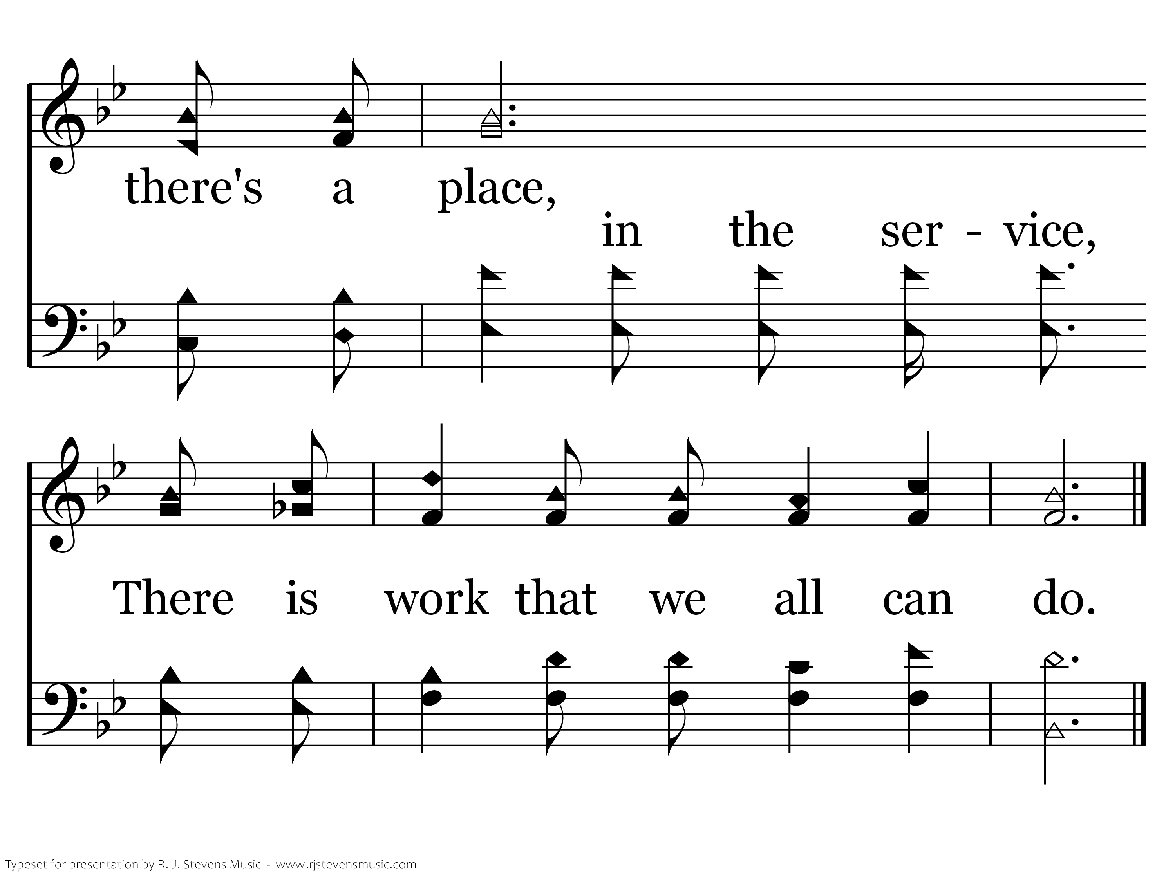
620 - Room In God's Kingdom - C.3
End of Verse 1

Slide 18
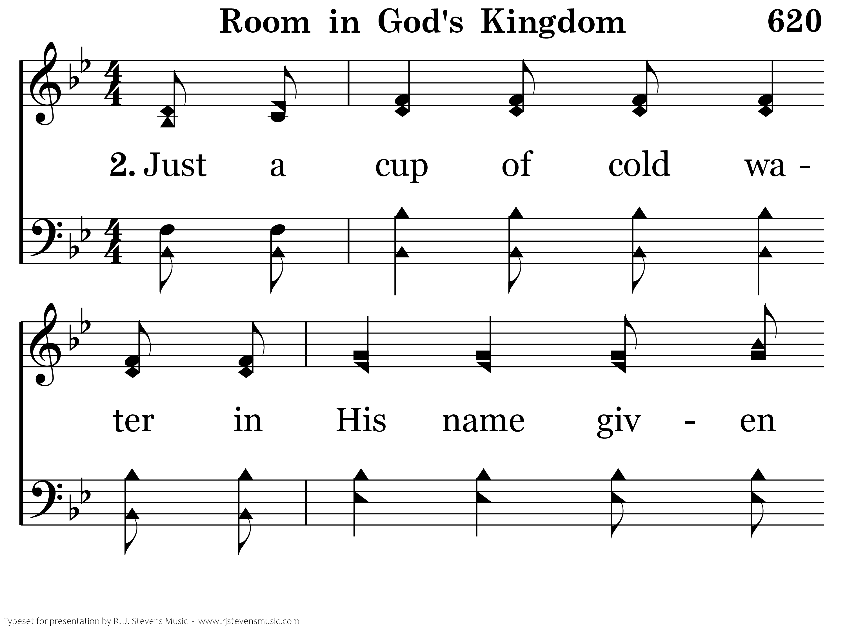
620 - Room In God's Kingdom - 2.1

Slide 19
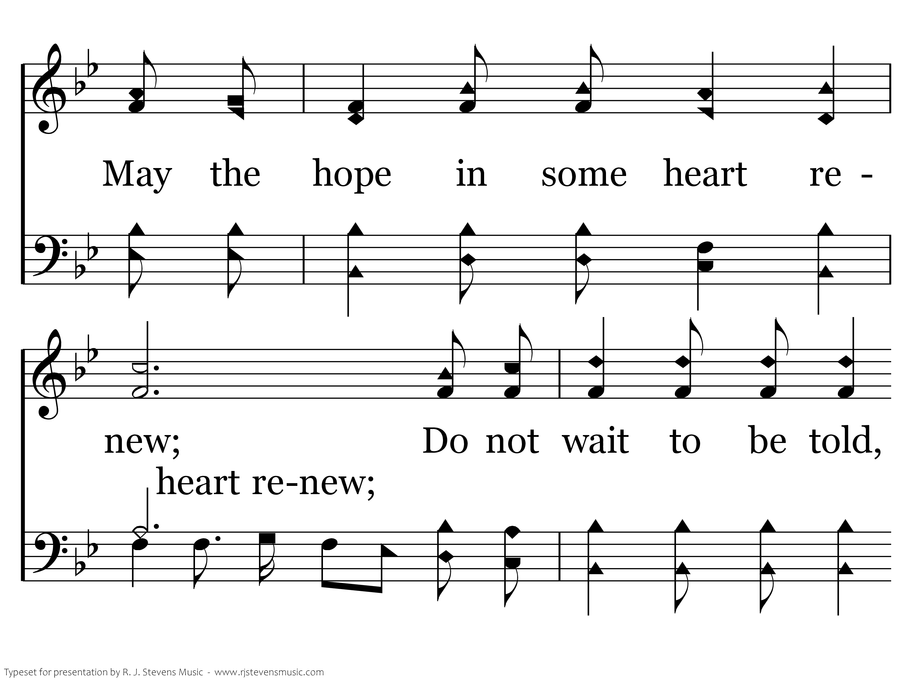
620 - Room In God's Kingdom - 2.2

Slide 20
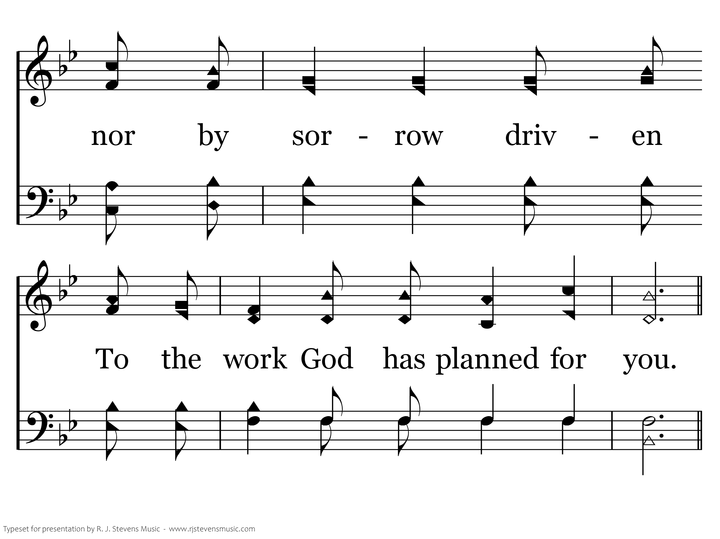
620 - Room In God's Kingdom - 2.3

Slide 21
620 - Room In God's Kingdom - C.1

Slide 22
620 - Room In God's Kingdom - C.2

Slide 23
620 - Room In God's Kingdom - C.3
End of Verse 2

Slide 24
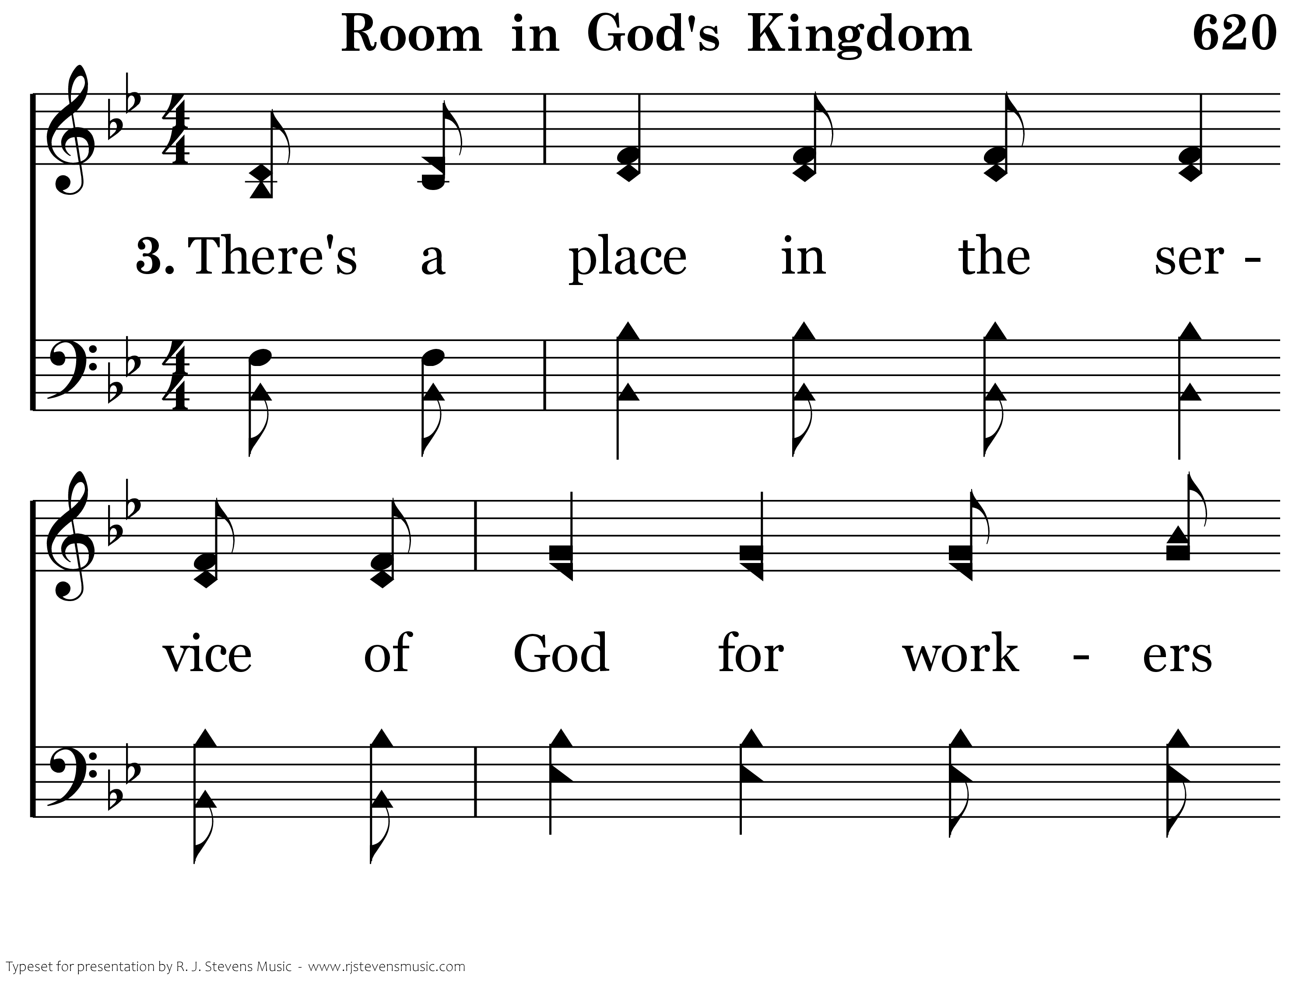
620 - Room In God's Kingdom - 3.1

Slide 25
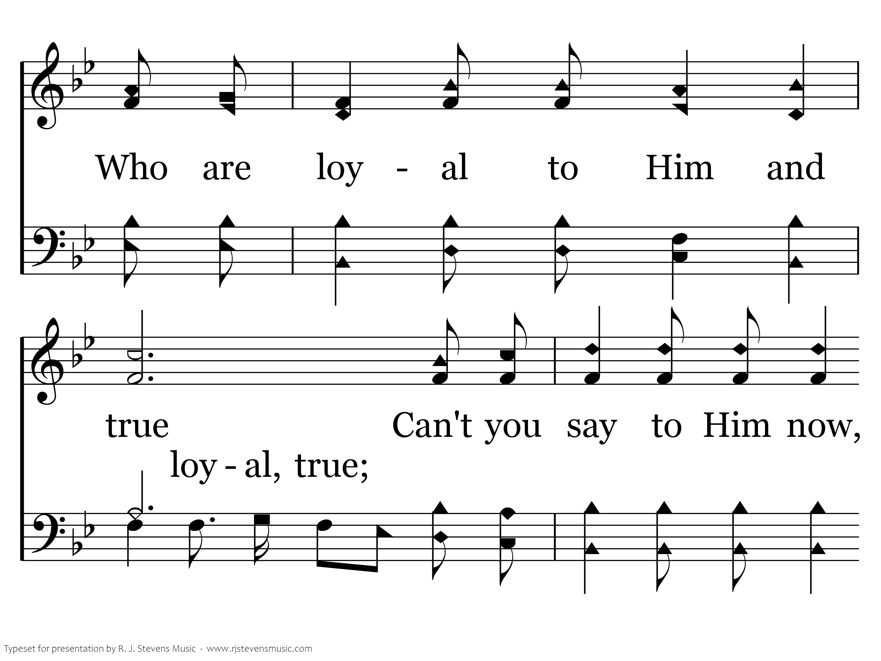
620 - Room In God's Kingdom - 3.2

Slide 26
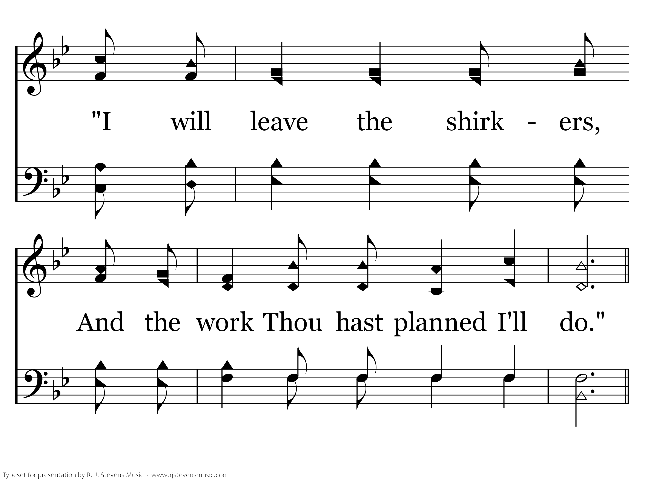
620 - Room In God's Kingdom - 3.3

Slide 27
620 - Room In God's Kingdom - C.1

Slide 28
620 - Room In God's Kingdom - C.2

Slide 29
620 - Room In God's Kingdom - C.3
End of Song

