Slide 2
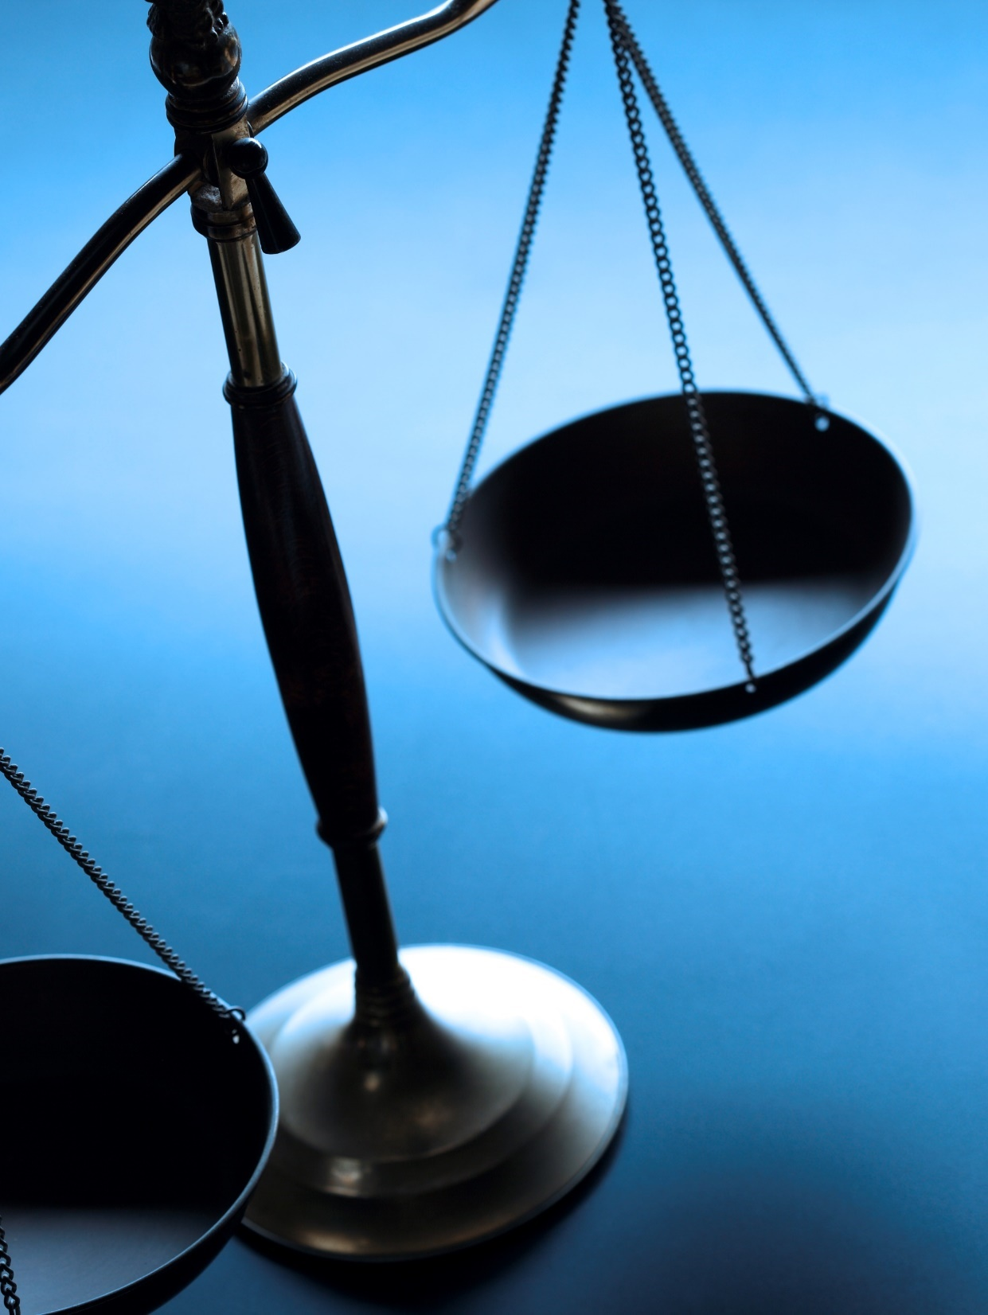
Justice

Slide 3
Etymology and Definitions
Etymology
Latin – iustitia – fairness, equity, also personified, (of reasons) validity, adequacy
Definitions
Maintenance of what is just or right by the exercise of authority or power
Assignment of deserved reward or punishment

Slide 4
Different Kinds of Justice
Man’s Justice
Matthew 14:1-12
1 Corinthians 6:1-11
God’s Justice Without Grace
Numbers 14:11-12
Numbers 21:4-6
God’s Justice With Grace
Numbers 14:13-25
Numbers 21:7-9

