Slide 2
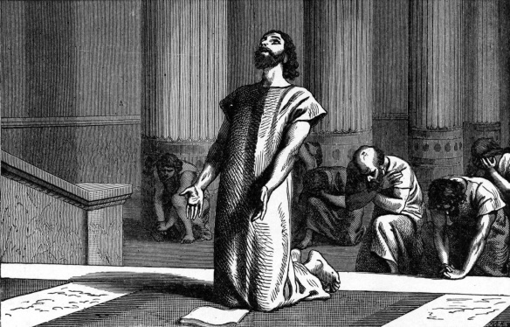
Hezekiah’s Prayer
2 Kings 18-19

Slide 3
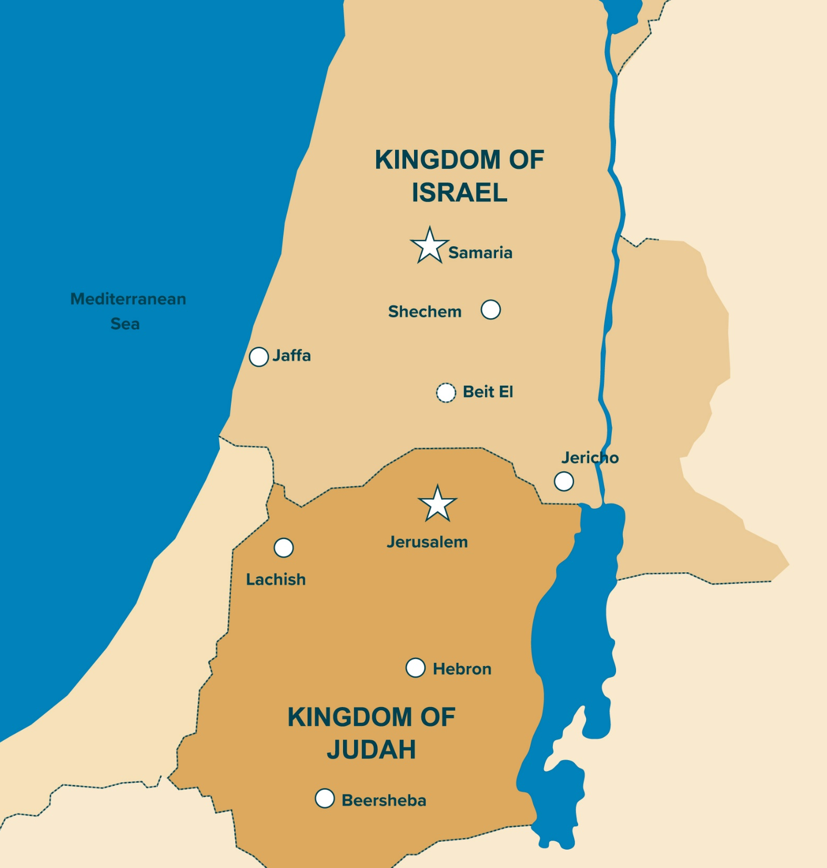
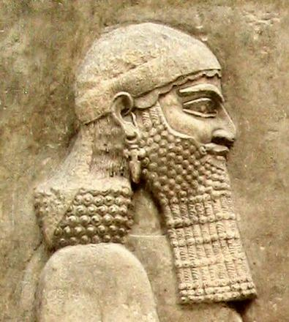
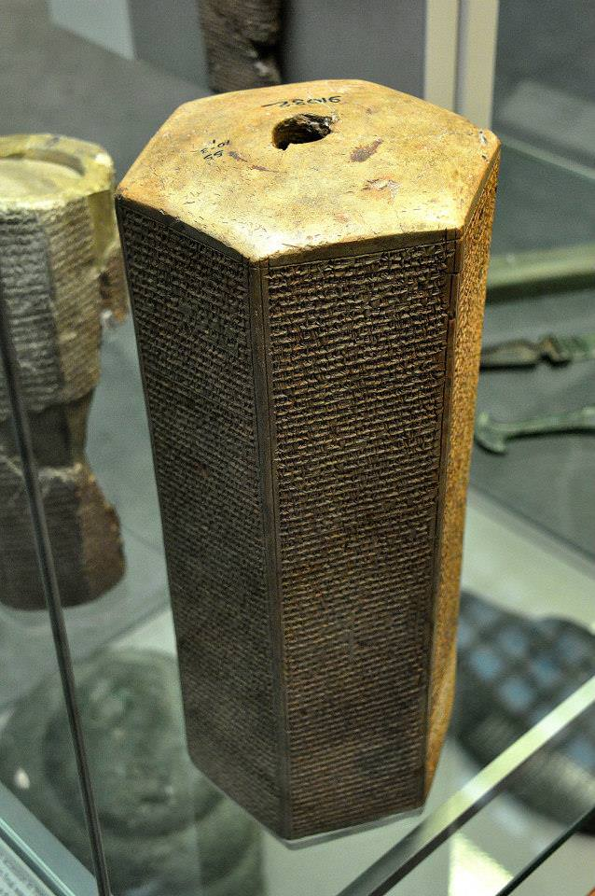

Slide 4
Sennacherib Challenged Their Trust
“Thus says the great king, the king of Assyria: ‘What confidence is this in which you trust?’” 2 Kings 18:19
Their military power (v. 20)
An alliance with Egypt (v. 21)
Their God (v. 22, 30-32)

Slide 5
God’s Reply
And Isaiah said to them, ‘Thus you shall say to your master, ‘Thus says the Lord: “Do not be afraid of the words which you have heard, with which the servants of the king of Assyria have blasphemed Me.
Surely I will send a spirit upon him, and he shall hear a rumor and return to his own land; and I will cause him to fall by the sword in his own land.”’”
2 Kings 19:6-7

Slide 6
Sennacherib’s Letter
Do not let your God in whom you trust deceive you, saying, “Jerusalem shall not be given into the hand of the king of Assyria.”
Look! You have heard what the kings of Assyria have done to all lands by utterly destroying them; and shall you be delivered?”
2 Kings 19:10-11

Slide 7
1. He Started Out Close to God
2 Kings 18:3-7
Hezekiah did not wait until trouble came to draw close to God.
He trusted in the Lord… held fast to the Lord… kept His commandments
God was not a stranger to Hezekiah when a crisis came in his life.

Slide 8
2. He Went to the House of God
2 Kings 19:14
We need to go to God
Ps. 18:2; 122:1; Heb. 4:14-16
We need to go to God’s people
Heb. 3:12-13; 10:24-25

Slide 9
3. He “Spread” Out His Trouble Before God
2 Kings 19:14
God asks us to cast our cares upon Him
1 Peter 5:7; Ps. 55:22
We do this through prayer
Phil. 4:6-7

Slide 10
4. He Prayed
2 Kings 19:15-19
Belief in God’s majesty and power - v. 15
Trust and confidence in God - v. 16
Belief in God’s superiority - vs. 17-18
Desire for God to defend His honor - v. 19

