Slide 2
Finding Ourselves in the Psalms
Psalm 90
A Prayer of Moses

Slide 3
The Contrast of Psalm 90
God
man
Eternal
Sovereign
Holy
Mortal
Dependent
Sinful

Slide 4
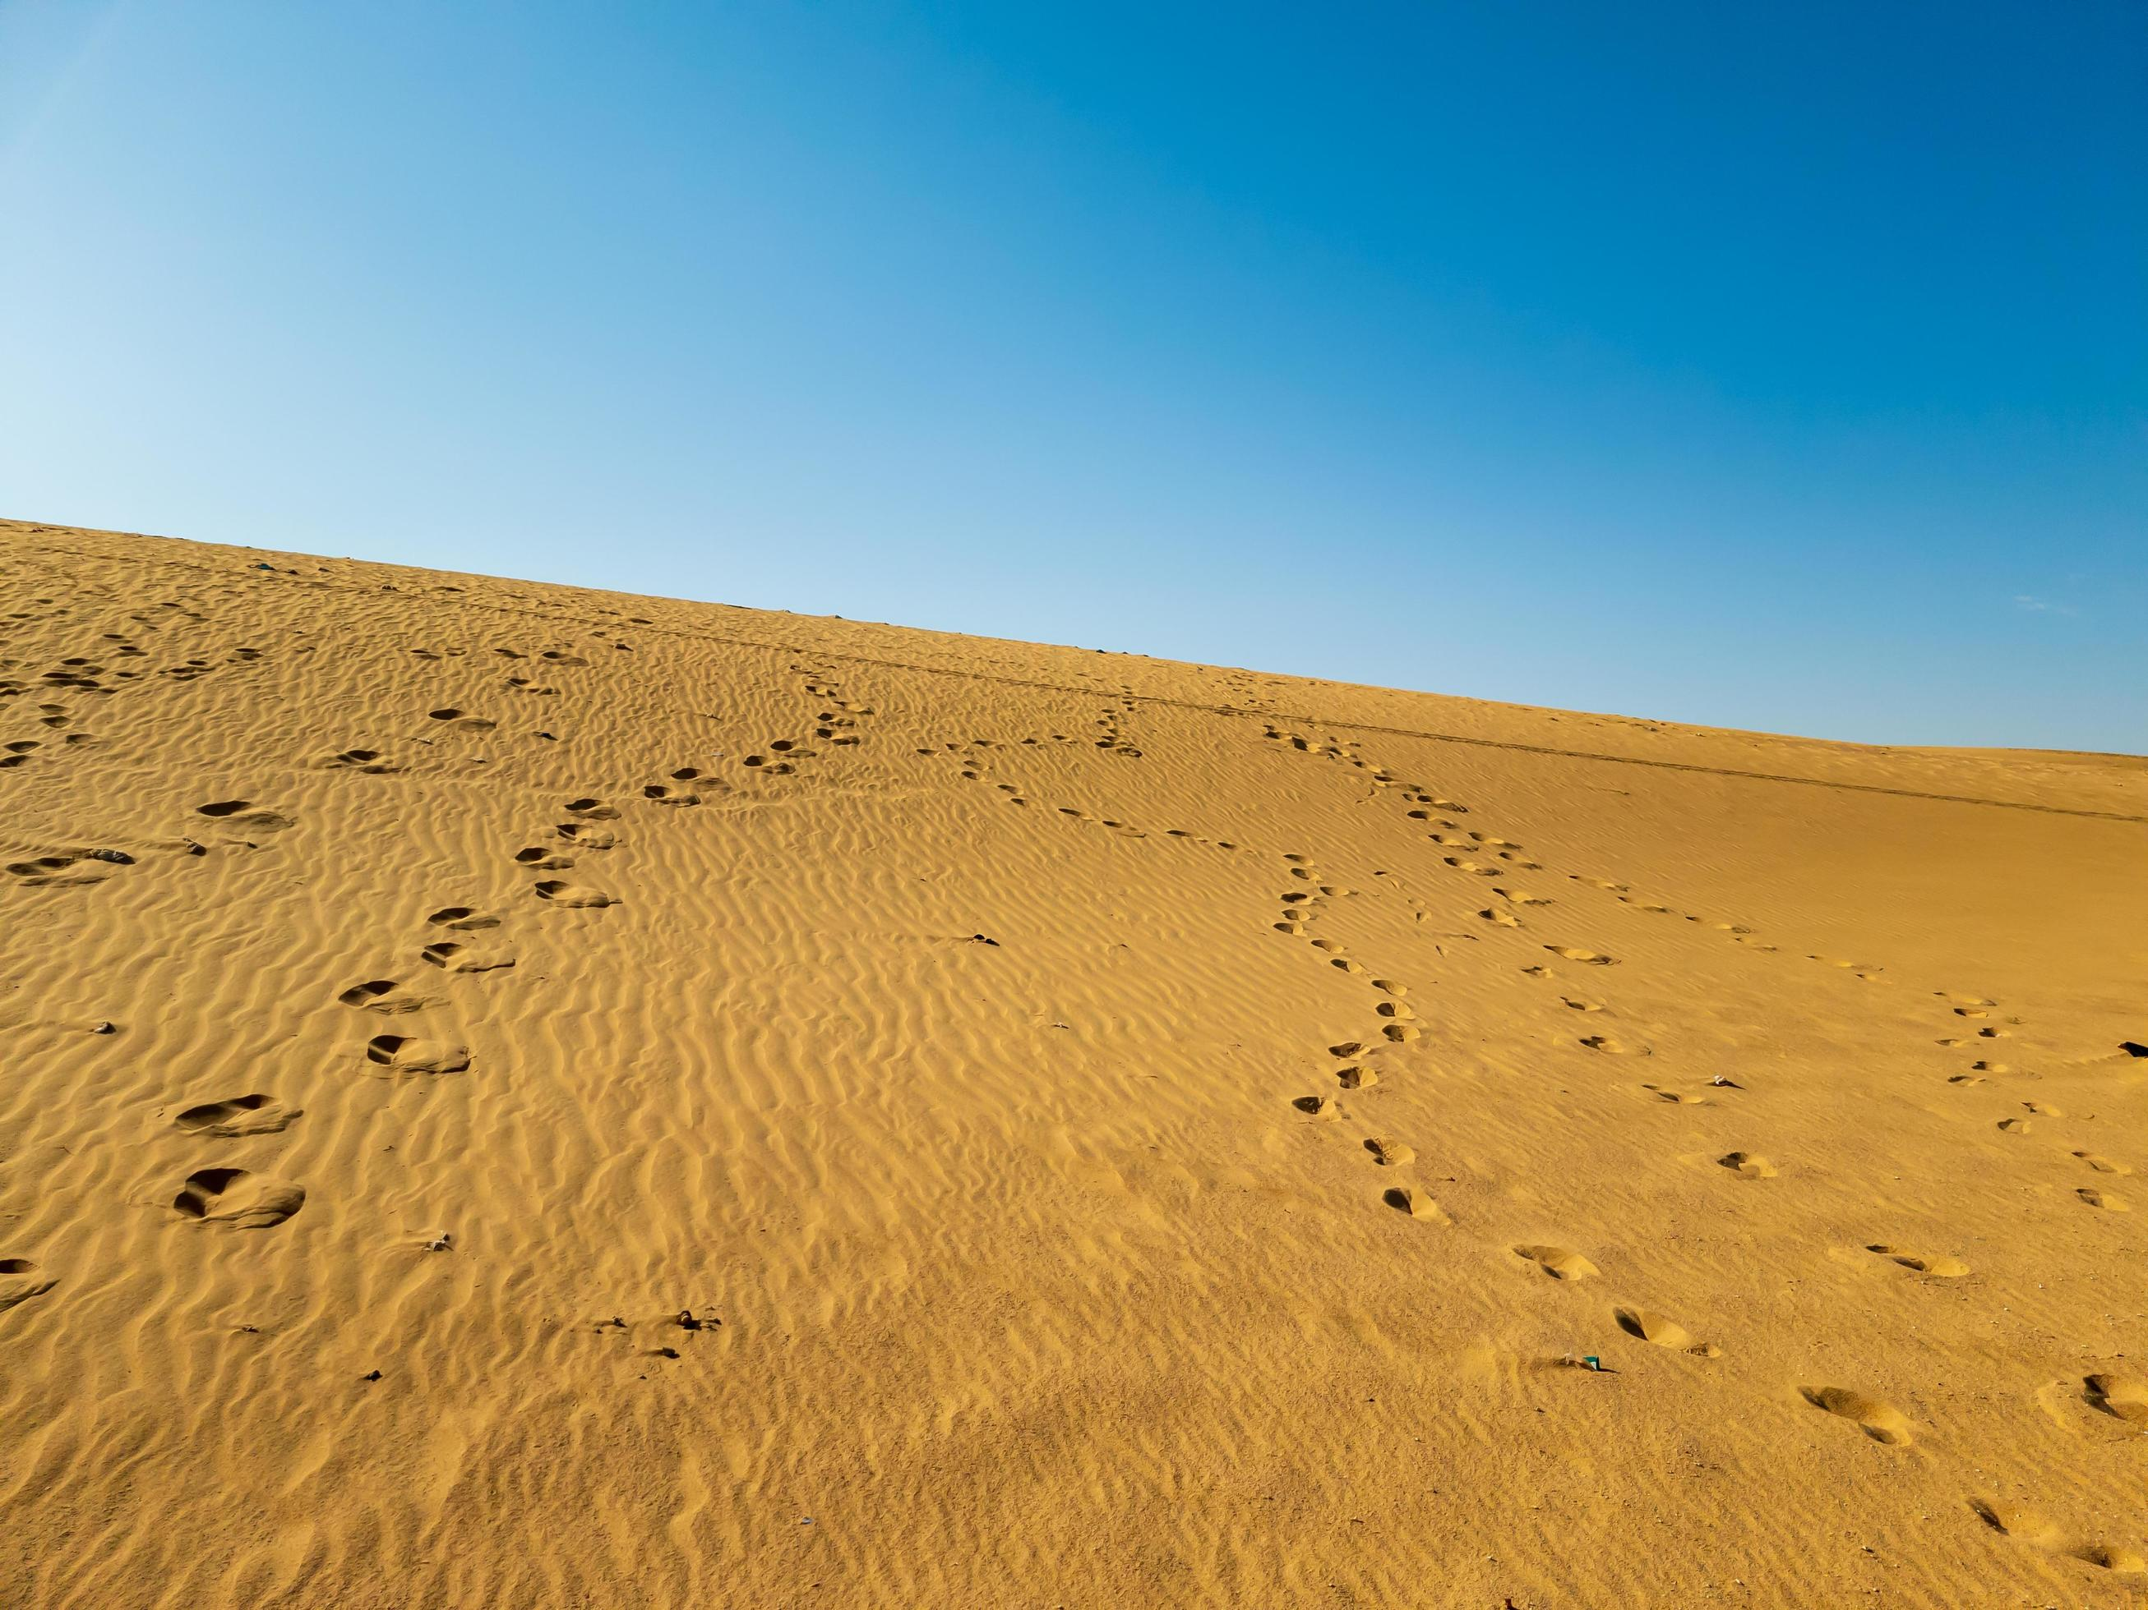
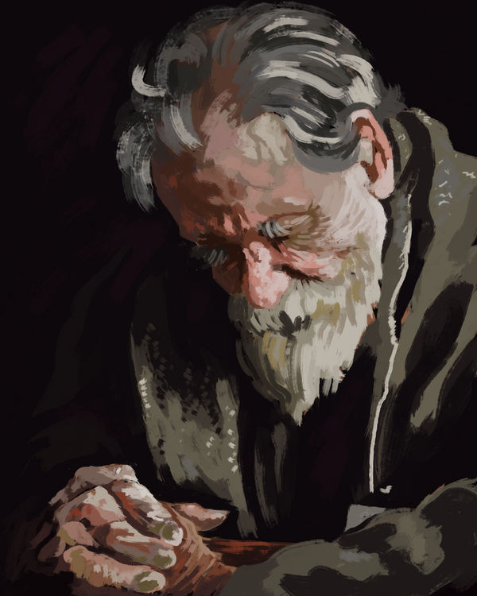
Perhaps this prayer was offered towards the end of the 40 years of wilderness wandering.

Slide 5
God is Our Dwelling Place
Lord, You have been our dwelling place in all generations.
Before the mountains were brought forth, or ever You had formed the earth and the world, even from everlasting to everlasting, You are God.

Slide 6
Our Frailty
You turn man to destruction, and say, “Return, O children of men.”
For a thousand years in Your sight are like yesterday when it is past, and like a watch in the night.

Slide 7
Our Frailty
You carry them away like a flood; they are like a sleep. In the morning they are like grass which grows up:
In the morning it flourishes and grows up; in the evening it is cut down and withers.

Slide 8
Our Frailty
For we have been consumed by Your anger, and by Your wrath we are terrified.
You have set our iniquities before You, our secret sins in the light of Your countenance.
For all our days have passed away in Your wrath; we finish our years like a sigh.

Slide 9
Our Frailty
For we have been consumed by Your anger, and by Your wrath we are terrified.
You have set our iniquities before You, our secret sins in the light of Your countenance.
For all our days have passed away in Your wrath; we finish our years like a sigh.

Slide 10
Our Frailty
The days of our lives are seventy years; and if by reason of strength they are eighty years, yet their boast is only labor and sorrow; for it is soon cut off, and we fly away.

Slide 11
Seeking God’s Wisdom and Favor

Slide 12
Seeking God’s Wisdom and Favor
Who knows the power of Your anger? For as the fear of You, so is Your wrath.
So teach us to number our days, that we may gain a heart of wisdom.

Slide 13
Seeking God’s Wisdom and Favor
Let Your work appear to Your servants, and Your glory to their children.
And let the beauty of the Lord our God be upon us, and establish the work of our hands for us; yes, establish the work of our hands.

Slide 14
Seeking God’s Wisdom and Favor
Let Your work appear to Your servants, and Your glory to their children.
And let the beauty of the Lord our God be upon us, and establish the work of our hands for us; yes, establish the work of our hands.

Slide 15
Psalm 90
God is eternal, sovereign, and will judge us for the way we spend our lives.
Man is mortal. Our lives are fragile and brief, and we will be judged by God.
Because of this, we must pray for a “heart of wisdom” that we may live appropriately.
Have you found yourself in this psalm?

