Slide 2
What the Bible says about

Slide 3
Hate Defined
A strong dislike.

Slide 4
Hate Defined
1. Malevolent Hatred
“to have a strong dislike or ill will for; loathe; despise” (Webster’s Dictionary).
Strong feeling of antagonism and dislike, generally malevolent and prompting to violence and injury.
The Bible strongly condemns this kind of hatred.

Slide 5
Hate Defined
2. Aversion Hatred
“to dislike or wish to avoid; shrink from” (Webster’s Dictionary).
A strong dislike of that which is disagreeable or offensive.
Repugnance or a right feeling of aversion from what is evil.
The Bible strongly commends this kind of hatred.

Slide 6
Hate Defined
3. Relative Hatred
Hate is sometimes used in the Bible as a hyperbole to express a strong preference for one over another.
“Jacob I have loved, but Esau I have hated” (Rom. 9:13; Malachi 1:2-3).
“hate his father and mother” (Luke 14:26).
“hate the one and love the other” (Matt. 6:24).

Slide 7
Malevolent Hatred

Slide 8
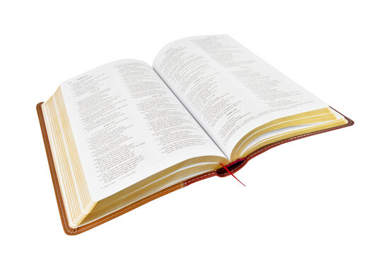
Malevolent Hatred
Love does no harm to a neighbor; therefore love is the fulfillment of the law.
Romans 13:10

Slide 9
Malevolent Hatred
For we ourselves were also once foolish, disobedient, deceived, serving various lusts and pleasures, living in malice and envy, hateful and hating one another.
Titus 3:3

Slide 10
Malevolent Hatred
Whoever hates his brother is a murderer, and you know that no murderer has eternal life abiding in him.
1 John 3:15

Slide 11
Malevolent Hatred
If he pushes him out of hatred or, while lying in wait, hurls something at him so that he dies,
or in enmity he strikes him with his hand so that he dies, the one who struck him shall surely be put to death. He is a murderer. The avenger of blood shall put the murderer to death when he meets him.
Numbers 35:20-21

Slide 12
Aversion Hatred

Slide 13
Aversion Hatred
You shall not worship the Lord your God in that way; for every abomination to the Lord which He hates they have done to their gods; for they burn even their sons and daughters in the fire to their gods.
Deuteronomy 12:31
God has this kind of hatred.

Slide 14
Aversion Hatred
But this you have, that you hate the deeds of the Nicolaitans, which I also hate.
Revelation 2:6
Jesus has this kind of hatred.

Slide 15
Aversion Hatred
You who love the Lord, hate evil! He preserves the souls of His saints; He delivers them out of the hand of the wicked.
Psalm 97:10

Slide 16
Aversion Hatred
The fear of the Lord is to hate evil; pride and arrogance and the evil way and the perverse mouth I hate.
Proverbs 8:13

Slide 17
Aversion Hatred
Let love be without hypocrisy. Abhor what is evil. Cling to what is good.
Romans 12:9

Slide 18
Aversion Hatred
I will set nothing wicked before my eyes; I hate the work of those who fall away; It shall not cling to me.
Psalm 101:3

Slide 19
Aversion Hatred
Through Your precepts I get understanding; Therefore I hate every false way.
Psalm 119:104

Slide 20
Aversion Hatred
I hate and abhor lying, but I love Your law.
Psalm 119:163

Slide 21
Aversion Hatred
But others save with fear, pulling them out of the fire, hating even the garment defiled by the flesh.
Jude 23

Slide 22
Aversion Hatred
The boastful shall not stand in Your sight; You hate all workers of iniquity.
You shall destroy those who speak falsehood; The Lord abhors the bloodthirsty and deceitful man.
Psalm 5:5-6

Slide 23
Aversion Hatred
The Lord tests the righteous, but the wicked and the one who loves violence His soul hates.
Psalm 11:5

Slide 24
Aversion Hatred
I have not sat with idolatrous mortals, Nor will I go in with hypocrites.
I have hated the assembly of evildoers, And will not sit with the wicked.
Psalm 26:4-5

Slide 25
Aversion Hatred
And Jehu the son of Hanani the seer went out to meet him, and said to King Jehoshaphat, “Should you help the wicked and love those who hate the Lord? Therefore the wrath of the Lord is upon you.”
2 Chronicles 19:2

Slide 26
Aversion Hatred
Do I not hate them, O Lord, who hate You? And do I not loathe those who rise up against You?
I hate them with perfect hatred; I count them my enemies.
Psalm 139:21-22

Slide 27
The Christian and Hate
We must have nothing to do with malevolent hate that results in ill will, violence, and eventually murder.
We must learn to detest and avoid those things and people that God hates.

