Slide 1
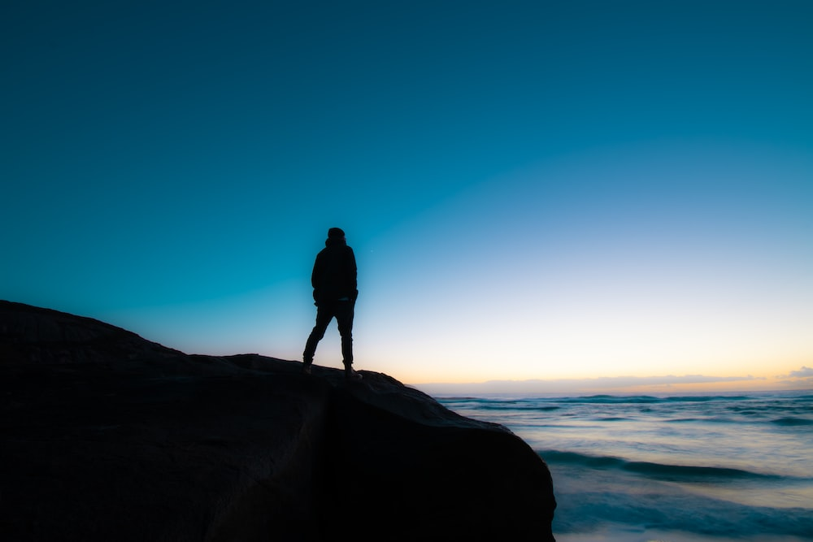
Finding Ourselves in the Psalms
Psalm 26
Living with Integrity

Slide 2
Integrity
“sincerity of purpose and single-heartedness of devotion”
Conduct from which no essential element is missing.
When one’s words and actions consistently match their profession.
From a Hebrew word describing anything that comes to a complete end.

Slide 3
Integrity
However, integrity does not imply sinlessness or perfection.
It describes one who is guilty of no wrong regarding the matter being discussed.

Slide 4
Vindicate me, O Lord, for I have walked in my integrity. I have also trusted in the Lord; I shall not slip.
Examine me, O Lord, and prove me; try my mind and my heart.
For Your lovingkindness is before my eyes, and I have walked in Your truth.

Slide 5
Vindicate me, O Lord, for I have walked in my integrity. I have also trusted in the Lord; I shall not slip.
Examine me, O Lord, and prove me; try my mind and my heart.
For Your lovingkindness is before my eyes, and I have walked in Your truth.

Slide 6
I have not sat with idolatrous mortals, nor will I go in with hypocrites.
I have hated the assembly of evildoers, and will not sit with the wicked.

Slide 7
I have not sat with idolatrous mortals, nor will I go in with hypocrites.
I have hated the assembly of evildoers, and will not sit with the wicked.

Slide 8
I will wash my hands in innocence; so I will go about Your altar, O Lord,
That I may proclaim with the voice of thanksgiving, and tell of all Your wondrous works.
Lord, I have loved the habitation of Your house, and the place where Your glory dwells.

Slide 9
I will wash my hands in innocence; so I will go about Your altar, O Lord,
That I may proclaim with the voice of thanksgiving, and tell of all Your wondrous works.
Lord, I have loved the habitation of Your house, and the place where Your glory dwells.

Slide 10
Do not gather my soul with sinners, nor my life with bloodthirsty men,
In whose hands is a sinister scheme, and whose right hand is full of bribes.

Slide 11
But as for me, I will walk in my integrity; redeem me and be merciful to me.
My foot stands in an even place; in the congregations I will bless the Lord.

Slide 12
Psalm 26
A person of integrity does not fear being examined.
Integrity is shown, in part, by the company that we refuse to keep.
Walking with integrity will keep us on safe footing and will cause us to stand with God’s people.
Have you found yourself in this psalm?

