Slide 2
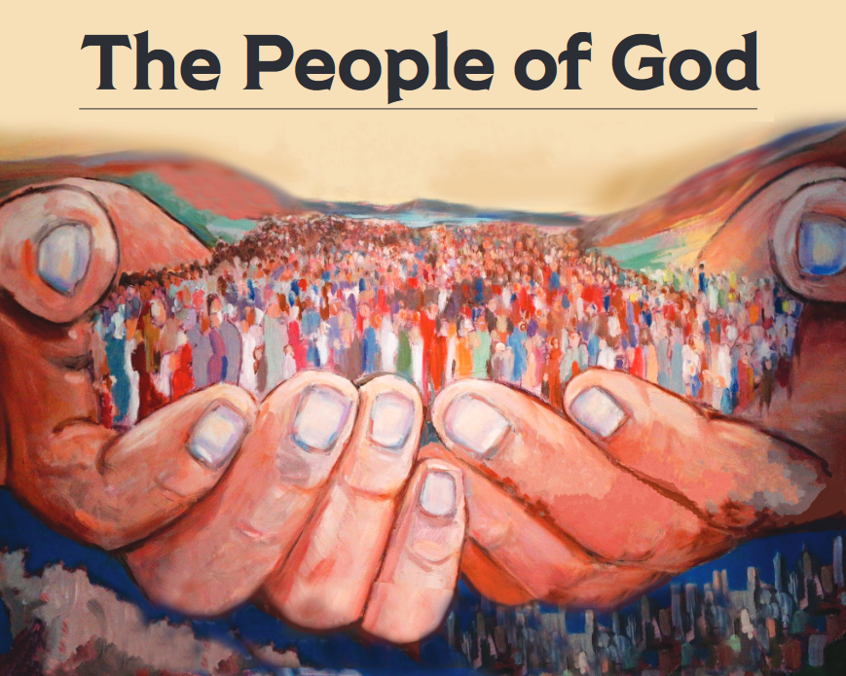
“But you are a chosen race, a royal priesthood, a holy nation, a people for God’s own possession, so that you may proclaim the excellencies of Him who has called you out of darkness into His marvelous light; for you once were not a people, but now you are the people of God.” (1 Peter 2:9-10)

Slide 3
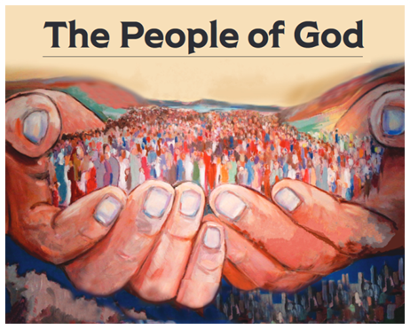
An Influential People
Matthew 5:13-16

Slide 4
The Power of Influence
The Power of Our Own Influence
Conscious Influence
Unconscious Influence
Building Our Influence
Cheerful Christianity
Consecrated to the Lord
Confident Living

