Slide 2
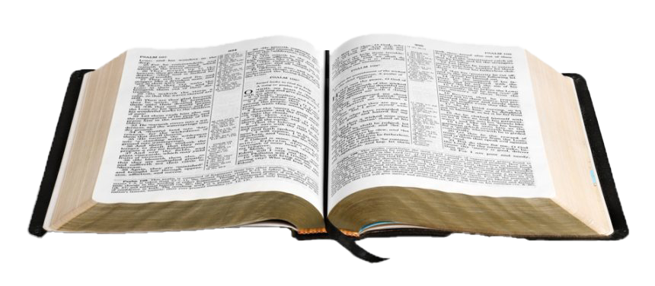
God’s Pattern for the Local Church

Slide 3
Now I plead with you, brethren, by the name of our Lord Jesus Christ, that you all speak the same thing, and that there be no divisions among you, but that you be perfectly joined together in the same mind and in the same judgment.
1 Corinthians 1:10

Slide 4
Paul and Timothy, bondservants of Jesus Christ,
To all the saints in Christ Jesus who are in Philippi,
with the bishops and deacons.
Philippians 1:1

Slide 5
Paul and Timothy, bondservants of Jesus Christ,
To all the saints in Christ Jesus who are in Philippi,
with the bishops and deacons.
Philippians 1:1

Slide 6
Who are these “bishops”?
EPISKOPOS
Bishop, Overseer
POIMEN
Shepherd, Pastor
PRESBUTEROS
Elder, Presbyter

Slide 7
Who are these “bishops”?
EPISKOPOS
Bishop, Overseer
POIMEN
Shepherd, Pastor
PRESBUTEROS
Elder, Presbyter
Must meet qualifications to serve as elders.
1 Timothy 3:1-7 Titus 1:6-9
Must be a plurality of elders.

Slide 8
The Work of Elders

Slide 9
The Work of Elders
Be Examples for the Members
Nor as being lords over those entrusted to you, but being examples to the flock.
1 Peter 5:3

Slide 10
The Work of Elders
Be Examples for the Members
Examine Themselves
Therefore take heed to yourselves and to all the flock, among which the Holy Spirit has made you overseers, to shepherd the church of God which He purchased with His own blood.
Acts 20:28

Slide 11
The Work of Elders
Be Examples for the Members
Examine Themselves
Oversee the Church - 1 Thess. 5:12; Heb. 13:17
Therefore take heed to yourselves and to all the flock, among which the Holy Spirit has made you overseers, to shepherd the church of God which He purchased with His own blood.
Acts 20:28

Slide 12
The Work of Elders
Be Examples for the Members
Examine Themselves
Oversee the Church - 1 Thess. 5:12; Heb. 13:17
Shepherd the Church - Heb. 13:17
Therefore take heed to yourselves and to all the flock, among which the Holy Spirit has made you overseers, to shepherd the church of God which He purchased with His own blood.
Acts 20:28

Slide 13
Knollwood’s Elders

Slide 14
Deacons
DIAKONOS
“a servant”
“one who executes the commands of another”
Acts 6:1-4
Deacons relieve the elders by taking care of the physical needs of the church.
Qualifications: 1 Timothy 3:8-13

Slide 15
Deacons

Slide 16
Members

Slide 17
Members
But we request of you, brethren, that you appreciate those who diligently labor among you, and have charge over you in the Lord and give you instruction,
and that you esteem them very highly in love because of their work. Live in peace with one another.
1 Thessalonians 5:12-13, NASU

Slide 18
Members
Obey those who rule over you, and be submissive, for they watch out for your souls, as those who must give account. Let them do so with joy and not with grief, for that would be unprofitable for you.
Hebrews 13:17

Slide 19
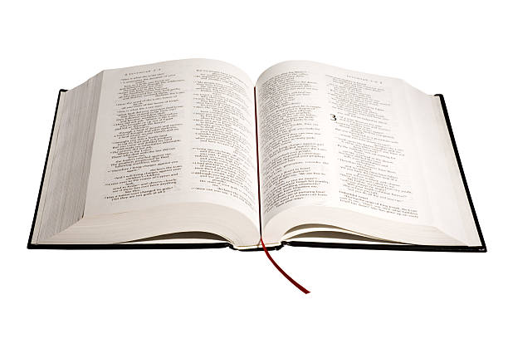
Paul and Timothy, bondservants of Jesus Christ,
To all the saints in Christ Jesus who are in Philippi,
with the bishops and deacons.
Philippians 1:1

