Slide 2
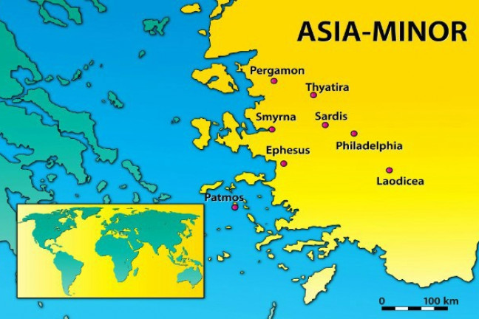
Summer Road Trip
The 7 Churches of Asia
Revelation 2-3
Thyatira
Revelation 2:18-29

Slide 3
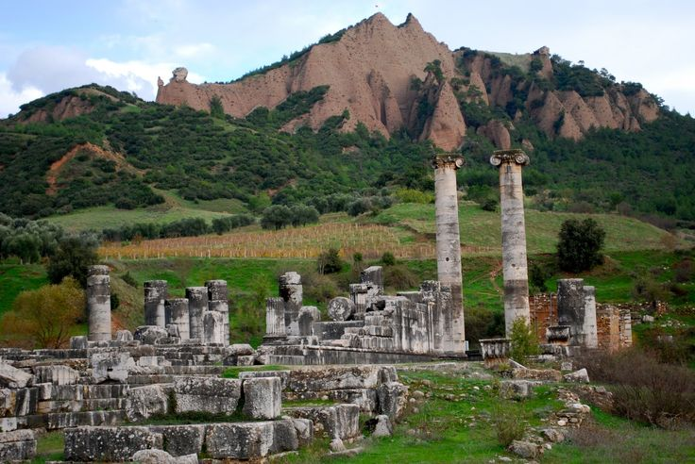
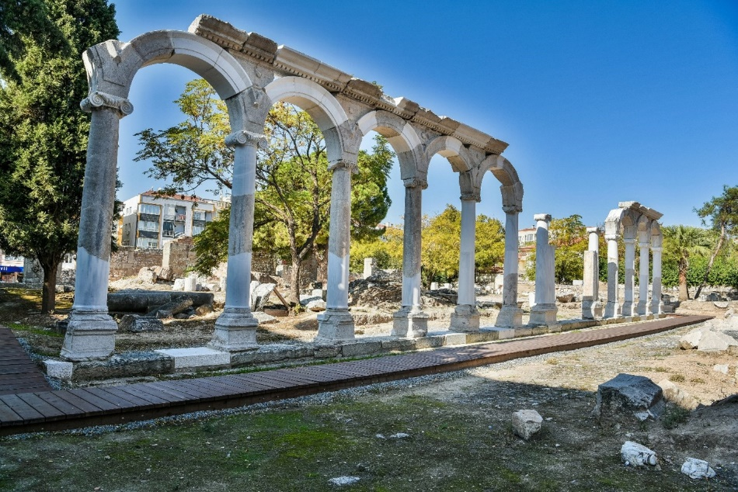
The City of Thyatira
Located 40 miles SE of Pergamos.
Least known, least important of these 7 cities.
Water made it an ideal place to dye fabric.
Lydia was from Thyatira (Acts 16:14).

Slide 4
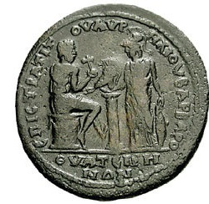
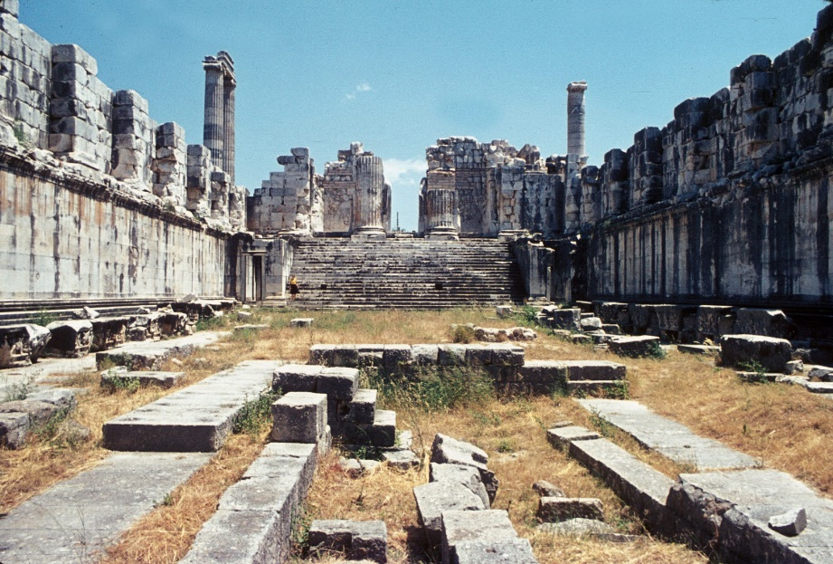
Trade Guilds in Thyatira
Thyatira was a thriving manufacturing center.
Every trade had a guild or union associated with idols.
In order to “get ahead,” one was expected to belong to and participate in such idol worship.

Slide 5
1. Commendation
I know
your works
love
service
faith
patience
as for your works, the last are more than the first

Slide 6
2. Complaint
you allow that woman Jezebel, who calls herself a prophetess, to teach and seduce My servants to commit sexual immorality and eat things sacrifices to idols (v. 20)

Slide 7
2. Complaint
you allow that woman Jezebel, who calls herself a prophetess, to teach and seduce My servants to commit sexual immorality and eat things sacrifices to idols (v. 20)

Slide 8
3. Counsel

Slide 9
3. Counsel
And I gave her time to repent of her sexual immorality, and she did not repent.
Indeed I will cast her into a sickbed, and those who commit adultery with her into great tribulation, unless they repent of their deeds.
I will kill her children with death, and all the churches shall know that I am He who searches the minds and hearts…

Slide 10
3. Counsel
Each will receive according to their works (v. 23)
Hold fast what they have until Jesus comes (v 25)
Overcome and keep His works until the end (v. 26)

Slide 11
Summer Road Trip
The 7 Churches of Asia
Revelation 2-3
Next Stop: Sardis
Revelation 3:1-6

