Slide 2
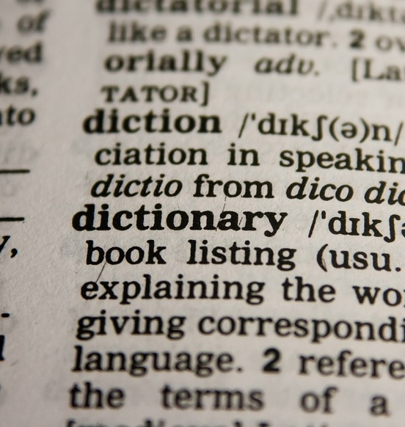
Words Study

Slide 3
Tower of Babel
Genesis 11:1-9
God, after witnessing what man was doing, confused language for everyone to stop work on the tower
From this, we have anywhere between 6500 and 7117 living languages today from a couple different sources found online
According to an article from Translate Day in 2020, English has 160 different dialects
Wikipedia states that 2877 different translations of the Bible exist over 1918 languages

Slide 4
Abram and Sarai in Egypt
Genesis 12:10-20
Abram lies to Pharaoh about Sarai only being his sister in order to receive protection from the bad famine.
Abram, later called “Friend of God” in James 2:23, was chastised by Pharaoh for his lie about Sarai
Abram’s words were used to deceive in this situation.

Slide 5
Nehemiah
Nehemiah 2:17-18
Nehemiah 4:13-18
Nehemiah was able to rouse those living in Jerusalem that had given up on rebuilding to start back again
Nehemiah inspired the Jews to continue building with tools in one hand and weapons in the other
Nehemiah brought the Jews together to build the wall in 52 days

Slide 6
Jesus and the Centurion’s Servant
Two different accounts of the same situation
Matthew 8:5-13
Luke 7:1-10
These accounts do not read the same while they are talking about the same event
Matthew’s Gospel was written for a Jewish audience
Luke’s Gospel was written for Theophilus, assumed to be an individual of Greek descent by the name
The Gospels consider perspective when presenting information of Christ and his life due to the different audiences for each Gospel

Slide 7
Use Your Words
God gave us language to communicate with one another, so it is important to use it appropriately
James 3:1-12
James 5:12
Stop and think about what you are going to say and ask the following questions:
What am I trying to say?
Why am I trying to say it?
Am I saying something that appropriately represents the truth?

