Slide 1
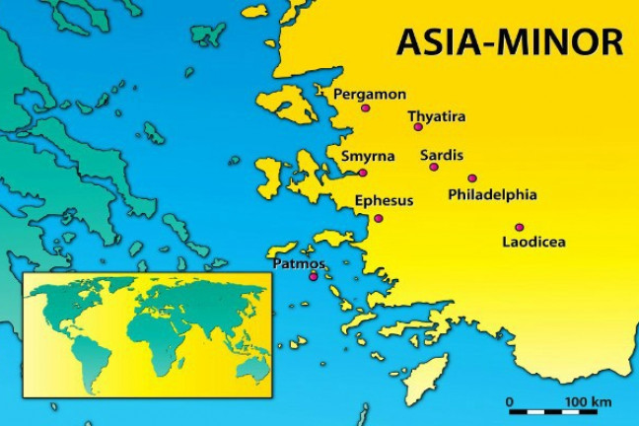
Summer Road Trip
The 7 Churches of Asia
Revelation 2-3
Pergamos
Revelation 2:12-17

Slide 2
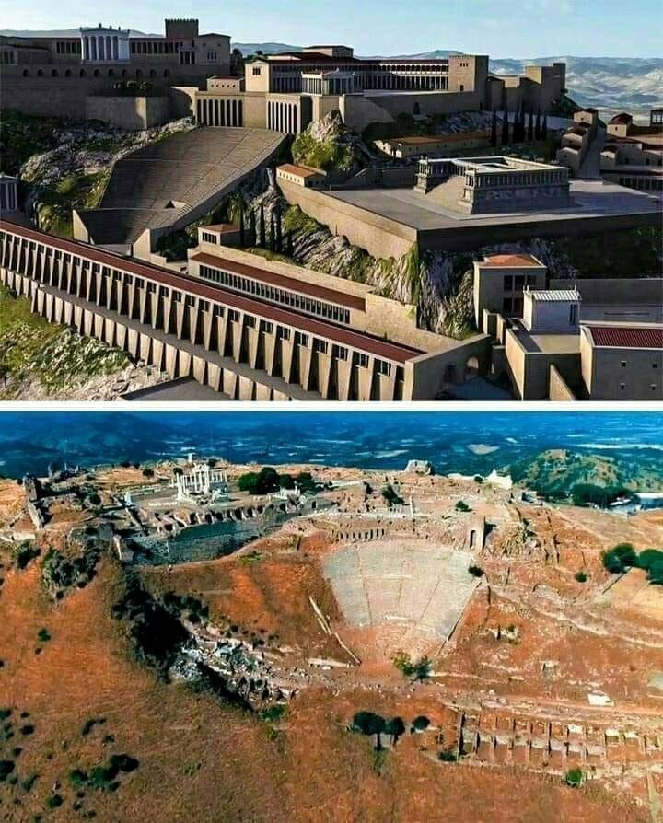
The City of Pergamos
Located 50 miles north of Smyrna.
Official capital of Asia Minor.
Housed a library second only to the one in Alexandria, Egypt.

Slide 3
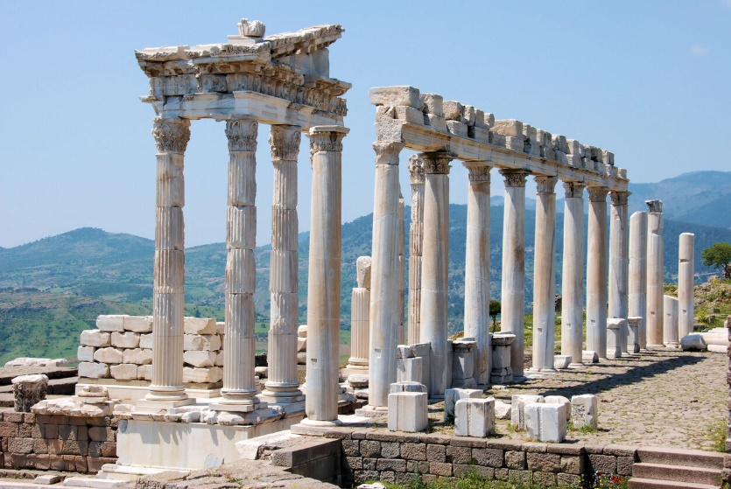
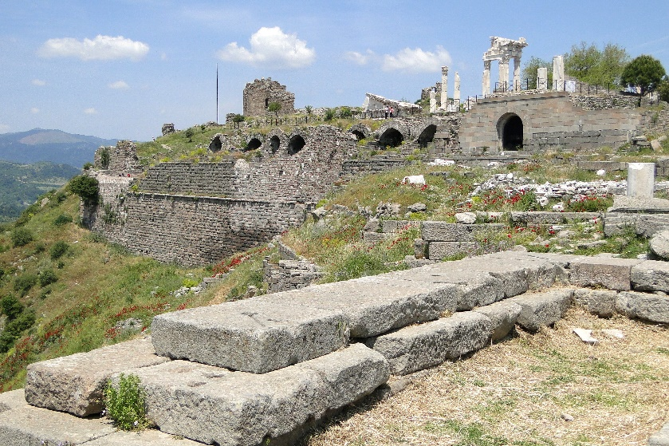
Religion in Pergamos
The most pagan of the seven cities.
“A city of temples devoted to sensuous worship.”
Was the center for Caesar worship in Asia Minor.

Slide 4
1. Commendation
I know
your works
where you dwell, where Satan’s throne is
you hold fast to My name, and did not deny My faith
even in the days in which Antipas was My faithful martyr, who was killed among you

Slide 5
2. Complaint
you have there those who hold the doctrine of Balaam
you also have those who hold the doctrine of the Nicolaitans

Slide 6
3. Counsel
repent
or else I will come to you quickly and will fight against them with the sword of My mouth

Slide 7
Summer Road Trip
The 7 Churches of Asia
Revelation 2-3
Next Stop: Thyatira
Revelation 2:18-29

