Slide 2
The Role of the Family in the Local Church

Slide 3
1. Contribute to the Work
Attendance
Bible Classes
Volunteer
Encourage
Help Visitors

Slide 4
2. Visitation
Pure and undefiled religion before God and the Father is this: to visit orphans and widows in their trouble, and to keep oneself unspotted from the world.
James 1:27

Slide 5
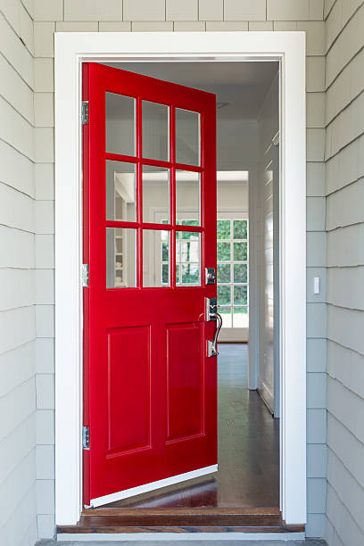
3. Hospitality
Romans 12:13
Hebrews 13:2
1 Peter 4:9
Acts 2:46; 4:32

Slide 6
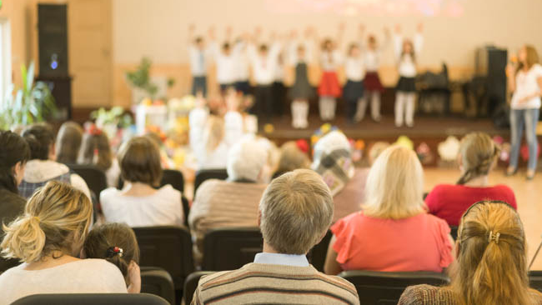
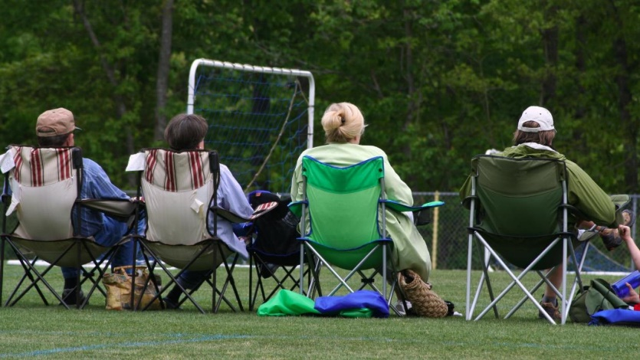
4. Evangelism
Let your light so shine before men, that they may see your good works and glorify your Father in heaven.
Matt. 5:16

Slide 7
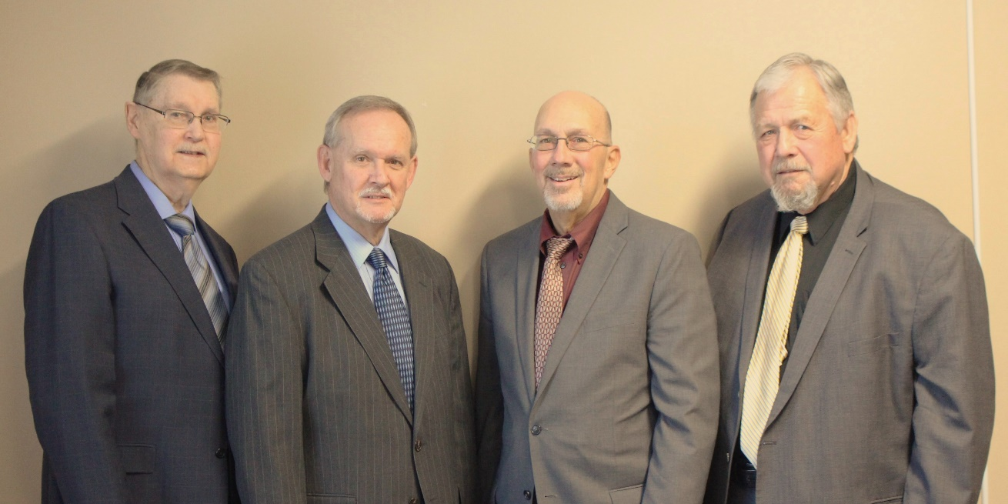
5. Produce Elders and Deacons
Elder - Titus 1:6; 1 Tim. 3:4-5
Deacon - 1 Tim. 3:11-12

Slide 8
Contribute to the Work
Visitation
Hospitality
Evangelism
Produce Elders and Deacons

