Slide 2
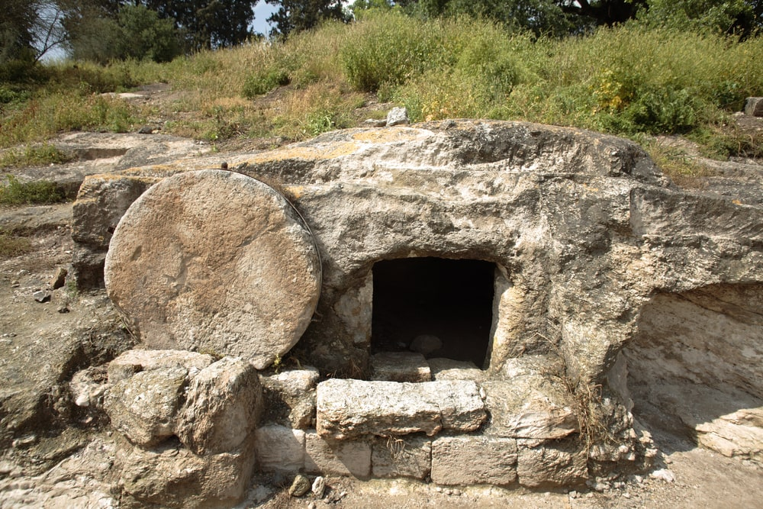
“Take Away the Stone”
John 11:39

Slide 3
God Never Does for Man What Man Can Do For Himself
Turning water into wine - John 2:7-8
Feeding the five thousand - John 6:5-12
Healing man born blind - John 9:6-7
Noah and the ark - Hebrews 11:7
Deliverance from Egypt - Exodus 3:7-10
Deliverance from serpents - Numbers 21:8-9

Slide 4
God Always Does for Man What Man Can’t Do For Himself
Not by works of righteousness which we have done, but according to His mercy He saved us, through the washing of regeneration and renewing of the Holy Spirit.
Titus 3:5

Slide 5
1. God Saves Us
For by grace you have been saved through faith, and that not of yourselves; it is the gift of God,
not of works, lest anyone should boast.
Ephesians 2:8-9

Slide 6
2. God Made the Plan of Salvation
Who has saved us and called us with a holy calling, not according to our works, but according to His own purpose and grace which was given to us in Christ Jesus before time began.
2 Timothy 1:9

Slide 7
3. God Furnished the Sacrifice
For God so loved the world that He gave His only begotten Son, that whoever believes in Him should not perish but have everlasting life.
John 3:16

Slide 8
4. God Sets Forth the Conditions to Be Met for Salvation
Though He was a Son, yet He learned obedience by the things which He suffered.
And having been perfected, He became the author of eternal salvation to all who obey Him.
Hebrews 5:8-9

Slide 9
5. God Gives Us Time and Opportunity to Be Saved
The Lord is not slack concerning His promise, as some count slackness, but is longsuffering toward us, not willing that any should perish but that all should come to repentance.
2 Peter 3:9

Slide 10
6. God Adds Us to the Church
…and the Lord added to the church daily those who were being saved.
Acts 2:47

Slide 11
God Always Does for Man What Man Can’t Do For Himself
God saves us.
God made the plan of salvation.
God furnished the sacrifice.
God sets forth the conditions.
God gives us time and opportunity.
God adds us to the church.

Slide 12
We Must Do Our Part
Therefore, my beloved, as you have always obeyed, not as in my presence only, but now much more in my absence, work out your own salvation with fear and trembling.
Philippians 2:12

Slide 13
We Must Do Our Part
BELIEVE
Therefore I said to you that you will die in your sins; for if you do not believe that I am He, you will die in your sins.
John 8:24

Slide 14
We Must Do Our Part
REPENT
Truly, these times of ignorance God overlooked, but now commands all men everywhere to repent.
Acts 17:30

Slide 15
We Must Do Our Part
CONFESS OUR FAITH
That if you confess with your mouth the Lord Jesus and believe in your heart that God has raised Him from the dead, you will be saved.
For with the heart one believes unto righteousness, and with the mouth confession is made unto salvation.
Romans 10:9-10

Slide 16
We Must Do Our Part
BE BAPTIZED
And now why are you waiting? Arise and be baptized, and wash away your sins, calling on the name of the Lord.
Acts 22:16

Slide 17
We Must Do Our Part
LIVE FAITHFULLY
For you have need of endurance, so that after you have done the will of God, you may receive the promise.
Hebrews 10:36

Slide 18
We Must Do Our Part
Believe in Jesus - John 8:24
Repent of our sins - Acts 17:30
Confess our faith - Romans 10:9-10
Be baptized - Acts 22:16
Live faithfully - Hebrews 10:36

