Slide 2
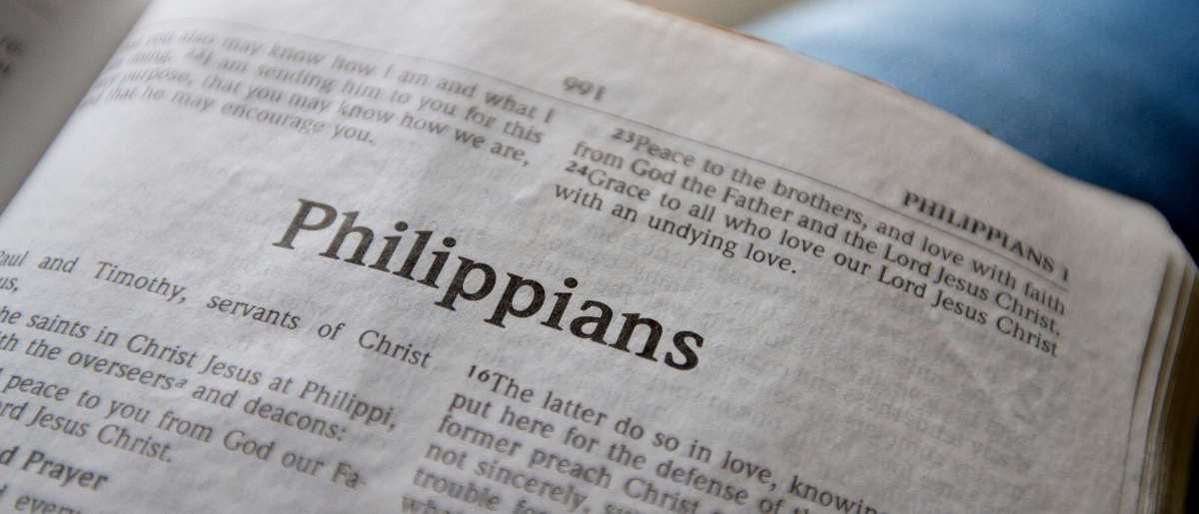
What Giving Does for the Giver
Philippians 4:14-20

Slide 3
“It is more blessed to give than to receive.”
Acts 20:35

Slide 4
Paul’s Gratitude
Nevertheless you have done well that you shared in my distress.
Philippians 4:14

Slide 5
The Philippian’s Track Record
Now you Philippians know also that in the beginning of the gospel, when I departed from Macedonia, no church shared with me concerning giving and receiving but you only.
For even in Thessalonica you sent aid once and again for my necessities.
Philippians 4:15-16

Slide 6
The Philippian’s Track Record
Now you Philippians know also that in the beginning of the gospel, when I departed from Macedonia, no church shared with me concerning giving and receiving but you only.
For even in Thessalonica you sent aid once and again for my necessities.
Philippians 4:15-16

Slide 7
The Philippian’s Track Record
Now you Philippians know also that in the beginning of the gospel, when I departed from Macedonia, no church shared with me concerning giving and receiving but you only.
For even in Thessalonica you sent aid once and again for my necessities.
Philippians 4:15-16

Slide 8
The Philippian’s Track Record
Now you Philippians know also that in the beginning of the gospel, when I departed from Macedonia, no church shared with me concerning giving and receiving but you only.
For even in Thessalonica you sent aid once and again for my necessities.
Philippians 4:15-16

Slide 9
The Heavenly Account of the Giver
Not that I seek the gift, but I seek the fruit that abounds to your account.
Indeed I have all and abound. I am full, having received from Epaphroditus the things sent from you, a sweet-smelling aroma, an acceptable sacrifice, well pleasing to God.
Philippians 4:17-18

Slide 10
The Heavenly Account of the Giver
Not that I seek the gift, but I seek the fruit that abounds to your account.
Indeed I have all and abound. I am full, having received from Epaphroditus the things sent from you, a sweet-smelling aroma, an acceptable sacrifice, well pleasing to God.
Philippians 4:17-18

Slide 11
The Heavenly Account of the Giver
Not that I seek the gift, but I seek the fruit that abounds to your account.
Indeed I have all and abound. I am full, having received from Epaphroditus the things sent from you, a sweet-smelling aroma, an acceptable sacrifice, well pleasing to God.
Philippians 4:17-18

Slide 12
The Heavenly Account of the Giver
Not that I seek the gift, but I seek the fruit that abounds to your account.
Indeed I have all and abound. I am full, having received from Epaphroditus the things sent from you, a sweet-smelling aroma, an acceptable sacrifice, well pleasing to God.
Philippians 4:17-18

Slide 13
The Heavenly Account of the Giver
Not that I seek the gift, but I seek the fruit that abounds to your account.
Indeed I have all and abound. I am full, having received from Epaphroditus the things sent from you, a sweet-smelling aroma, an acceptable sacrifice, well pleasing to God.
Philippians 4:17-18

Slide 14
God’s Storehouses
And my God shall supply all your need according to His riches in glory by Christ Jesus.
Now to our God and Father be glory forever and ever. Amen.
Philippians 4:19-20

Slide 15
God’s Storehouses
And my God shall supply all your need according to His riches in glory by Christ Jesus.
Now to our God and Father be glory forever and ever. Amen.
Philippians 4:19-20

Slide 16
God’s Storehouses
And my God shall supply all your need according to His riches in glory by Christ Jesus.
Now to our God and Father be glory forever and ever. Amen.
Philippians 4:19-20

Slide 17
God’s Storehouses
And my God shall supply all your need according to His riches in glory by Christ Jesus.
Now to our God and Father be glory forever and ever. Amen.
Philippians 4:19-20

Slide 18
God’s Storehouses
And my God shall supply all your need according to His riches in glory by Christ Jesus.
Now to our God and Father be glory forever and ever. Amen.
Philippians 4:19-20

Slide 19
God’s Storehouses
And my God shall supply all your need according to His riches in glory by Christ Jesus.
Now to our God and Father be glory forever and ever. Amen.
Philippians 4:19-20
“Now to Him who is able to do exceedingly abundantly above all that we ask or think, according to the power that works in us.”
Ephesians 3:20

Slide 20
We can rejoice!
If we have sacrificed to help others in need.
Knowing such action has added to our heavenly account.
Knowing our giving is a pleasing sacrifice to God.
Knowing God has promised to richly supply all our needs for giving again in the future.
“Rejoice in the Lord always, Again I will say, rejoice!”

