Slide 1
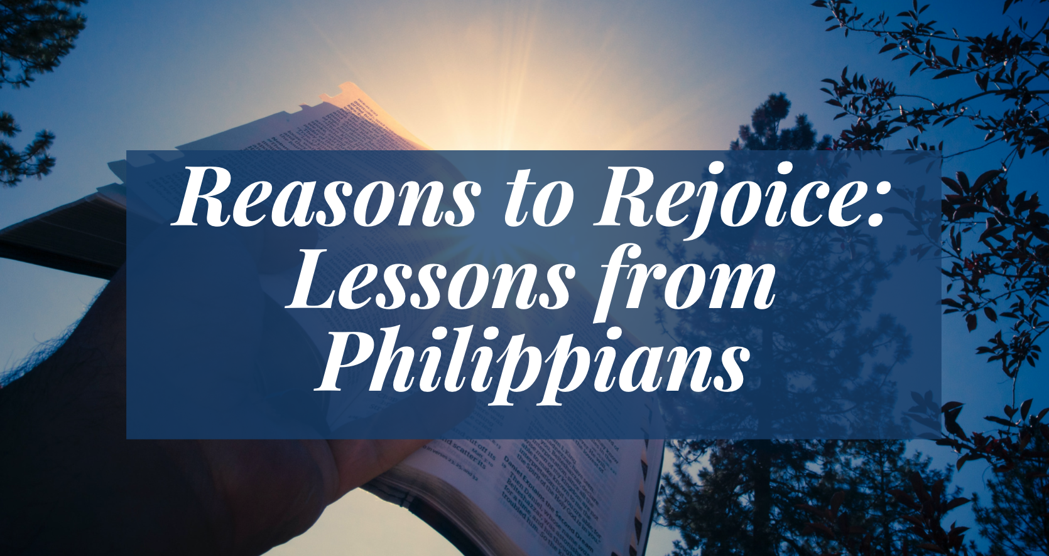

Slide 2
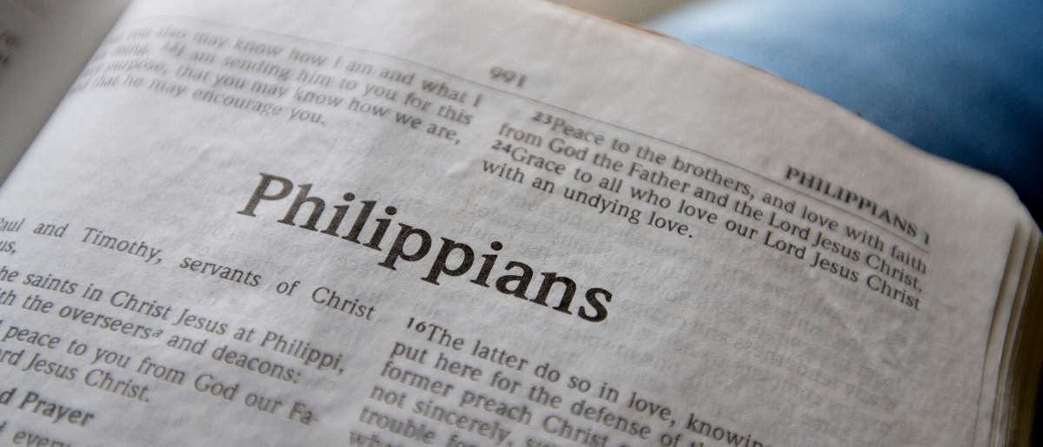
Learning Contentment
Philippians 4:10-13

Slide 3
What is “contentment”?
“satisfied with what one is or has; not wanting more or anything else.”
Discontentment is “a lack of satisfaction with one’s possessions, status, or situation.”

Slide 4
Paul’s “Thank You” Note
But I rejoiced in the Lord greatly that now at last your care for me has flourished again; though you surely did care, but you lacked opportunity.
Philippians 4:10

Slide 5
Paul’s Acquisition of Contentment
Not that I speak in regard to need, for I have learned in whatever state I am, to be content.
Philippians 4:11

Slide 6
Paul’s Acquisition of Contentment
I know how to be abased, and I know how to abound. Everywhere and in all things I have learned both to be full and to be hungry, both to abound and to suffer need.
Philippians 4:12

Slide 7
The Power Behind Contentment
I can do all things through Christ who strengthens me.
Philippians 4:13

Slide 8
The Power Behind Contentment
I can do all things through Christ who strengthens me.
Philippians 4:13

Slide 9
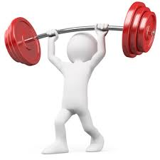
The Power Behind Contentment
I can do all things through Christ who strengthens me.
Philippians 4:13

Slide 10
The Power Behind Contentment
I can do all things through Christ who strengthens me.
Philippians 4:13

Slide 11
We can rejoice greatly because…
We have brethren who care for us.
God has given us opportunities to learn to be content.
Christ strengthens us to endure any circumstance in our service to Him.
“Rejoice in the Lord always, Again I will say, rejoice!”

