Slide 2
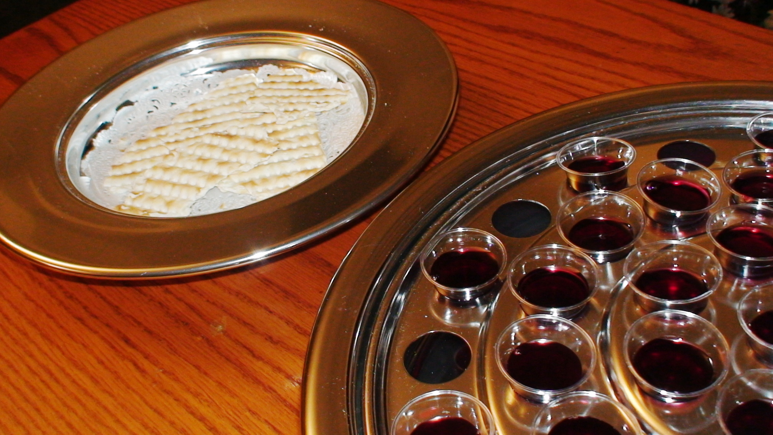
What is the Lord’s Supper?

Slide 3
What is the Lord’s Supper?
A Command - 1 Cor. 11:23-25
A Memorial - vs. 24-25
A Proclamation - v. 26
A Self-Examination - vs. 27-30
A Communion - 1 Cor. 10:16-17

Slide 4
Mark 15:16-39

Slide 6
Then He took the cup, and gave thanks, and gave it to them, saying, “Drink from it, all of you.
For this is My blood of the new covenant, which is shed for many for the remission of sins.”
Matthew 26:27-28

Slide 7
To be saved by this shed blood we must…
Believe in Jesus - John 8:24
Repent of our sins - Luke 13:3
Confess our faith - Romans 10:9-10
Be baptized - Acts 22:16

