Slide 2
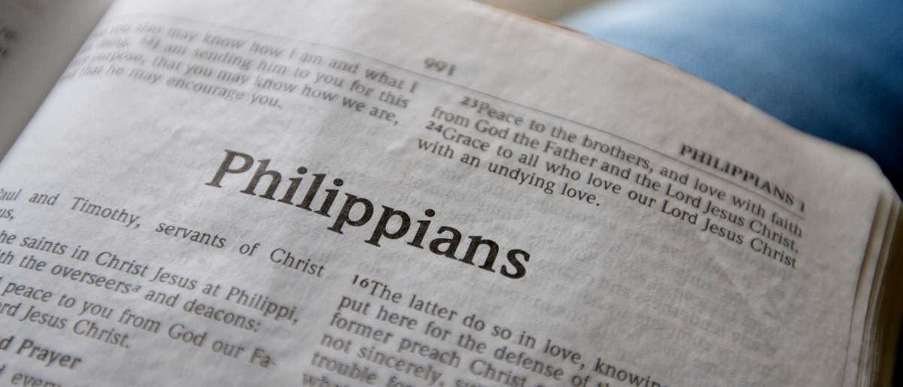
Pressing Toward the Goal
Philippians 3:12-16

Slide 3
Paul’s Plan for Progress
Not that I have already attained, or am already perfected; but I press on, that I may lay hold of that for which Christ Jesus has also laid hold of me.
Philippians 3:12

Slide 4
Paul’s Plan for Progress
Not that I have already attained, or am already perfected; but I press on, that I may lay hold of that for which Christ Jesus has also laid hold of me.
Philippians 3:12

Slide 5
Paul’s Plan for Progress
Not that I have already attained, or am already perfected; but I press on, that I may lay hold of that for which Christ Jesus has also laid hold of me.
Philippians 3:12

Slide 6
Paul’s Plan for Progress
Not that I have already attained, or am already perfected; but I press on, that I may lay hold of that for which Christ Jesus has also laid hold of me.
Philippians 3:12

Slide 7
Paul’s Plan for Progress
Brethren, I do not count myself to have apprehended; but one thing I do, forgetting those things which are behind and reaching forward to those things which are ahead.
Philippians 3:13

Slide 8
Paul’s Plan for Progress
Brethren, I do not count myself to have apprehended; but one thing I do, forgetting those things which are behind and reaching forward to those things which are ahead.
Philippians 3:13

Slide 9
Paul’s Plan for Progress
Brethren, I do not count myself to have apprehended; but one thing I do, forgetting those things which are behind and reaching forward to those things which are ahead.
Philippians 3:13

Slide 10
Paul’s Plan for Progress
I press toward the goal for the prize of the upward call of God in Christ Jesus.
Philippians 3:14

Slide 11
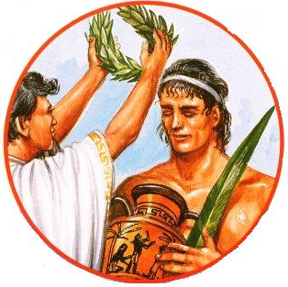
Paul’s Plan for Progress
I press toward the goal for the prize of the upward call of God in Christ Jesus.
Philippians 3:14

Slide 12
Paul’s Change in Pronouns
Therefore let us, as many as are mature, have this mind; and if in anything you think otherwise, God will reveal even this to you.
Nevertheless, to the degree that we have already attained, let us walk by the same rule, let us be of the same mind.
Philippians 3:15-16

Slide 13
We can rejoice!
Christ has laid hold of us.
Our past sins and failures have been forgiven.
We have a heavenly goal.
We have our brethren to help us along the way.
“Rejoice in the Lord always, Again I will say, rejoice!”

