Slide 2
The Precious Blood of Christ
1 Peter 1:18-19

Slide 3
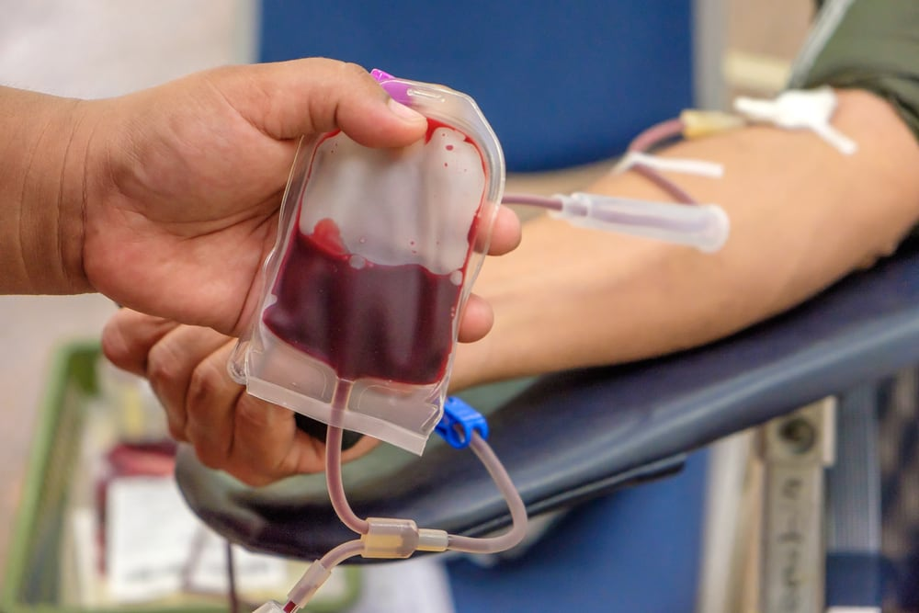
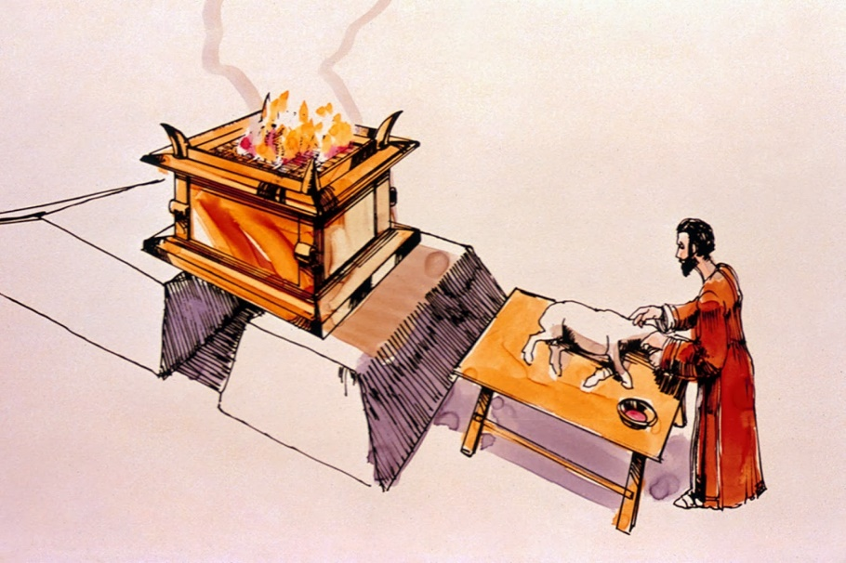
For the life of the flesh is in the blood, and I have given it to you upon the altar to make atonement for your souls; for it is the blood that makes atonement for the soul.
Leviticus 17:11

Slide 4
Knowing that you were not redeemed with corruptible things, like silver or gold, from your aimless conduct received by tradition from your fathers, but with the precious blood of Christ, as of a lamb without blemish and without spot.
1 Peter 1:18-19

Slide 5
1. Redeems Us
1 Peter 1:18-19
Redeem – “to cause to be released; to liberate by payment of ransom.”
Romans 6:16-18
Mark 10:45
Ephesians 1:7

Slide 6
2. Remission of Our Sins
Matthew 26:28
Remission – “to dismiss or release; to grant freedom or pardon.”
Remission is exemption from the consequences of an offense.
We are still guilty but will not have to face the consequences.

Slide 7
3. Justifies Us
Romans 5:9
Justification – the legal and formal acquittal from guilt.
“to acquit or declare just”
“to be pronounced and treated as righteous”

Slide 8
4. Cleanses Us
Isaiah 1:18
Anything brought before the presence of God must be pure and holy.
“…to Him who loved us and washed us from our sins in His own blood” (Rev. 1:5).
1 John 1:7-9

Slide 9
5. Sanctifies Us
“Therefore Jesus also, that He might sanctify the people with His own blood, suffered outside the gate” (Heb. 13:12).
Sanctify – “to set aside or set apart to God; to be consecrated to God.”

Slide 10
The Precious Blood of Jesus
Redeems Us
Remission of Our Sins
Justifies Us Before God
Cleanses Us
Sanctifies Us to God

