Slide 1
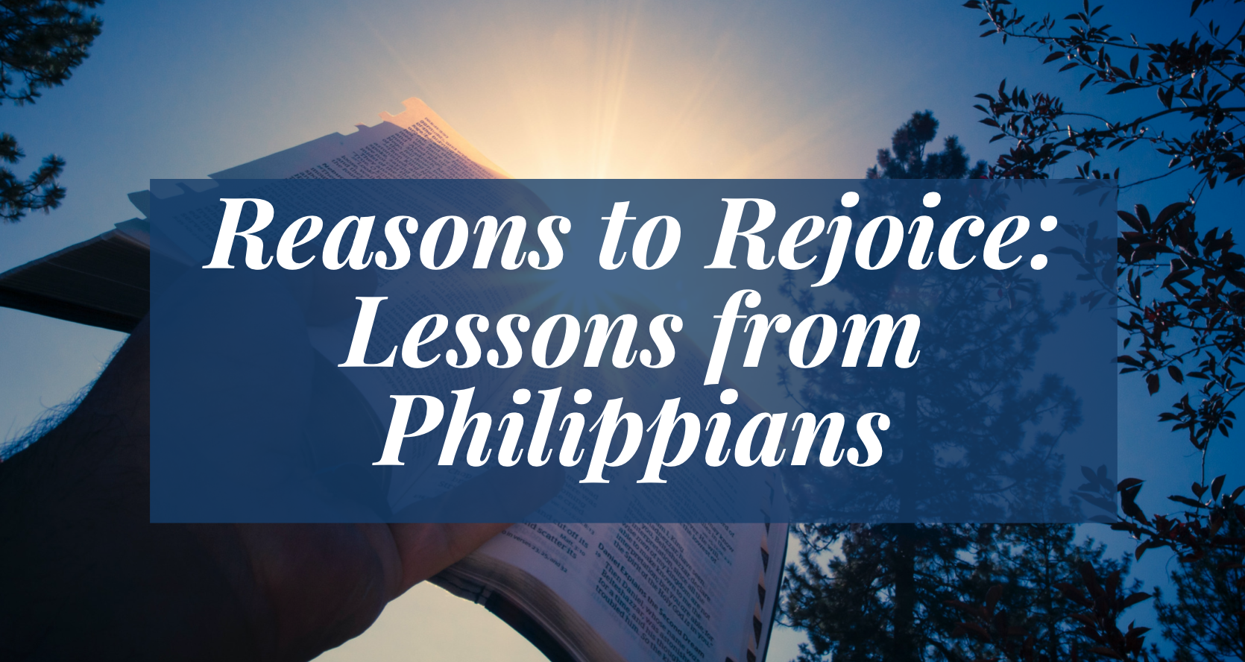

Slide 2
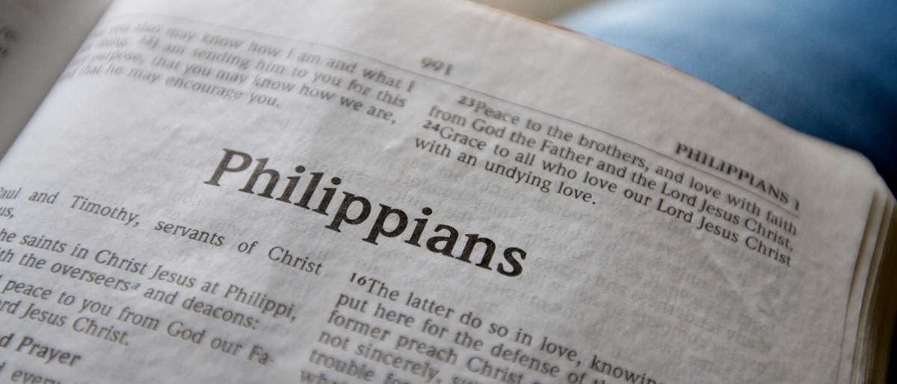
Work Out Your Own Salvation
Philippians 2:12-18

Slide 3
Therefore, my beloved, as you have always obeyed, not as in my presence only, but now much more in my absence, work out your own salvation with fear and trembling.
Philippians 2:12

Slide 4
Therefore, my beloved, as you have always obeyed, not as in my presence only, but now much more in my absence, work out your own salvation with fear and trembling.
Philippians 2:12
katergazomai - “do work fully, accomplish, to finish” (Strong’s).
We are to accomplish or finish what we have begun; see it through to the end.

Slide 5
Therefore, my beloved, as you have always obeyed, not as in my presence only, but now much more in my absence, work out your own salvation with fear and trembling.
Philippians 2:12

Slide 6
With the Right Attitude

Slide 7
With the Right Attitude
1. Reverently
Therefore, my beloved, as you have always obeyed, not as in my presence only, but now much more in my absence, work out your own salvation with fear and trembling.
Philippians 2:12

Slide 8
With the Right Attitude
2. Confidently
For it is God who works in you both to will and to do for His good pleasure.
Philippians 2:13

Slide 9
With the Right Attitude
3. Willingly
Do all things without complaining and disputing.
Philippians 2:14

Slide 10
With the Right Attitude
4. Blamelessly
That you may become blameless and harmless, children of God without fault in the midst of a crooked and perverse generation, among whom you shine as lights in the world.
Philippians 2:15

Slide 11
With the Right Attitude
5. Steadfastly
Holding fast the word of life, so that I may rejoice in the day of Christ that I have not run in vain or labored in vain.
Philippians 2:16

Slide 12
With the Right Attitude
6. Cheerfully
Yes, and if I am being poured out as a drink offering on the sacrifice and service of your faith, I am glad and rejoice with you all.
For the same reason you also be glad and rejoice with me.
Philippians 2:17-18

Slide 13
We can rejoice if we are doing…
the right thing,
in the right way,
with the right attitude.
“Rejoice in the Lord always, Again I will say, rejoice!”

