Slide 2
Good Morning

Slide 3
Our Destination= Heaven
Hebrews 11:10- For he looked for a city which hath foundations, whose builder and maker is God.
Rev. 21:2- And I John saw the holy city, new Jerusalem, coming down from God out of heaven, prepared as a bride adorned for her husband.

Slide 4

John 14:1-3

Slide 5
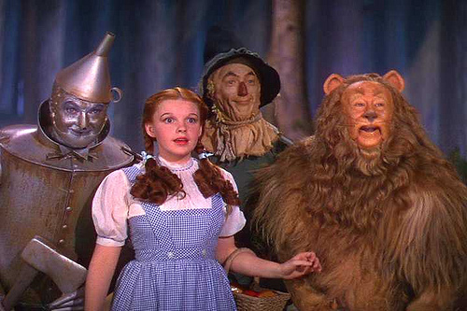
Dorothy’s Help
Lacked Heart
Lacked Wisdom
Lacked Courage

Slide 6
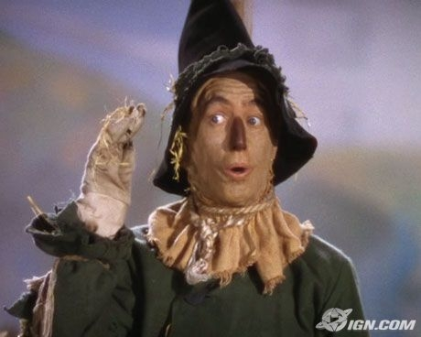
Wisdom-Knowledge
Proverbs 4:5 & 7
Get wisdom, get understanding: Forget it not; neither decline from the words of my mouth…7-Wisdom is the principal thing; therefore get wisdom: and with all thy getting get understanding.

Slide 7

Wisdom-Knowledge
1 Corinthians 8:1-2
James 1:5-6

Slide 8
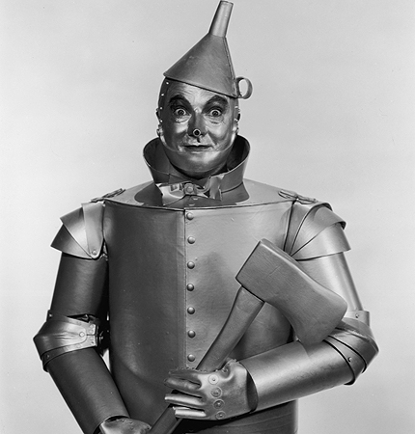
Heart
1 Chronicles :28:9- And thou, Solomon my son, know thou the God of thy father, and serve him with a perfect heart and with a willing mind; for the Lord searcheth all hearts, and understandeth all the imaginations of the thoughts:

Slide 9
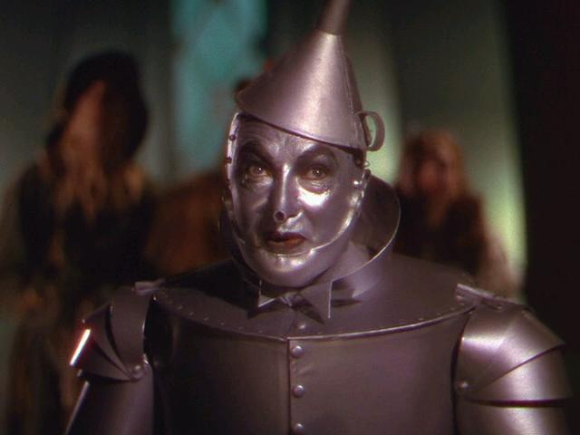
Heart
Colossians 3:12-14
Matt 15:8- This people draweth nigh unto me with their mouth, and honoreth me with their lips; but their heart is far from me.

Slide 10
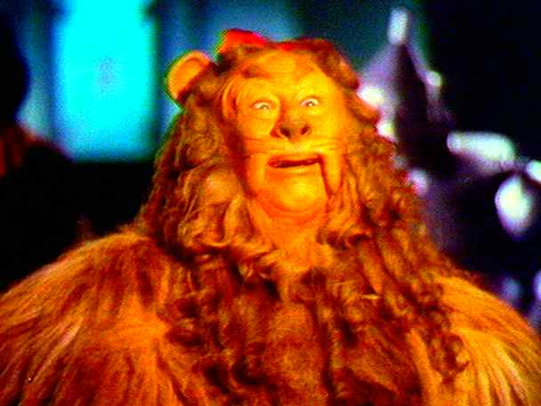
Courage
Psalms 27:14- Wait on the Lord: be of good courage, and he shall strengthen thine heart: wait, I say, on the Lord.

Slide 11
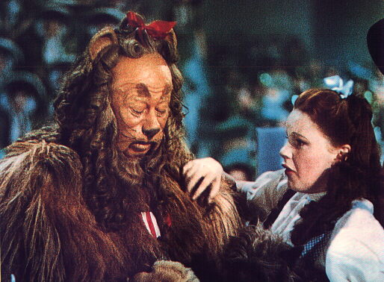
Courage
When talking courage, one must ALWAYS consider the martyrs of Jesus Christ. (Ex. Apostle Paul, Stephen)

Slide 12
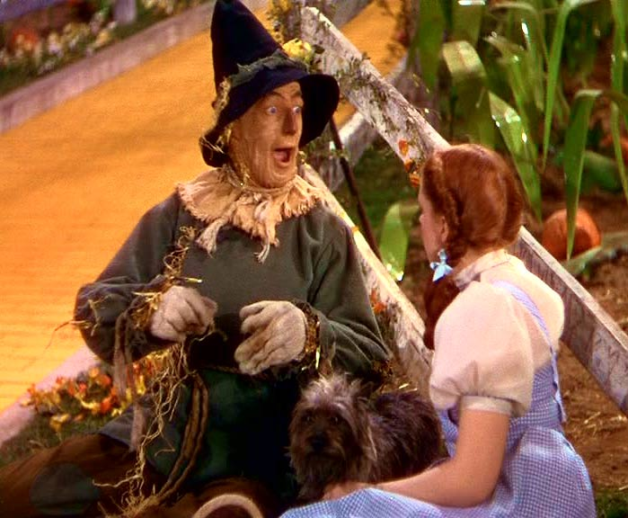
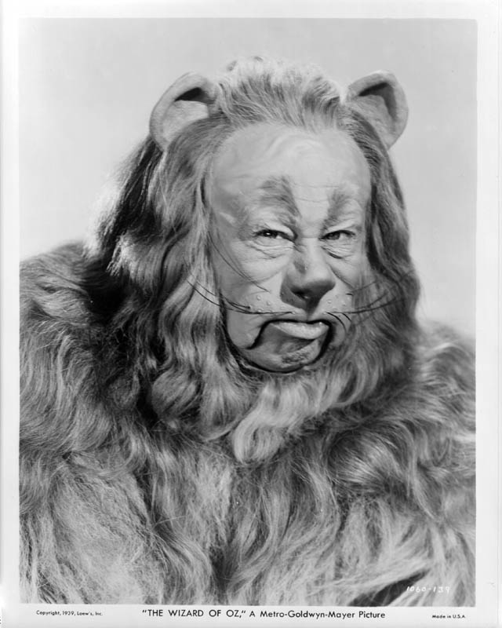
Facing Our Fears- Matthew 8:26
Fire
Water
Anything

Slide 13
Facing Fears
2 Corinthians 4:8-9- We are troubled on every side, yet not distressed; we are perplexed, but not in despair; Persecuted , but not forsaken; cast down but not destroyed;
1 Corinthians 10:13- There hath no temptation taken you but such as is common to man: but God is faithful, who will not suffer you to be tempted above that ye are able; but will with the tempation also make a way to escape, that ye may be able to bear it.

Slide 14
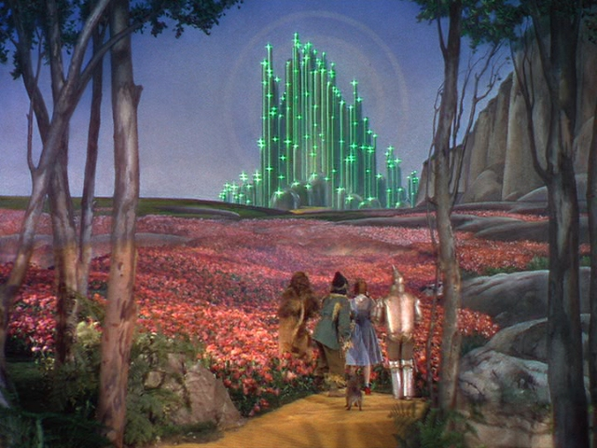
Closing
Where is your journey this morning?

