Slide 2
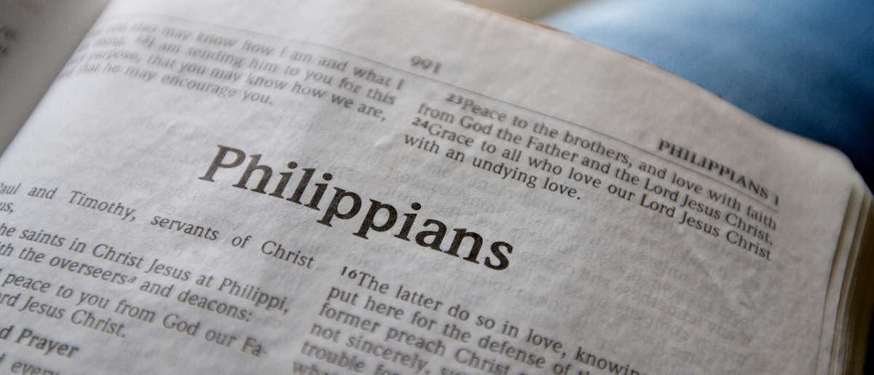
Being Like-Minded
Philippians 2:1-4

Slide 3
Congregational Unity
Is essential for the work of the local church.
One of Satan’s target areas.
Jesus prayed for our unity (John 17:20-21).
Paul made an appeal for congregational unity in every epistle written to churches.

Slide 4
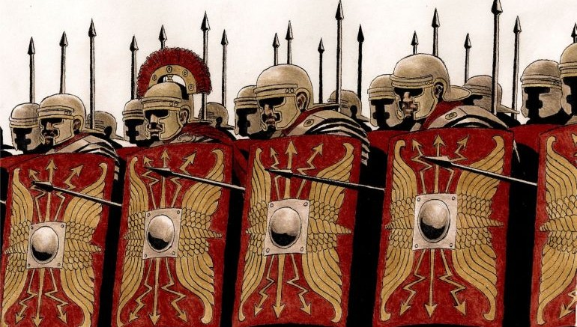
Only let your conduct be worthy of the gospel of Christ, so that whether I come and see you or am absent, I may hear of your affairs, that you stand fast in one spirit, with one mind striving together for the faith of the gospel
Philippians 1:27

Slide 5
Paul’s Appeal for Unity
Therefore if there is any consolation in Christ, if any comfort of love, if any fellowship of the Spirit, if any affection and mercy,
Philippians 2:1

Slide 6
Paul’s Appeal for Unity
Therefore if there is any consolation in Christ, if any comfort of love, if any fellowship of the Spirit, if any affection and mercy,
Philippians 2:1

Slide 7
Paul’s Appeal for Unity
Therefore if there is any consolation in Christ, if any comfort of love, if any fellowship of the Spirit, if any affection and mercy,
Philippians 2:1

Slide 8
Paul’s Appeal for Unity
Therefore if there is any consolation in Christ, if any comfort of love, if any fellowship of the Spirit, if any affection and mercy,
Philippians 2:1

Slide 9
Paul’s Appeal for Unity
Therefore if there is any consolation in Christ, if any comfort of love, if any fellowship of the Spirit, if any affection and mercy,
Philippians 2:1

Slide 10
Paul’s Appeal for Unity
Therefore if there is any consolation in Christ, if any comfort of love, if any fellowship of the Spirit, if any affection and mercy,
Philippians 2:1

Slide 11
Paul’s Appeal for Unity
Therefore if there is any consolation in Christ, if any comfort of love, if any fellowship of the Spirit, if any affection and mercy,
Philippians 2:1

Slide 12
The Essence of This Unity
Fulfill my joy by being like-minded, having the same love, being of one accord, of one mind.
Philippians 2:2

Slide 13
The Essence of This Unity
Fulfill my joy by being like-minded, having the same love, being of one accord, of one mind.
Philippians 2:2
“One” is the number of unity.
Eph. 4:3-6

Slide 14
The Essence of This Unity
Fulfill my joy by being like-minded, having the same love, being of one accord, of one mind.
Philippians 2:2
“One” is the number of unity.
Eph. 4:3-6

Slide 15
The Essence of This Unity
Fulfill my joy by being like-minded, having the same love, being of one accord, of one mind.
Philippians 2:2
“One” is the number of unity.
Eph. 4:3-6

Slide 16
The Essence of This Unity
Fulfill my joy by being like-minded, having the same love, being of one accord, of one mind.
Philippians 2:2
“One” is the number of unity.
Eph. 4:3-6

Slide 17
The Essence of This Unity
Fulfill my joy by being like-minded, having the same love, being of one accord, of one mind.
Philippians 2:2
“One” is the number of unity.
Eph. 4:3-6

Slide 18
The Expression of This Unity
Let nothing be done through selfish ambition or conceit, but in lowliness of mind let each esteem others better than himself.
Let each of you look out not only for his own interests, but also for the interests of others.
Philippians 2:3-4

Slide 19
The Expression of This Unity
Don’t act out of selfishness.
Don’t focus just on your own interests.
Consider others as better than yourself.
Balance your interests with the interests of others.

Slide 20
If each of us will do these things, we will be positive contributors to the peace and working unity of the Knollwood congregation.
As long as this unity exists – we have a real reason to rejoice!
“Rejoice in the Lord always, Again I will say, rejoice!”

